Slide 1


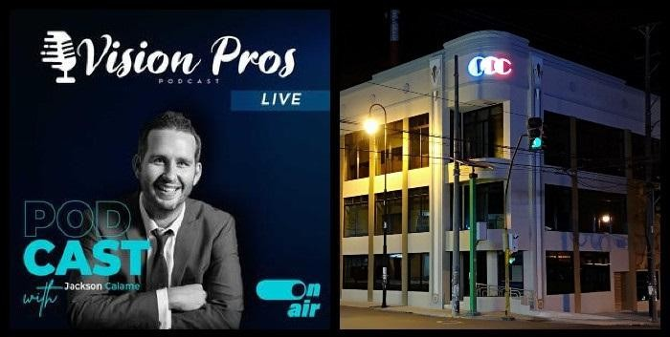
Downloaded from: justpaste.it/visionporslivepodcast
Vision Pros Live Podcast by Jackson Calame. What's your vision? Richard Blank tells all on Session 1
Mr. Richard Blank holds a bachelors degree in Communication and Spanish from the University of Arizona and a certificate of language proficiency from the University of Sevilla, Spain.
Learn powerful wisdom from awesome visionary leaders and gain access to growth principles, methods, and resources that will take YOUR vision to the next level!
Vision Pros Live Podcast .The secret ingredients to success are in your blind spots.

Slide 2
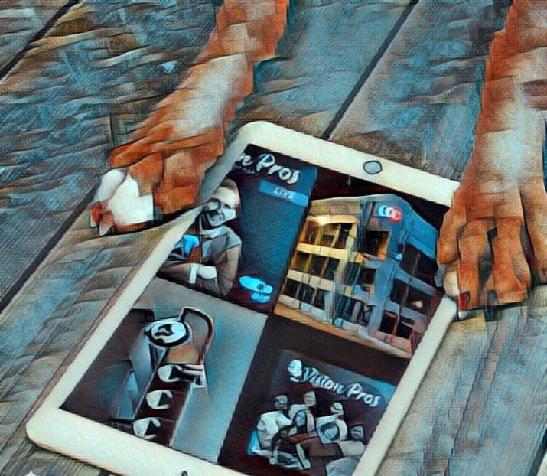
The problem is that content marketing, social media, and A.I. are over-simplified buzz words.

Slide 3
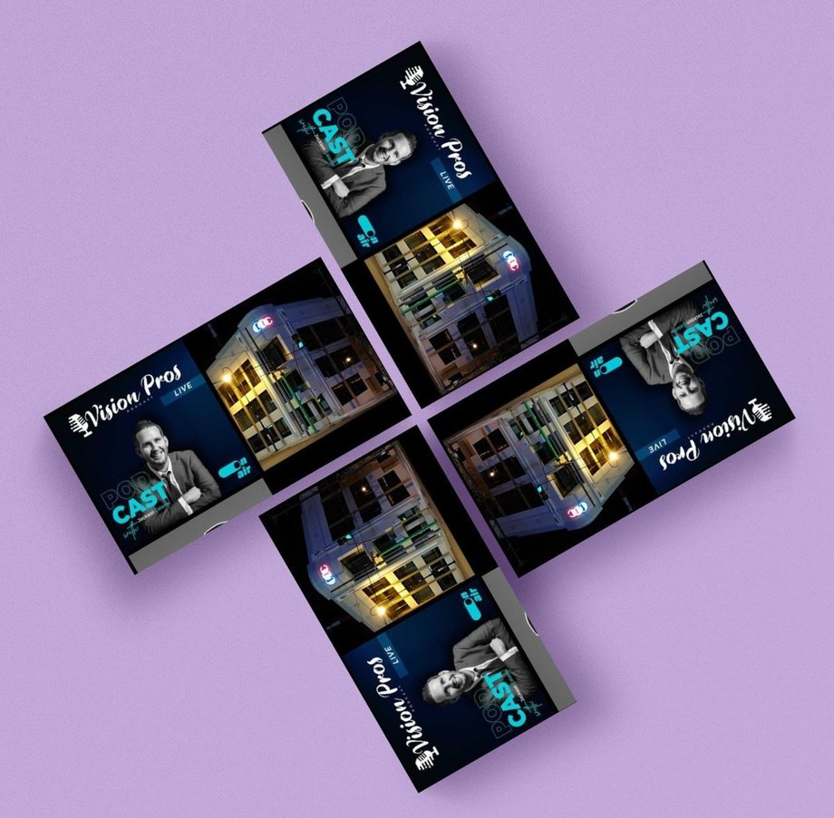
They are ALL short-term revenue growth hacks. Get rich quick schemes.

Slide 4
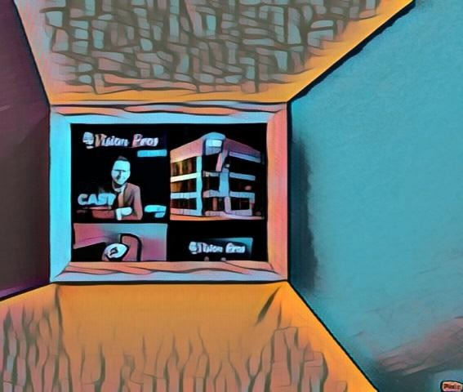
Branding, organic seo, online ads, email marketing, digital, traditional, funnel hacking, and automation will continue to leave you empty handed and depleted.

Slide 5
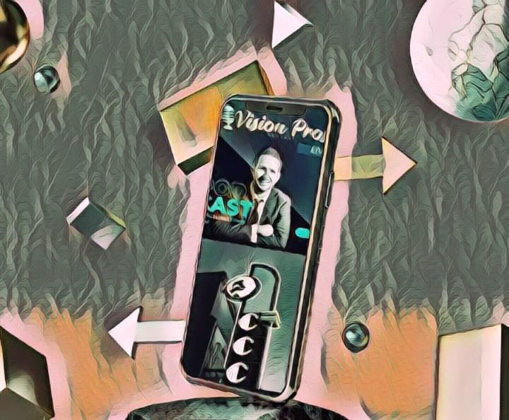
That won't change with your next contracted "yes man".

Slide 6
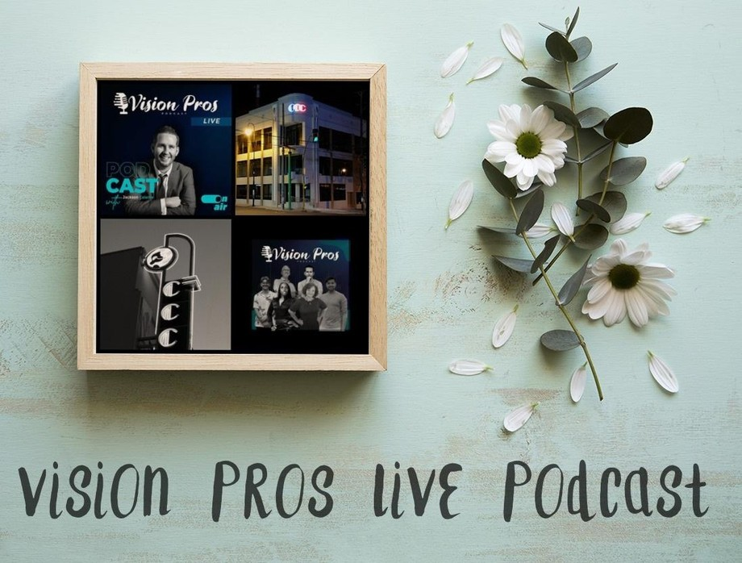
The Law of Abundance and the Law of the Harvest can work in your favor though.

Slide 7
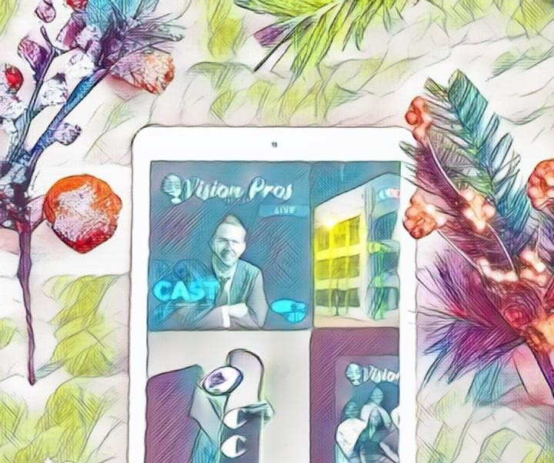
Especially when you focus your life on serving others.

Slide 8
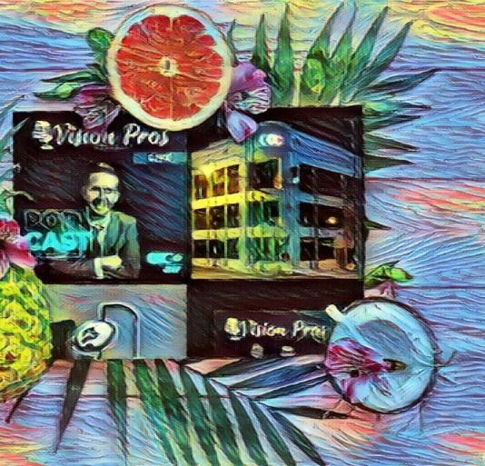
How can you better tap into the power of that truth?

Slide 9
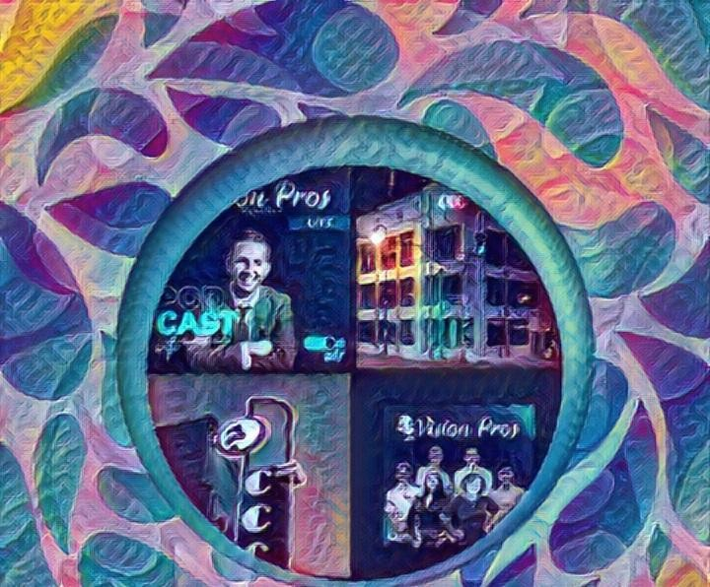
Hard-work is to be embraced.

Slide 10
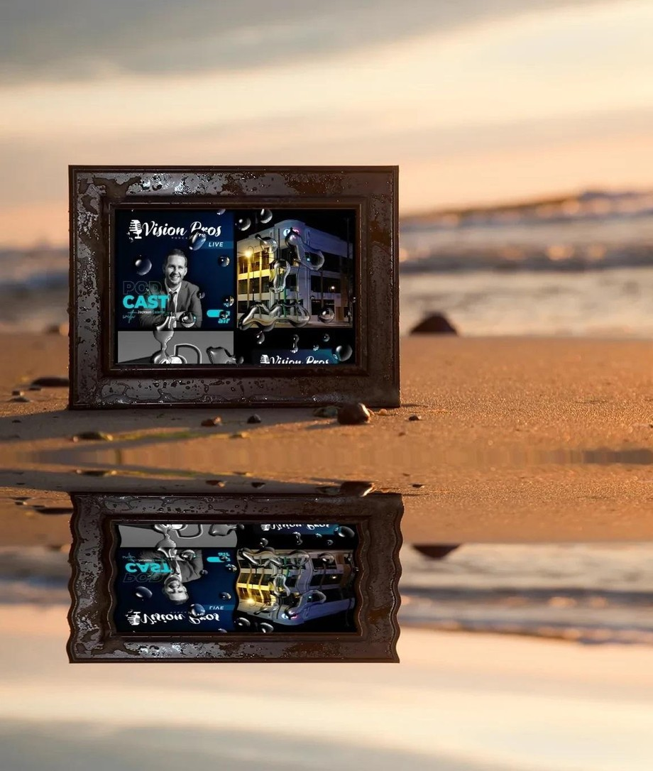
Entrepreneurs and business leaders that truly care about the people they serve see value in our approach.

Slide 11
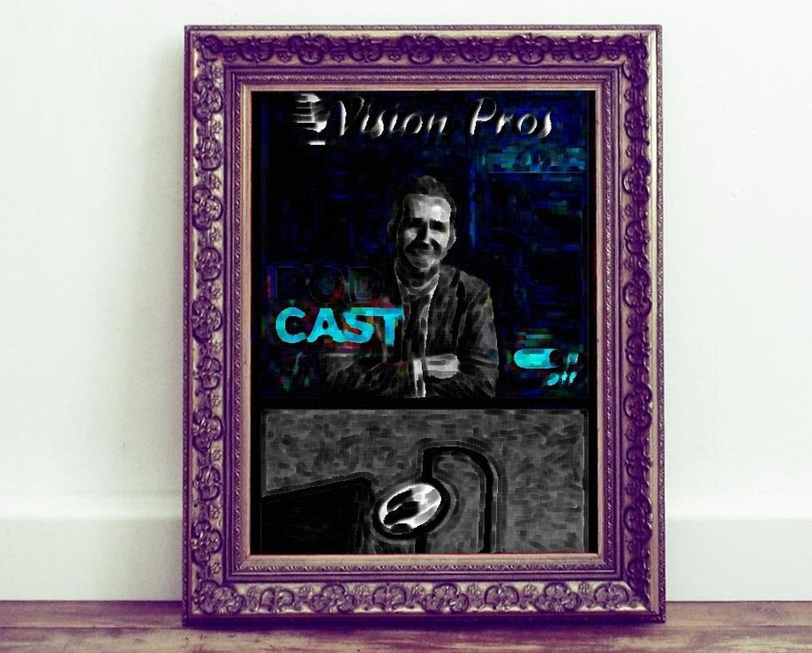
If you want to make an impact that helps more people throughout this world, call me.

Slide 12
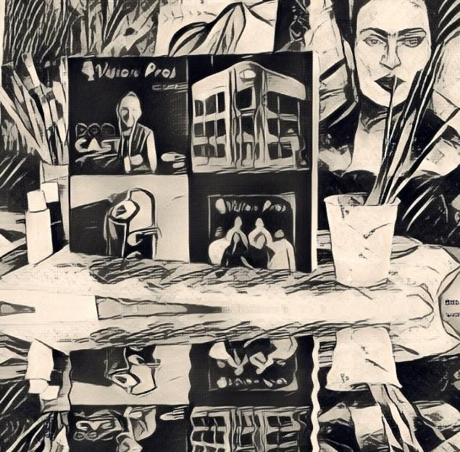
Sustainable revenue growth is the answer.

Slide 13

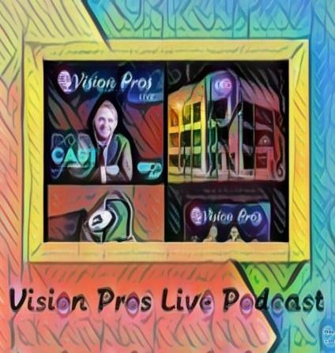
Why? Because hype is failing all around you.
96% of businesses fail within 10 years.

Slide 14
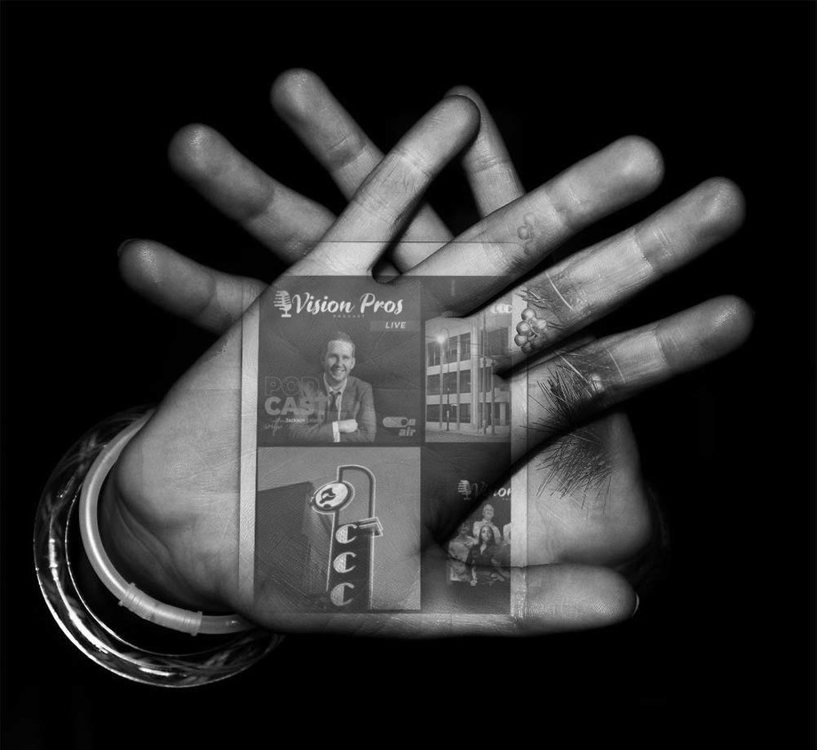
Tradition causes that.
But fads aren't the answer.

Slide 15

What can you do about it?
You need true growth, and it's not easy.

Slide 16
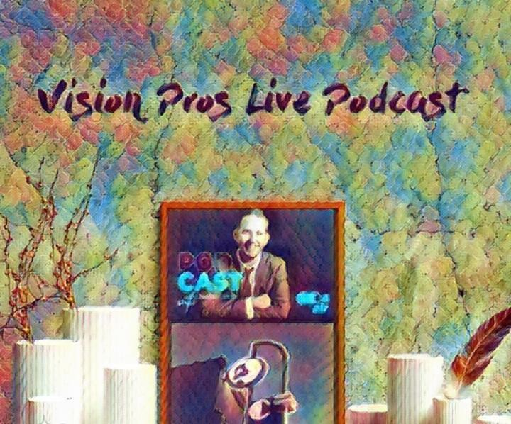
You need expert guidance to BUILD a real organization.
You must put your customers' needs first.
Your “minimum budget” shouldn’t be your focus. Your desired results should be because strategy isn't a passive afterthought.

Slide 17
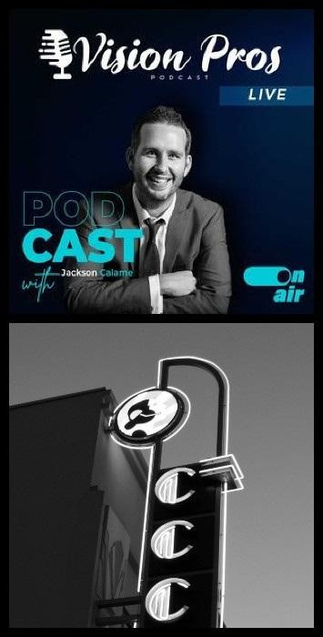
3. Shifting from a "catch up" culture to a "get ahead" power house takes immense discipline, but great teams enjoy the process.
For lasting success and growth, consider the power of aligning your vision and mission so that your sales department, support team, marketing materials, and processes finally reflect what you envisioned.

Slide 18
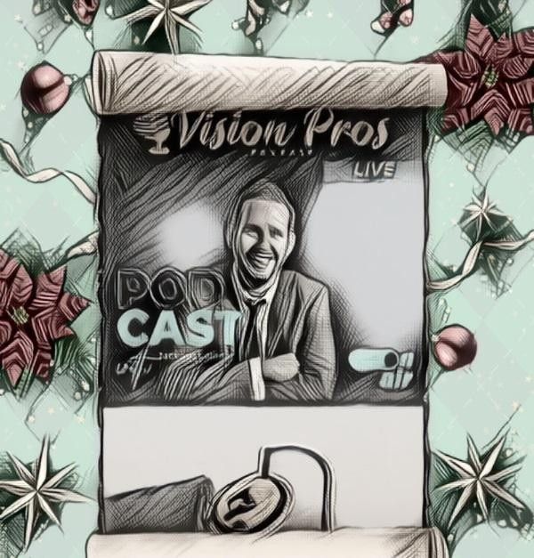
I'm sad to see how many visionaries fail by trying to force it on the wrong teams.
If you're reading this still, it's because you or your team need guidance to achieve meaningful growth, so just reach out.
I truly care about forming the right relationships.

Slide 19
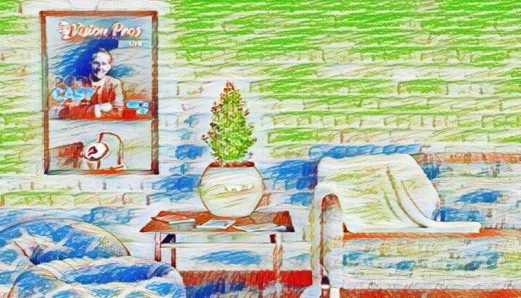
If you have 5-10 years of experience in your field, you're ready for proper support.
If you're a mission-centric person, passionately serving your market then come ready to teach us all about you and what you do because we need to believe in it, too.
We show up ready to dive in because legacies aren't built with passive effort.
If you're making a massive impact and building a better future for our world, and you value dedicated team members that aren't scared to refine your vision with you we look forward to catching up with you!

Slide 20

Richard’s vision quest journey is filled with twists and turns. At 27 years old, he relocated to Costa Rica to train employees for one of the larger call centers in San Jose. With a mix of motivational public speaking style backed by tactful and appropriate rhetoric, Richard shared his knowledge and trained over 10 000 bilingual telemarketers over two decades.

Slide 21


Richard Blank has the largest collection of restored American Pinball machines and antique Rockola Jukeboxes in Central America making gamification a strong part of CCC culture.Richard Blank is the Chief Executive Officer for Costa Rica’s Call Center since 2008. Mr. Richard Blank holds a bachelors degree in Communication and Spanish from the University of Arizona and a certificate of language proficiency from the University of Sevilla, Spain.
A Keynote speaker for Philadelphia's Abington High School 68th National Honors Society induction ceremony. In addition, entered into the 2023 Hall of Fame for Business along side other famous alumni. Paying it forward to Abington Senior High School is very important to Mr.

Slide 22

Blank. As such, he endows a scholarship each year for students that plan on majoring in a world language at the university level.

Slide 23

Costa Rica’s Call Center (CCC) is a state of the art BPO telemarketing outsource company located in the capital city of San Jose, Costa Rica. Our main focus has been, and will always be to personally train each and every Central America call center agent so that we may offer the highest quality of outbound and inbound telemarketing solutions and bilingual customer service to small and medium sized international companies, entrepreneurs as well as fortune 500 companies.
https://costaricascallcenter.com/en/outbound-bpo-campaigns/
Jackson Calame, Vision Pros Live Podcast, Richard Blank, Costa Rica's Call Center, Outsourcing, Telemarketing Call Centre, BPO, Nearshore Contact Center, Sales,

Slide 24

Entrepreneur, B2B, Business, Podcast, Gamification,Leadership, Marketing, CX, Guest, Money, B2C education, BPO trainer,
#JacksonCalame #VisionProsLivePodcast #CostaRica #CallCenter #Outsourcing #Telemarketing #BPO #Sales #Entrepreneur #B2B #Business #Podcast #Gamification #CEO #learnpodcasting #podcastepisode #podcastguest #podcasting #podcastinterview #podcastplaylist #podcasts #podcastskills #podcastshow
What's your vision? Richard Blank tells all on Session 1 Vision Pros Live Podcast by Jackson Calame.

Slide 25
