Slide 1
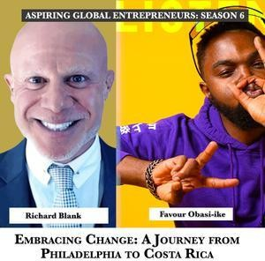

Downloaded from: justpaste.it/wedontplay
We Don't PLAY! by Favour Obasi-ike. The SEO Marketing Podcast Show with guest Richard Blank
Embracing Change: A Journey from Philadelphia to Costa Rica with Richard Blank Welcome to the We Don't PLAY Podcast where you get all the latest and greatest news updates on all things digital marketing, SEO, entrepreneurship, personal development, branding, and so much more!
Embracing Change: A Journey from Philadelphia to Costa Rica with Richard Blank
Welcome to the We Don't PLAY Podcast where you get all the latest and greatest news updates on all things digital marketing, SEO, entrepreneurship, personal development, branding, and so much more!

Slide 2
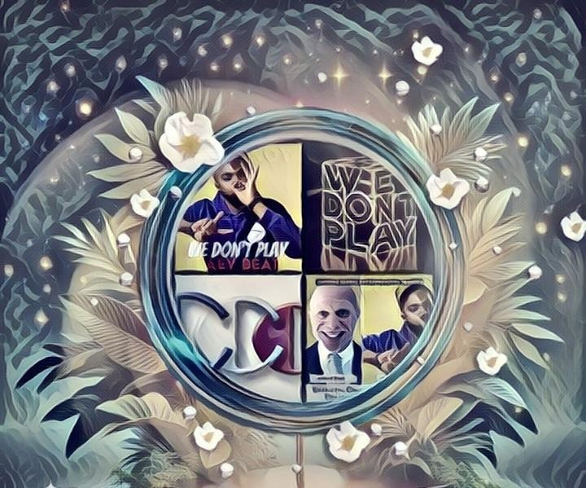
Work & PLAY Entertainment. An entertainment hub that provides marketing & innovative products to solve problems through e-Learning & business development packages.

Slide 3

Your favorite Media & Entertainment Business news sourceAre you looking for fun and professional advice for navigating a work-life balance?

Slide 4

We Don't PLAY is a great podcast SEO Marketing show to tune into with an international roster of guests discussing topics including Search Engine Optimization (SEO), Artificial Intelligence (AI), digital marketing, email marketing, content marketing, entrepreneurship, relationship management, & trending topics you will find interesting!

Slide 5
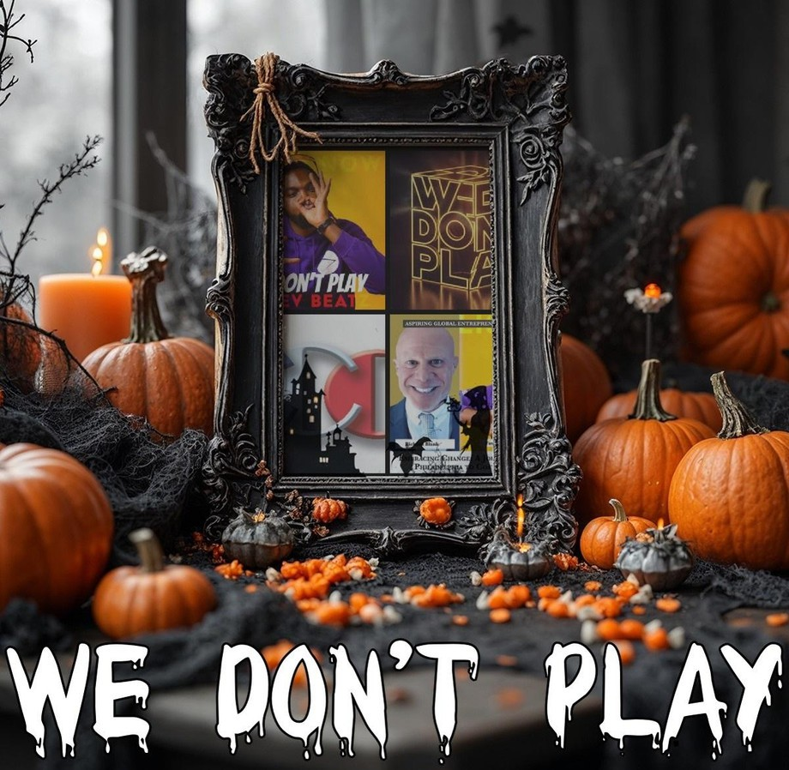
We Don't PLAY:The SEO Marketing Podcast Show

Slide 6
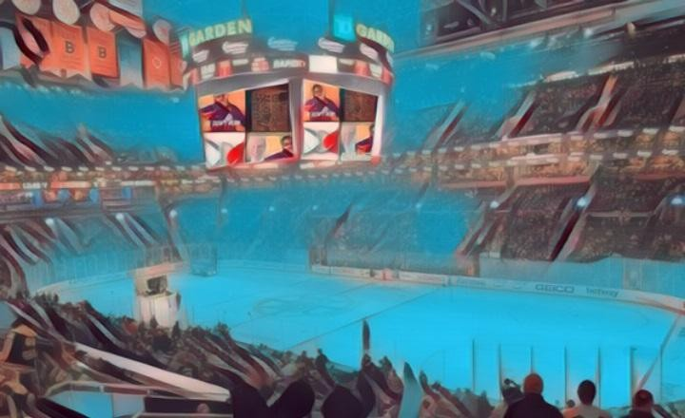
Welcome to We Don't PLAY, hosted by entrepreneur, artist, and CEO Favour Obasi-ike.

Slide 7
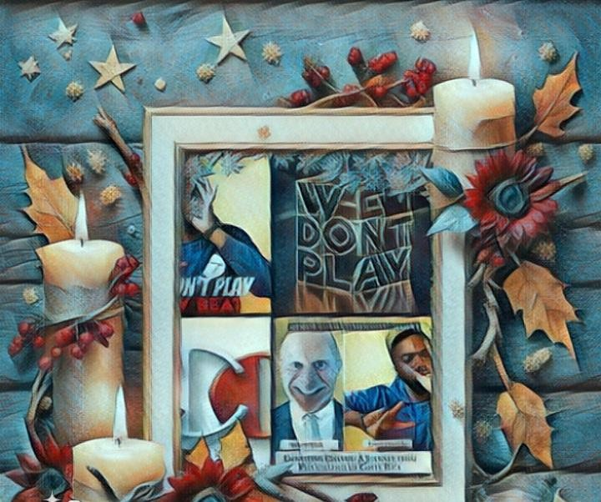

This podcast is one of the top 10% most popular shows out of 2.7M podcasts global on ListenNotes.com.

Slide 8

Are you looking for experienced advice & pro tips? We Don't PLAY is a great podcast to tune into with SEO, Pinterest marketing, content marketing, digital marketing, entrepreneurship tips, music reviews, LIVE! interviews, giveaways, hot and trending topics you will find interest in.
Subscribe to this podcast show to grab digital courses, marketing resources, and so much more
Favour Obasi-ike:
I provide SEO & Marketing consulting services to business leaders, entrepreneurs, and creative professionals seeking assistance in achieving their annual revenue objectives through the development of tailored strategies and operational systems.

Slide 9
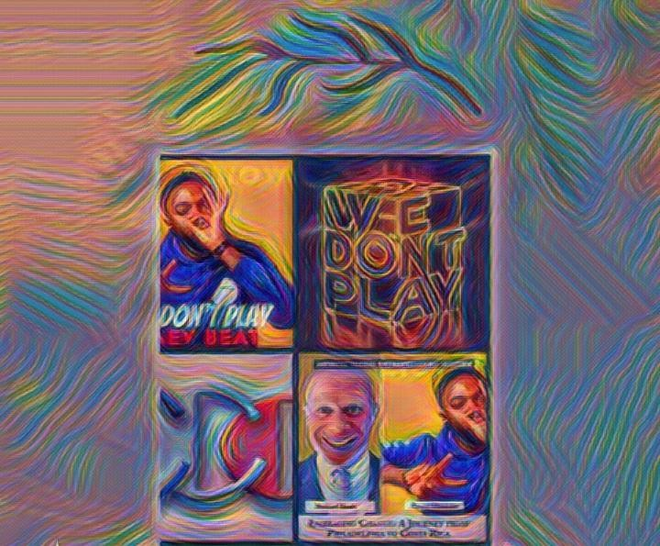
With a decade of industry experience, my areas of expertise include search engine optimization (SEO), heat mapping, zip code marketing, podcast advertising, content development and distribution, email marketing, organic and paid social media advertising, and podcast production.

Slide 10
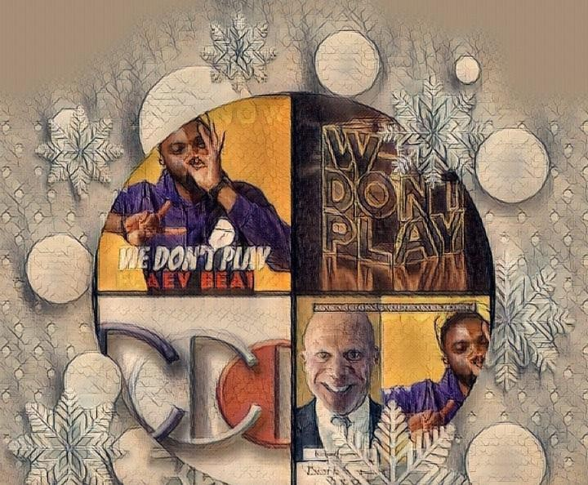
I run a podcast show ranked Top 3% Globally called We Don’t PLAY where we share over 430 episodes across over 119 countries with stories from business leaders and professionals who have established their brand locally or internationally.

Slide 11
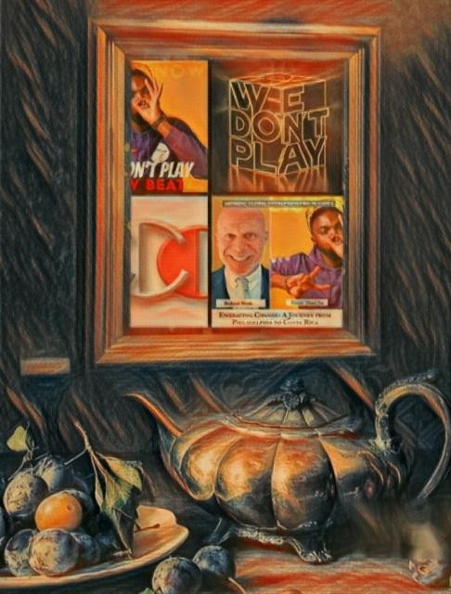
My goal is to help businesses protect, earn and scale their digital assets and intellectual property for effective website traffic that convert leads into sales.

Slide 12

Richard Blank spoke on Embracing Change: A Journey from Philadelphia to Costa Rica. You don't want to miss this!

Slide 13
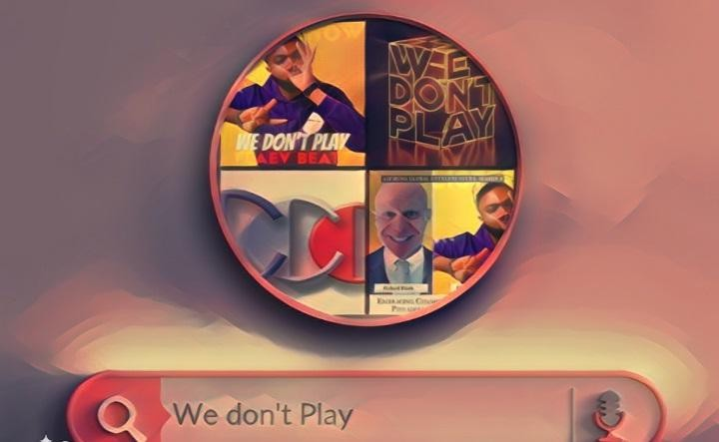
Experience the thrill of leaving everything behind and stepping into the unknown with our guest Richard. This brave soul embarked on a life-changing journey from the comfortable familiarity of northeast Philadelphia to the intriguing, yet challenging terrains of Costa Rica to work in a call center.

Slide 14

His story is not merely one of geographical displacement, but an incredible journey of personal and professional growth as he mastered the art of sales, retention, customer support, training, onboarding, and human resources. Richard's tale is a testament to the power of calculated risks and a strong network of support, which inspired his forthcoming children's books.
Communication is an art, and Richard is a master painter. We get a chance to delve into his palette of effective communication strategies and techniques. He introduces us to the 'buffer boomerang' - his secret weapon for handling difficult conversations with diplomacy and strategy. Richard encourages us not simply to speak, but to express with authenticity, listen actively, and respond strategically. He underscores the significance of constructive feedback along with the apt use of expressions and vocabulary.

Slide 15
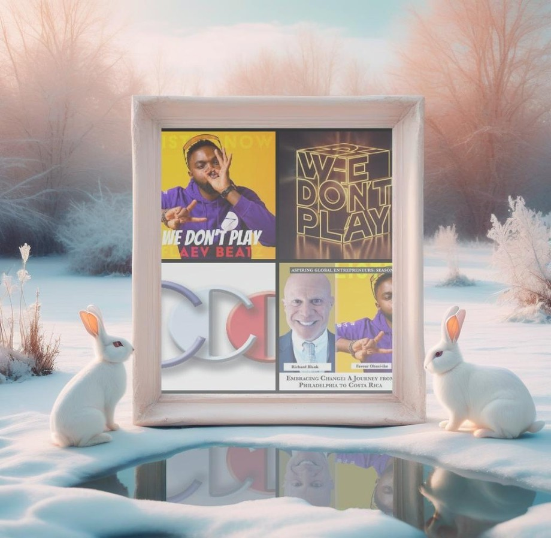
Lastly, Richard unravels the hidden connections between due diligence, travel, and relationship building. He advocates investing time to understand a person or organization's culture before engagement. He believes in the power of being present - it’s more than just showing up, it’s about being there, fully engaged, listening, and participating. Richard’s journey from Philadelphia to Costa Rica is the epitome of embracing different cultures, leading to personal and professional growth. So, plug in your earphones, press play, and let Richard take you on an unforgettable journey, equipping you with practical insights and inspiring you to take the leap toward growth and success.

Slide 16

EPISODE CHAPTERS
(0:00:00) - Business and Personal Growth for Entrepreneurs (0:08:17) - Effective Communication Strategies and Techniques (0:16:21) - Due Diligence and Building Relationships
(0:24:05) - The Power of Travel and Inspiration EPISODE CHAPTERS WITH SHORT KEY POINTS
(0:00:00) - Business and Personal Growth for Entrepreneurs
Richard took a calculated risk and moved to Costa Rica, gaining experience in sales, customer support, and human resources, and plans to write children's books. (0:08:17) - Effective Communication Strategies and Techniques

Slide 17

Authenticity, active listening, constructive feedback, and soft skills were discussed to improve communication.
(0:16:21) - Due Diligence and Building Relationships
Taking time to research and understand company culture pays off, as listening actively and taking notes, using delivery and performance to stand out.
(0:24:05) - The Power of Travel and Inspiration
Richard discussed the importance of openness to cultures and opportunities, authenticity, active listening, and researching company culture.
Richard’s vision quest journey is filled with twists and turns. At 27 years old, he relocated to Costa Rica to train employees for one of the larger call centers in San Jose. With a mix of motivational public speaking style backed by tactful and appropriate rhetoric, Richard shared his knowledge and trained over 10 000 bilingual telemarketers over two decades.

Slide 18

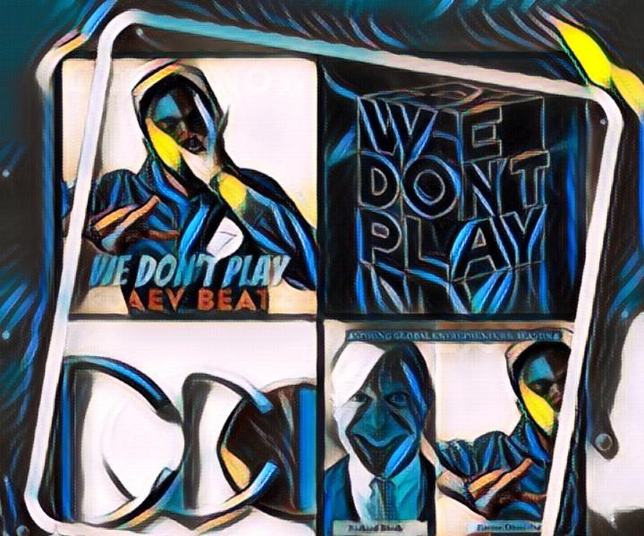
Richard Blank has the largest collection of restored American Pinball machines and antique Rockola Jukeboxes in Central America making gamification a strong part of CCC culture.Richard Blank is the Chief Executive Officer for Costa Rica’s Call Center since 2008.
Mr. Richard Blank holds a bachelors degree in Communication and Spanish from the University of Arizona and a certificate of language proficiency from the University of Sevilla, Spain.

Slide 19


A Keynote speaker for Philadelphia's Abington High School 68th National Honors Society induction ceremony. In addition, entered into the 2023 Hall of Fame for Business along side other famous alumni. Paying it forward to Abington Senior High School is very important to Mr. Blank. As such, he endows a scholarship each year for students that plan on majoring in a world language at the university level.
Costa Rica’s Call Center (CCC) is a state of the art BPO telemarketing outsource company located in the capital city of San Jose, Costa Rica. Our main focus has been, and will always be to personally train each and every Central America call center agent so that we may offer the highest quality of outbound and inbound telemarketing solutions and bilingual customer

Slide 20

service to small and medium sized international companies, entrepreneurs as well as fortune 500 companies.
https://costaricascallcenter.com/en/outbound-bpo-campaigns/

Slide 21

Favour Obasi-ike, We Dont PLAY Podcast, Richard Blank, Costa Rica's Call Center, Outsourcing, Telemarketing Call Centre, BPO, Nearshore Contact Center, Sales, Entrepreneur, B2B, Business, Podcast, Gamification,Leadership, Marketing, CX, Guest, Money, B2C education, BPO trainer,

Slide 22

#FavourObasiike #WeDontPLAYPodcast #CostaRica #CallCenter #Outsourcing #Telemarketing #BPO #Sales #Entrepreneur #B2B #Business #Podcast #Gamification #CEO #learnpodcasting #podcastepisode #podcastguest #podcasting #podcastinterview #podcastplaylist #podcasts #podcastskills #podcastshow

Slide 23


Slide 24

https://youtube.com/shorts/_XJkxPs9zWg https://youtube.com/shorts/C7v8PXy2D6o https://youtube.com/shorts/bnJmPtNg2zg https://youtube.com/shorts/teIQUjm56IU https://youtube.com/shorts/X--SwK2L23o

