Slide 1



Downloaded from: justpaste.it/TheRenownedLeadership
The Renowned Leadership Podcast - Leadership, Progression, and Life Advice with B2B teacher Richard
Startup Strategies: Discover Richard's insights into startup strategies, investment opportunities, and navigating the ever-evolving entrepreneurial landscape. Gain practical tips for launching and scaling your own ventures.
Welcome to the Renowned Leadership Podcast, where we ignite the leader within you! Hosted by Stephen J. Morris, a seasoned leader with over 21 years of military and corporate experience, this podcast is your go-to source for transformative leadership insights.
Join us for inspiring interviews, actionable strategies, and real-world stories that empower you to lead with purpose, build elite teams, and drive success.

Slide 2
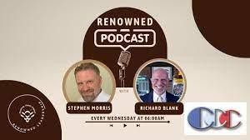

Whether you're a seasoned executive or an aspiring leader, tune in to elevate your leadership journey and make a lasting impact.
Hey Podcast Enthusiasts! Exciting News! In our latest episode, I had the pleasure of chatting with Richard Blank, a seasoned entrepreneur, and innovator, diving deep into the world of startups, investment, and business growth.

Slide 3

Entrepreneurial Journey:
Richard shares his inspiring journey, from startup ventures to becoming a seasoned entrepreneur and investor. Explore the highs, lows, and invaluable lessons learned along the way.
Startup Strategies:

Slide 4
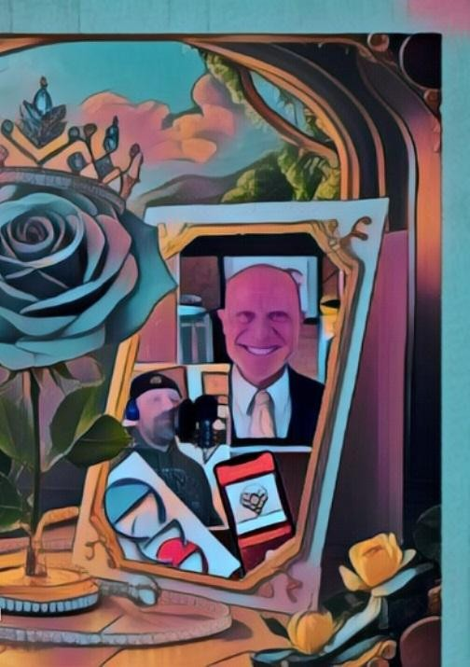
Discover Richard's insights into startup strategies, investment opportunities, and navigating the ever-evolving entrepreneurial landscape. Gain practical tips for launching and scaling your own ventures.
Business Growth and Innovation:

Slide 5

Delve into discussions on business growth, innovation, and staying ahead in competitive markets. Learn how to identify opportunities, adapt to change, and foster innovation within your organization.
Leadership and Vision:

Slide 6

Explore Richard's perspective on leadership, vision, and the qualities that drive success in entrepreneurship. Gain valuable insights into effective leadership strategies and vision-setting for long-term growth.
Hit play now and join us on this insightful journey of empowerment, entrepreneurship, and innovation! Don't miss out!

Slide 7


By Stephen J. Morris:
Lead like a Champion with Purpose and Impact
Leadership is where I thrive. It's my passion and what I've dedicated the past 23 years of my professional career to, both in the Military and Corporate worlds. I've been fortunate to learn from some of the most exceptional leaders, and now I’m committed to sharing that knowledge as a Leadership Development and Career Coach. Whether you’re a CEO, manager, or team member, with or without a military background, I can help elevate your leadership and career to the next level.

Slide 8
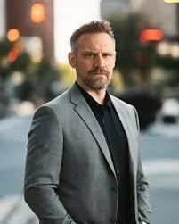
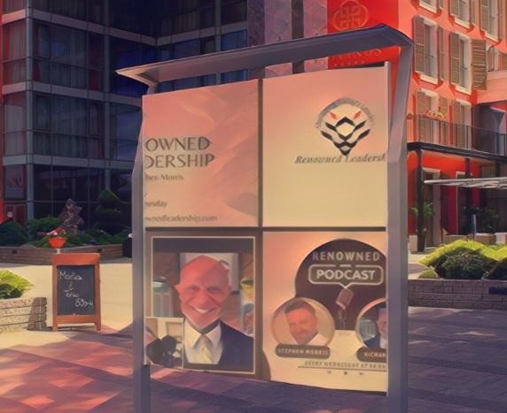
As a United States Army veteran, I have spent much of my adult life serving my country and leading both combat and non-combat deployments worldwide.
After transitioning to the civilian workforce, I faced significant challenges adapting to a new environment. Leaving behind the high-octane, goal-oriented structure of the military was not easy.

Slide 9

However, with the guidance of an exceptional coach, I found my calling in coaching others. This experience ignited my passion for helping leaders develop their skills, craft effective career strategies, and build elite teams.

Slide 10

Inspired by the great leaders who have shaped my journey, I founded Renowned Leadership with a clear purpose: to cultivate authentic leaders characterized by integrity and character. At Renowned Leadership, we focus on developing the whole person, empowering them to achieve their greatest aspirations and fostering elite team development.

Slide 11

Let's connect to explore how we can elevate your leadership journey together. Discover our "Purposeful Success" program and more by visiting our website.

Slide 12

Advanced telemarketing strategy, conflict management, interpersonal soft skills, customer support, rhetoric, gamification, pinball machines, employee motivation, tell signs through phonetic micro expression reading, the pros and cons of A.I and finally, The Famous Buffer- Boomerang Technique

Slide 13

Richard’s vision quest journey is filled with twists and turns. At 27 years old, he relocated to Costa Rica to train employees for one of the larger call centers in San Jose. With a mix of motivational public speaking style backed by tactful and appropriate rhetoric, Richard shared his knowledge and trained over 10 000 bilingual telemarketers over two decades.

Slide 14
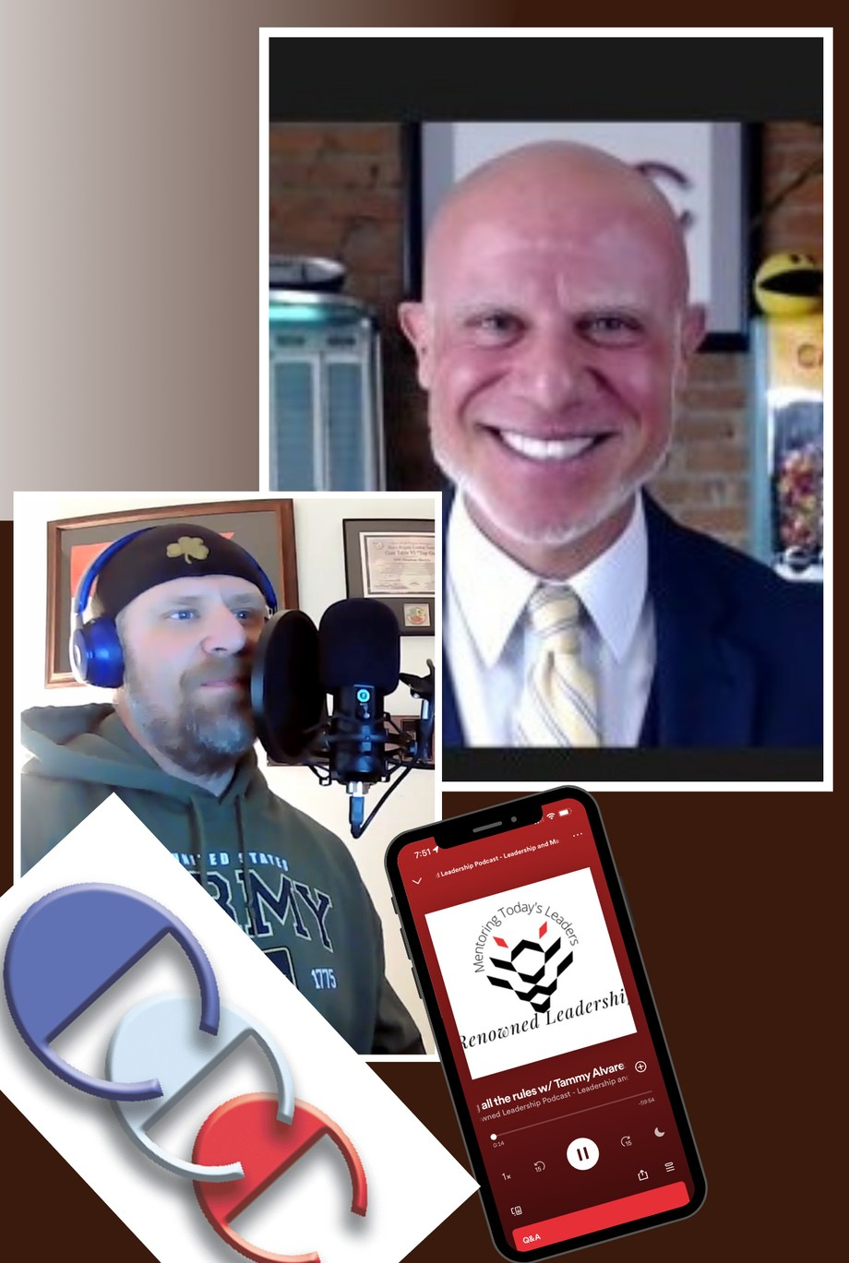

Slide 15
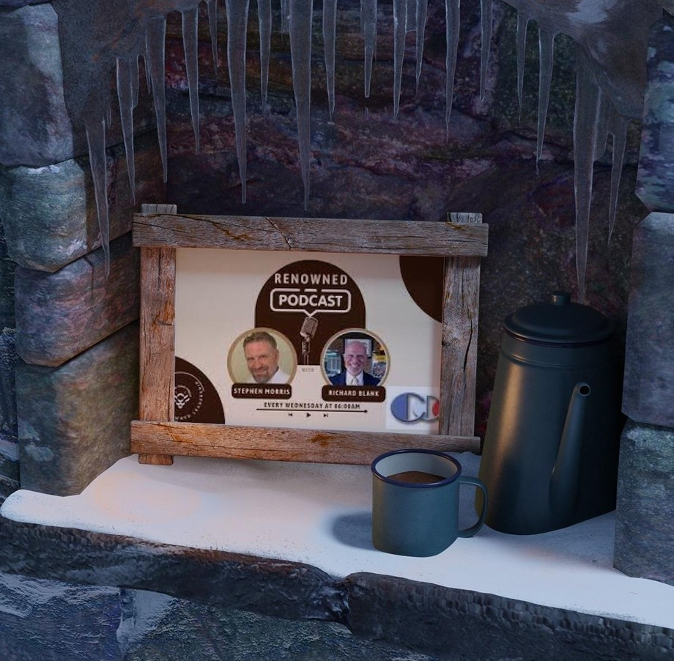
Richard Blank has the largest collection of restored American Pinball machines and antique Rockola Jukeboxes in Central America making gamification a strong part of CCC culture.Richard Blank is the Chief Executive Officer for Costa Rica’s Call Center since 2008.
Mr. Richard Blank holds a bachelors degree in Communication and Spanish from the University of Arizona and a certificate of language proficiency from the University of Sevilla, Spain.

Slide 16

A Keynote speaker for Philadelphia's Abington High School 68th National Honors Society induction ceremony. In addition, entered into the 2023 Hall of Fame for Business along side other famous alumni.
Paying it forward to Abington Senior High School is very important to Mr. Blank. As such, he endows a scholarship each year for students that plan on majoring in a world language at the university level.

Slide 17
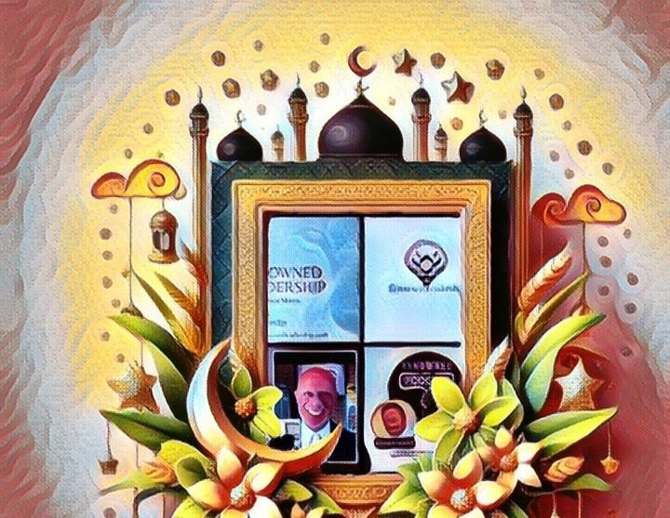
Costa Rica’s Call Center (CCC) is a state of the art BPO telemarketing outsource company located in the capital city of San Jose, Costa Rica.

Slide 18

Our main focus has been, and will always be to personally train each and every Central America call center agent so that we may offer the highest quality of outbound and inbound telemarketing solutions and bilingual customer service to small and medium sized international companies, entrepreneurs as well as fortune 500 companies.

Slide 19

https://costaricascallcenter.com/en/outbound-bpo-campaigns/

Slide 20

Stephen J. Morris, The Renowned Leadership Podcast, Richard Blank,Costa Rica's Call Center, Outsourcing, Telemarketing Call Centre, BPO, Nearshore Contact Center, Sales, Entrepreneur, B2B, Business, Podcast, Gamification,Leadership, Marketing, CX, Guest, Money, B2C education, BPO trainer,

Slide 21

#StephenJMorris #TheRenownedLeadershipPodcast #RichardBlank #CostaRica #CallCenter #Outsourcing #Telemarketing #BPO #Sales #Entrepreneur #B2B #Business #Podcast #Gamification #CEO #learnpodcasting #podcastepisode #podcastguest #podcasting #podcastinterview #podcastplaylist #podcasts #podcastskills #podcastshow

Slide 22



Slide 23


Slide 24


Slide 25



Slide 26


Slide 27


