Slide 1

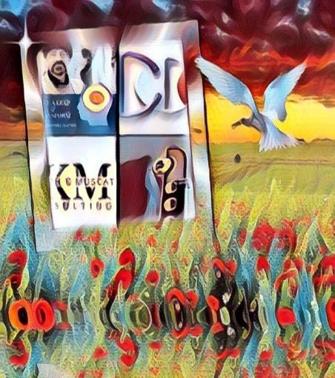
Downloaded from: justpaste.it/Neurodiversityjourneypodcast
Think a Neurodiversity Journey. Take A Leap & Transform through the art of speech with Richard Blank
We all should know how to learn tonality and how to read people, especially over the phone. This is why I am happy to welcome Richard Blank to the podcast.Richard is the CEO of the largest Costa Rica Call centre.
Every two weeks, my purpose is to bring you through a journey of Neurodiversity awareness and skillsets in the workplace and with entrepreneurs.

Slide 2
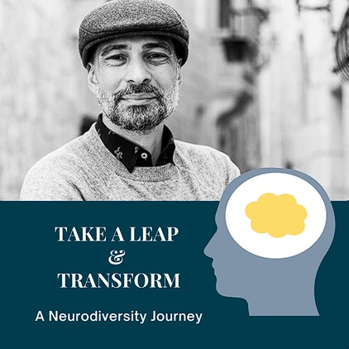
This is all about transforming our mindset, finding purpose, discovering our superpowers, setting clear goals and creating solutions that will increase productivity and profitability by becoming more inclusive and diverse.

Slide 3
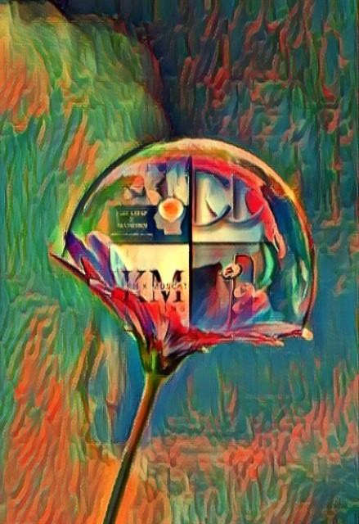
I would like to illustrate how my new venture came about and to do that I have to tell you a bit more about myself and my journey. Hopefully, this will inspire you to accept yourself for who you are and you will be able to relate.

Slide 4
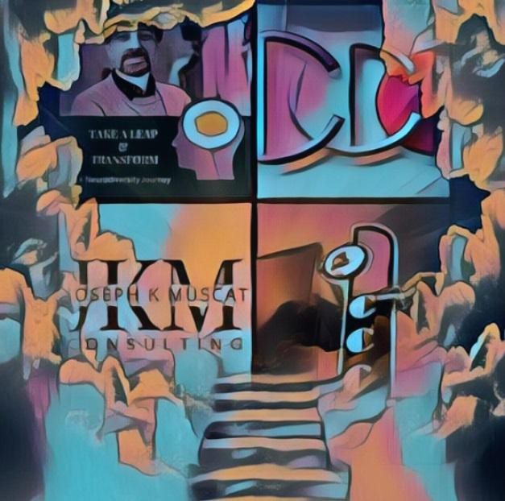
I am neurodiverse... not sure what that is...? Well, simply put, it's a person who has been diagnosed with one or more learning disabilities. In my case, I have few; Visual Motor, Visual Perception, Working Memory, and Dyslexia. This has been both a struggle and a blessing for me; over the course of my education, relationships, employment and my various businesses.

Slide 5
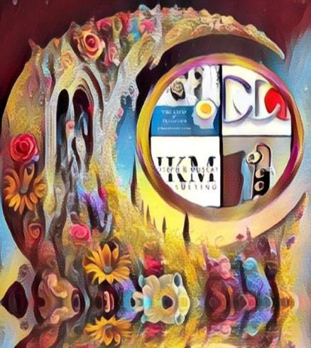
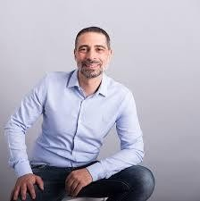
I was diagnosed with visual motor and visual perception at school age and to this day I am still trying to fully understand what they mean. Both my family and teachers were not able to offer me sufficient support. Struggling at school became the norm for me, but I persevered. Despite these challenges, I earned a Bachelor of Fine Arts from York University and then later on I continued on to study at Humber College, in Toronto Canada.
My path was set. I would be a professional photographer... and I remained on that path for 20+ years. Over my years following this path, I developed my entrepreneurial skills in order to be able to consult many clients with their projects, objectives, social media marketing, business development and client relations.
In 2014, we embarked on a new adventure out of Canada and moved to Malta as a family, to seek new challenges and opportunities for us. This is where I re-evaluated my path and took a

Slide 6

step back from photography in order to focus on other business opportunities. I carved out a new path for myself where I worked with various companies in project management and business development.
2018 was a turning point for me. I was in my third job on the island, which was very stressful, my learning disabilities were showing, I couldn’t hide them anymore. It affected me emotionally which in turn affected my family...
Over the years I had searched for private support in relation to my learning disabilities. This was challenging as learning difficulties are often perceived as a childhood problem and thus there is very little support available to adults. Not being able to find the support I needed, led me to take the challenge upon myself and create a system that I could implement to help me in my entrepreneurship. It entailed lots of trial and error, many workshops and books to read. But in the end, I finally can say that I have created a Seven-Step Transformative Management Methodology (SSTMM) solution for adults with learning disabilities who are either running their own business or are employed. I believe that if it is implemented correctly it will greatly improve the working environment and provide a solution to their challenges.

Slide 7
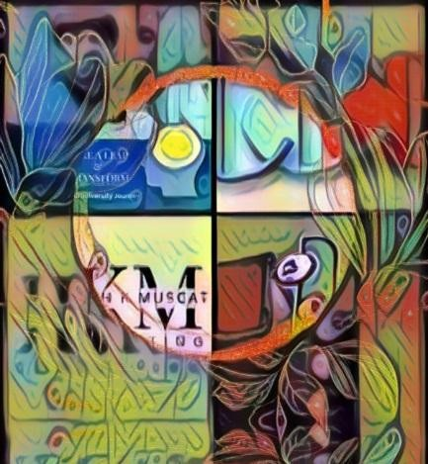
This was the birth of my consultancy business. Joseph K Muscat
Take a leap & transform
Throughout my extensive experience in entrepreneurship and various professional roles, I have encountered three significant challenges that have shaped my understanding of the importance of fostering Neurodivergent talent. Firstly, the lack of awareness and understanding among employers and managers regarding the unique thinking and working styles of individuals with Neurodivergent traits. Secondly, the need for comprehensive knowledge and strategies to provide appropriate accommodations, support, productivity strategies, and coaching tailored to Neurodivergent individuals. Lastly, the absence of management awareness, skills, and resources to effectively foster and cultivate Neurodivergent talent for the long-term benefit of both the individual and the company as a whole.

Slide 8
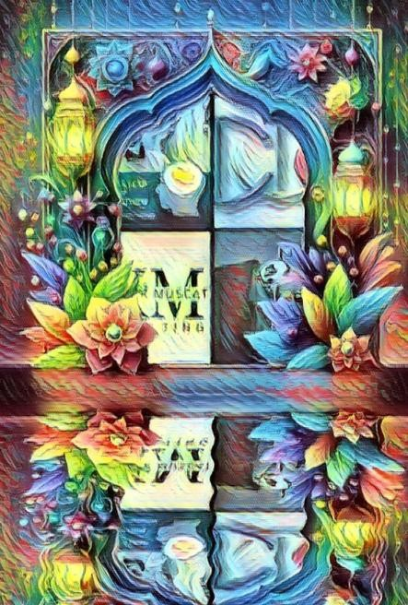
These challenges have inspired me to dedicate my time to self-improvement and acquiring the necessary knowledge and skill set to overcome these obstacles. As someone who has personally experienced learning difficulties, I have become a passionate advocate for individuals facing similar challenges and a valuable resource for business owners seeking guidance in implementing transformative changes to accommodate Neurodivergent talent.

Slide 9
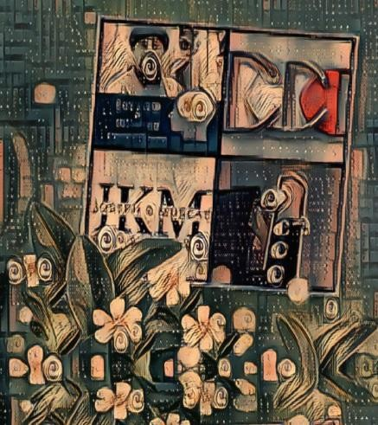
I invite you to join me in taking a leap forward, embracing a new perspective, and unlocking the untapped potential within your organization.

Slide 10
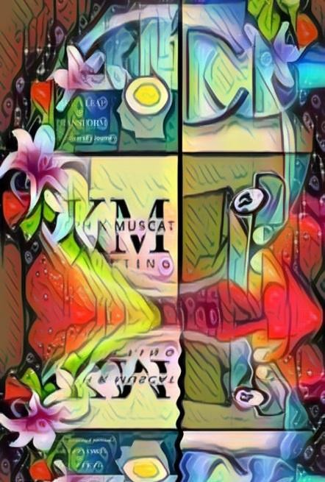
Do You feel you have a journey that you can share with our Take a Leap & Transform community?
We are looking for Neurodivergent talent to share their experiences.
We are looking for business leaders and coaches who can deliver DEI&B solutions to businesses.
We are looking for mindset professionals who can empower Nuerodivergent talent

Slide 11
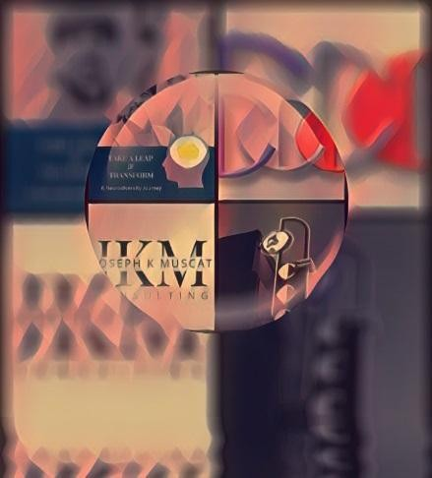
We all should know how to learn tonality and how to read people, especially over the phone. This is why I am happy to welcome Richard Blank to the podcast. Richard is the CEO of the largest Costa Rica Call centre. Richard has such a use of language that he naturally uses and trainers over 10,000 employees.
Together we engage on how to develop and use such language and then jump into how business leaders can inspire and motivate through inclusion principles and practices.

Slide 12

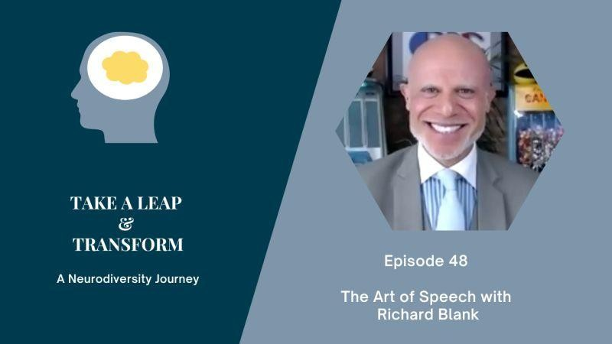
My name is Joseph K Muscat and my purpose is to bring you through a journey of Neurodiversity awareness and skillsets in the workplace and with entrepreneurs. This is all about transforming our mindset, finding purpose, discovering our superpowers, setting clear goals and creating solutions that will increase productivity and profitability by becoming more inclusive and diverse.

Slide 13

I help companies, entrepreneurs and individuals develop strong:
Project Management Practices
grow their business with Business Development
Leadership Development
Productivity Strategies
And I help develop Management create policies, communications, systems and strategies in living with and working with neurodiversity employees or individuals with Learning Difficulties (i.e. dyslexia, dyscalculia, working memory, etc)

Slide 14

Interpersonal Communication Conflict Management Strategy
Phonetic Micro Expression reading for mastering verbal tell signs.
The Famous Buffer-Boomerang Technique

Slide 15

Advanced telemarketing strategy, conflict management, interpersonal soft skills, customer support, rhetoric, gamification, pinball machines, employee motivation and phonetic micro expression reading.
Richard’s vision quest journey is filled with twists and turns. At 27 years old, he relocated to Costa Rica to train employees for one of the larger call centers in San Jose. With a mix of motivational public speaking style backed by tactful and appropriate rhetoric, Richard shared his knowledge and trained over 10 000 bilingual telemarketers over two decades.

Slide 16

Richard Blank has the largest collection of restored American Pinball machines and antique Rockola Jukeboxes in Central America making gamification a strong part of CCC culture.Richard Blank is the Chief Executive Officer for Costa Rica’s Call Center since 2008.

Slide 17

Mr. Richard Blank holds a bachelors degree in Communication and Spanish from the University of Arizona and a certificate of language proficiency from the University of Sevilla, Spain.
A Keynote speaker for Philadelphia's Abington High School 68th National Honors Society induction ceremony. In addition, entered into the 2023 Hall of Fame for Business along side other famous alumni. Paying it forward to Abington Senior High School is very important to Mr. Blank. As such, he endows a scholarship each year for students that plan on majoring in a world language at the university level.

Slide 18

https://costaricascallcenter.com/en/outbound-bpo-campaigns/
#Neurodiversity #JosephKMuscat #RichardBlank #CostaRica #CallCenter #Outsourcing #Telemarketing #BPO #Sales #Entrepreneur #B2B #Business #Podcast #Gamification #CEO
, Richard Blank,Costa Rica's Call Center, Outsourcing, Telemarketing, BPO, Nearshore, Sales, Entrepreneur, B2B, Business,Podcast,Gamification,Leadership,Marketing, Radio, Guest, Money, education, trainer,
Take A Leap & Transform: A Neurodiversity Journey Podcast.The Art of Speech With Richard
Blank.

Slide 19


