Slide 1



Downloaded from: justpaste.it/simonsaysccc
Simon Says Simplify Sales - Micro Podcast. The biggest hurdle I have overcome with Richard Blank
Simon Morris is the Founder and Major Shareholder of a group of businesses that operate in Sales and Marketing, Online Fitness, Business Consultancy, and selling Coffee. A Strategic and forward focussing business leader, with over 40 years’ experience helping companies to achieve significant growth across several industries.
Working alongside a wide range of multi nationals and regional SME’s. Commercially astute, identifying opportunities and mitigating associated risks. Applying strict governance structures with clarity and transparency. Implementing system and process improvements to develop accountability and efficiency cultures. Supporting sales and marketing strategies and driving sustainable growth.

Slide 2
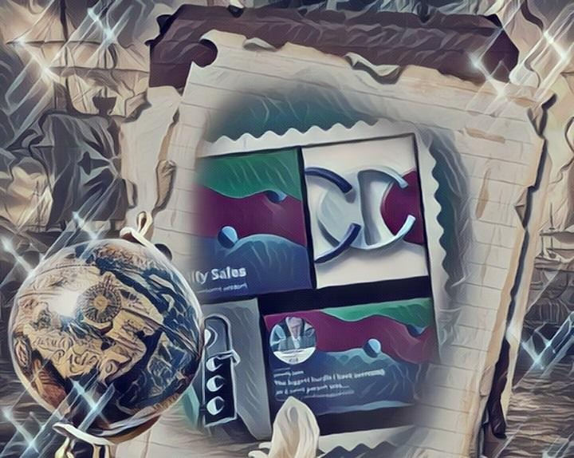
Simon believes business is a wonderful game. He works with business owners to turnaround the growth of the business ready for exit or sale. Simon does this by merging his sales and marketing skills, business experience and training in Neuro Linguistic Programming (NLP) with resources from the Sales Master's Guild and the Business Buyers Club.

Slide 3
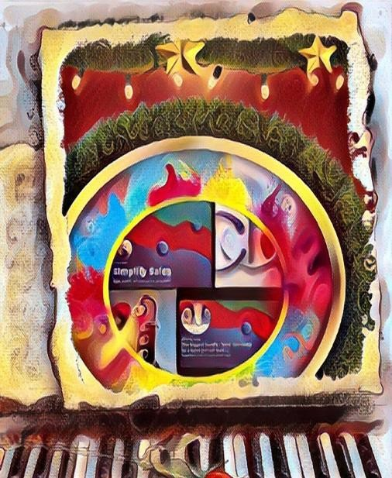
He have worked with many business people over the last 40 years and started and funded businesses from scratch. He grew and exited businesses in a variety of sectors - such as Optics, DIY, Pet, Veterinary and Food and Drink. His mission is to inspire a great sales performance and solve business problems with agility, creativity, and excellence.

Slide 4
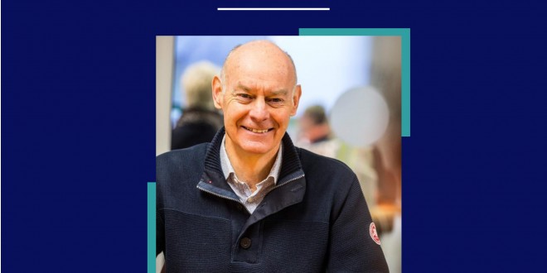
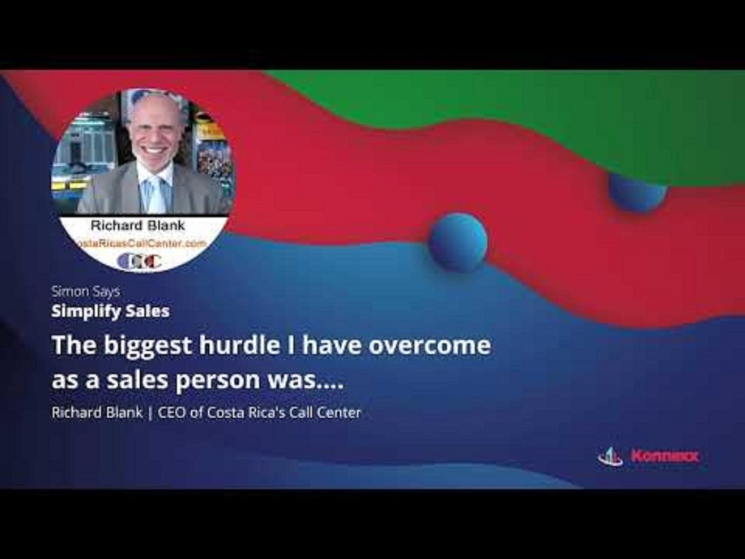
SimonSaysSimplifySales is your go to Micro-Podcast for sales inspiration. Learn from other sales people what hurdles they have faced in getting better leads, finding the right customer contact strategy or becoming better at closing the sales. We never know where inspiration will come from, but often the best ideas come from listening to others.
CallumConnects Micro-Podcast is your daily dose of wholesome entrepreneurial inspiration.

Slide 5

Hear from many different entrepreneurs in just 5 minutes what hurdles they have faced, how they overcame them, and what their key learning is.
Be inspired, subscribe, leave a comment, go and change the world
Knowing the principles of selling is a prerequisite for #success of any kind. This podcast offers bite-sized expert tips and tricks from sales professionals.

Slide 6
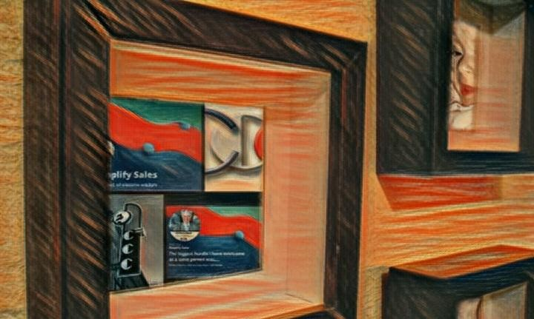
Richard’s journey in the call center space is filled with twists and turns. When he was 27 years old, he relocated to Costa Rica to train employees for one of the larger call centers in San Jose. With a mix of motivational public speaking style backed by tactful and appropriate rhetoric, Richard shared his knowledge and trained over 10 000 bilingual telemarketers.
Richard Blank has the largest collection of restored American Pinball machines and antique Rockola Jukeboxes in Central America making gamification a strong part of CCC culture.Richard Blank is the Chief Executive Officer for Costa Rica’s Call Center since 2008.

Slide 7
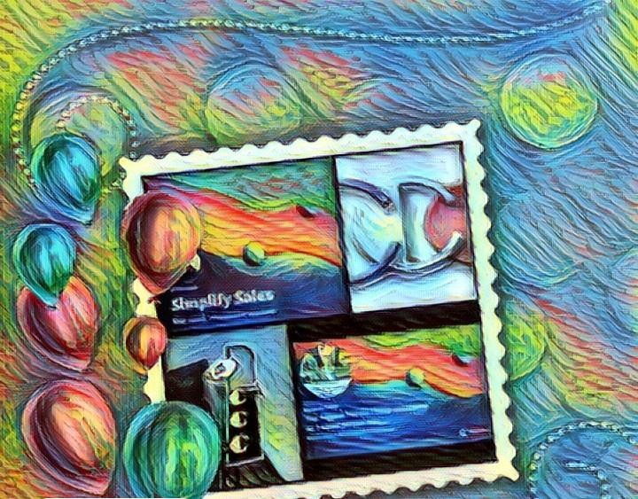
Mr. Richard Blank holds a bachelors degree in Communication and Spanish from the University of Arizona and a certificate of language proficiency from the University of Sevilla, Spain. A Keynote speaker for Philadelphia's Abington High School 68th National Honors Society induction ceremony. In addition, inducted into the 2023 Hall of Fame for Business. Giving back to Abington Senior High School is very important to Mr. Blank. As such, he endows a scholarship each year for students that plan on majoring in a world language at the university level.

Slide 8
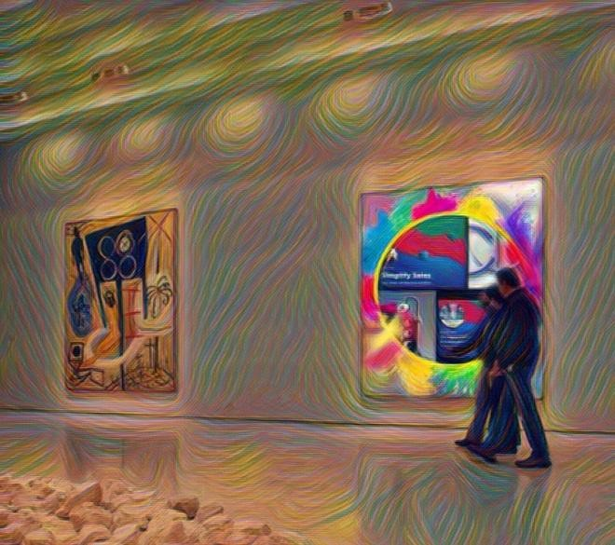
Costa Rica’s Call Center (CCC) is a state of the art BPO telemarketing outsource company located in the capital city of San Jose, Costa Rica. Our main focus has been, and will always be to personally train each and every Central America call center agent so that we may offer the highest quality of outbound and inbound telemarketing solutions and bilingual customer service to small and medium sized international companies, entrepreneurs as well as fortune 500 companies.

Slide 9
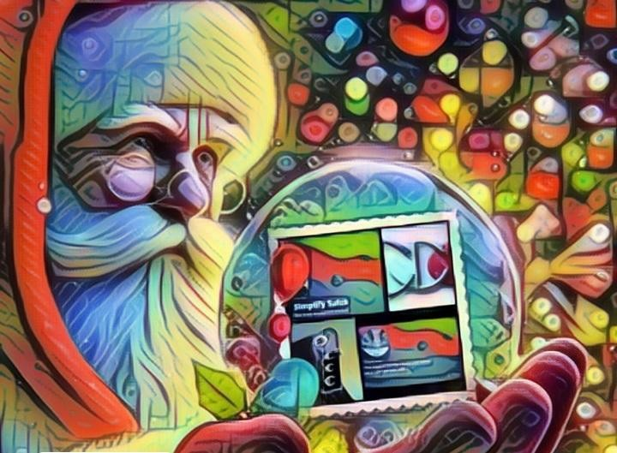
We encourage you to visit one of our call centers on your next personal vacation or business trip to Central America’s paradise, Costa Rica. While you are here, we would recommend taking an extra day of your trip to visit breathtaking virgin beaches, play golf next to the ocean, try your luck at deep sea fishing, explore tropical jungles, climb volcanos or just relax in natural hot springs. Come and see for yourself why call center outsourcing in Costa Rica is a perfect solution for your growing company and a powerhouse in the BPO industry.

Slide 10
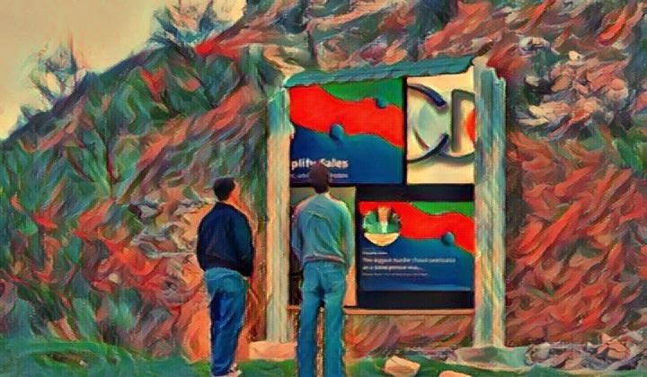
https://costaricascallcenter.com/en/outbound-bpo-campaigns/

Slide 11

#RichardBlank #CostaRica #CallCenter #Outsourcing #Telemarketing #BPO #Sales #Entrepreneur #B2B #Business #Podcast #Gamification #CEO #simonsayssimplifysales

Slide 12
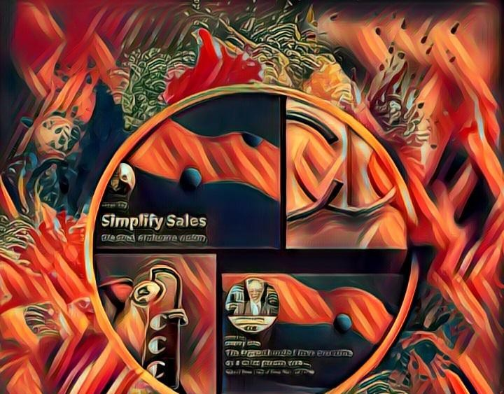
Simon Says Simplify Sales - Micro Podcast, Richard Blank,Costa Rica's Call Center, Outsourcing, Telemarketing, BPO, Nearshore, Sales, Entrepreneur, B2B, Business,Podcast,Gamification,Leadership,Marketing, Radio, Guest, Money, education, trainer,

Slide 13

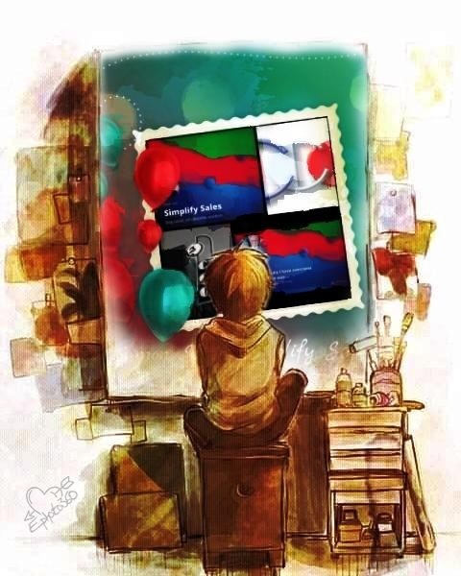

Slide 14
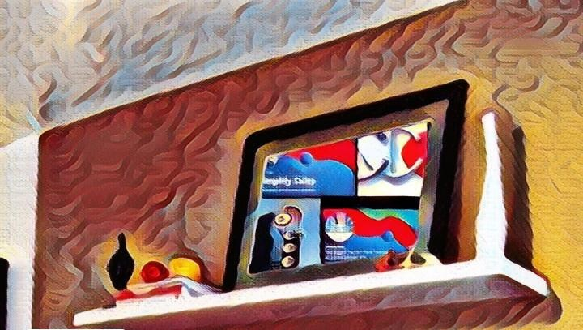


Slide 15
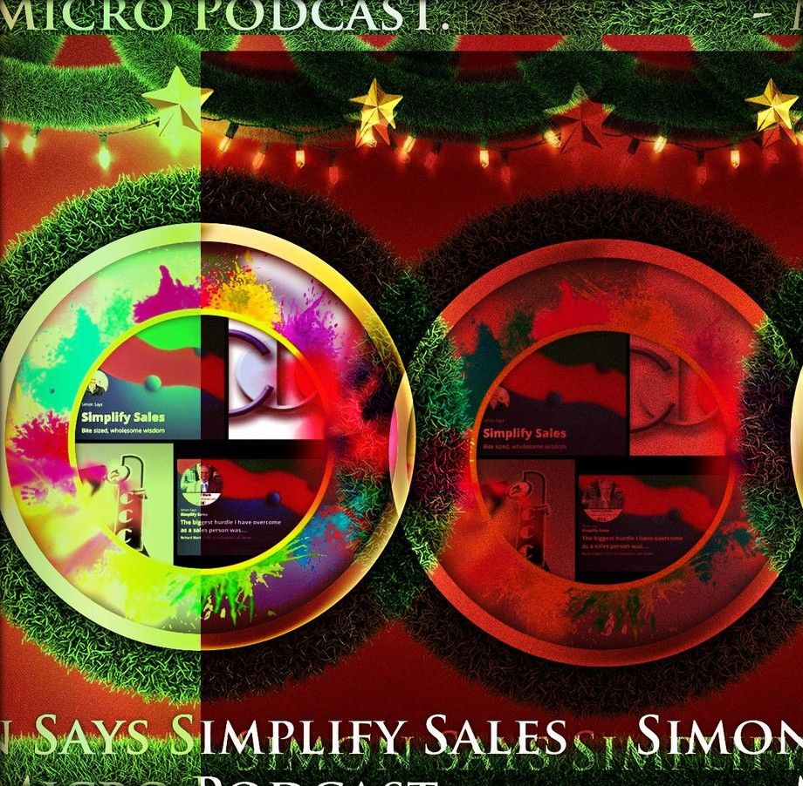

Slide 16


Slide 17


Slide 18


Slide 19


Slide 20


this is a recording of from Richard who is the CEO of the Costa Rica call center a hurdle I faced as a salesperson would be dedicated practice a lot of the times individuals will just jump on a phone

Slide 21
call go into meetings and not be very well versed I practice their pitch not understanding their rhetoric or how to
even build a rapport and so when making phone calls the greatest thing that I
could do was
listen to the recordings and to make certain adjustments because actions create reactions and one of the greatest things you can do is adjust your tone with specific types of vocabulary that could be more diplomatic and strategic and also being humble being vulnerable allowing yourself to be open-minded for suggestions I don't see it as more as critiquing because if individuals are taking the time to walk you through areas in which you should focus your attention or just Improvement
self-confidence and self-reliance I think it's fantastic especially if it's
one of your colleagues or an individual that you've done business with for a very long time that can call the balls and the strikes and let you know if your tie is crooked that day and so one of the greatest learnings I got from that
was to Pay It Forward by mastering these skills giving myself the luxury of a
track record and I felt confident enough to expand and to teach and train over ten thousand individuals here in local Costa Rica on how to make effective phone calls and so one of the greatest things anybody could ever do for
self-confidence and self-growth is self-analysis so by using this
technology and analyzing how you sound and the reactions of individuals you

Slide 22
will definitely be able to make this sort of adjustments to represent yourself in the best line and so I really can't thank enough that Simon Says simplify sales micro podcast I enjoyed my time today or Evita from Costa Rica

