Slide 1
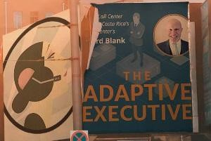
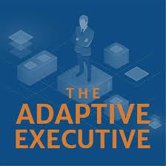
Downloaded from: justpaste.it/adaptiveexecutivepodcastguest
The Adaptive Executive Podcast by Greg Ballard. A Positive Call Centre Culture with Richard Blank.
Listen in on “The Adaptive Executive” where they share stories from leading executives and discuss how to keep yourself and your organization adaptive and your employees engaged. Special guest CEO Richard Blank.
Your host, Greg Ballard, talks with Richard Blank of Costa Rica's Call Center. Costa Rica's Call Center is a state of the art BPO Telemarketing outsource company that personally trains call centers across Central America. They are bilingual and professionally trained and they can do the same for your staff.
The Adaptive Executive podcast host, founder, and CEO of Five C Consulting Greg Ballard is based in Northern Virginia. Greg has 25+ years of extensive experience in management and leadership development for start-ups, corporate, entrepreneurial, and faith-based enterprises. Five C Consulting works with a diverse set of clients ranging from mid-size tech companies, large government agencies, military, and non-profits to radically improve strategic investments and organizational performance. Greg has led and managed over 300+ business units and has mentored more than 225 leaders.

Slide 2
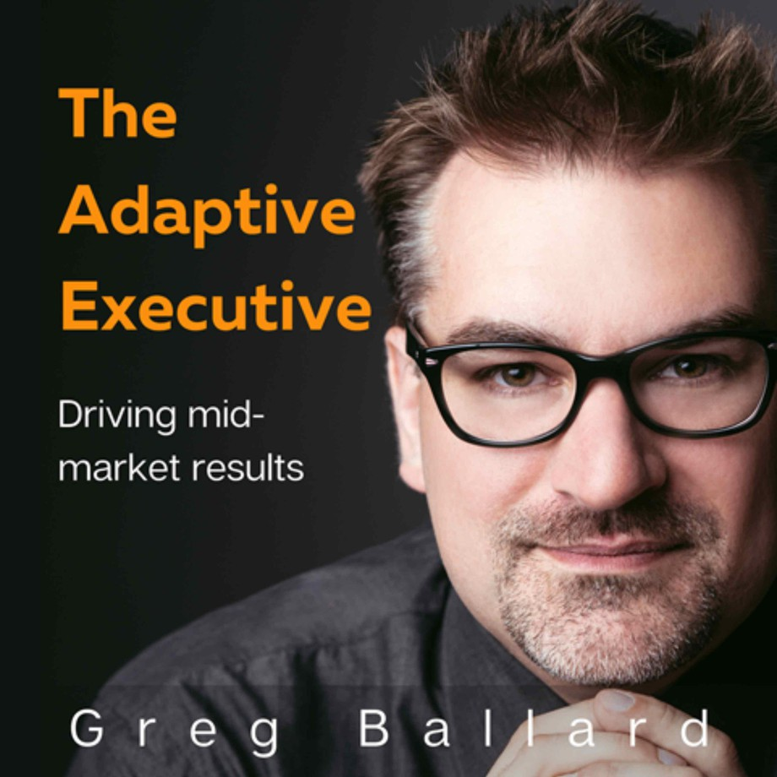
Listen in on “The Adaptive Executive” where they share stories from leading executives and discuss how to keep yourself and your organization adaptive and your employees engaged. In this episode, Greg Ballard and I discuss applying the mindset of being both adaptive as an executive and being innovative at the same time when working though organizational development processes and opportunities. Also hear why asking great questions can really have an impact on your team and the innovation in your organization. Check out the episode now!

Slide 3
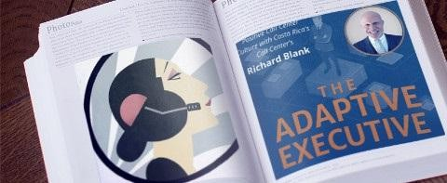
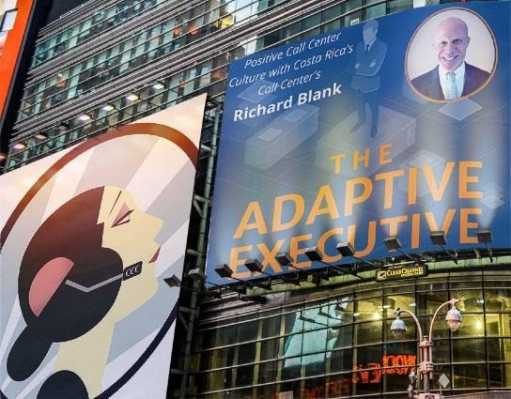
Greg Ballard is the founder and CEO of Five C Consulting, a boutique firm based in Washington, D.C. Metro. His company works with a diverse set of clients ranging from mid- sized tech companies, large government agencies, military, and non-profits to radically improve strategic people investments and organizational performance.
With over 20+ years of experience, Greg has developed extensive experience in management and leadership development through start-up, corporate, entrepreneurial, and faith-based enterprises.
In prior roles, Greg has led and managed business units of 300+ and has personally mentored over 225 leaders. Greg has facilitated 300+ classroom/workshop experiences and organized or supported 1,400 large event experiences.

Slide 4
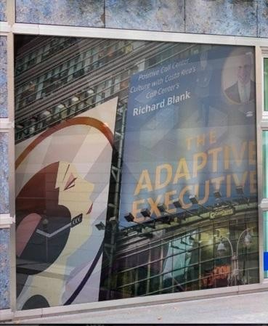

Over the past six years, Greg has actively worked with CEO’s, operational executives, mid- level managers, and small business owners to improve their mindset, business habits and overall approach to management and leadership. He has helped executive professionals improve productivity, communicating difficult feedback, navigating politics, influencing, strategic decision making, mindset, designing habits that last and other management and leadership challenges.
Greg holds an undergraduate degree in Cross-Cultural Communications and has participated in or led eight foreign service trips around the world. Greg is active in his community, a member of a regional chamber, and support of several non-profit organizations.

Slide 5


Interpersonal Communication Conflict Management Strategy
Phonetic Micro Expression reading for mastering verbal tell signs.
The Famous Buffer-Boomerang Technique
Advanced telemarketing strategy, conflict management, interpersonal soft skills, customer support, rhetoric, gamification, pinball machines, employee motivation and phonetic micro expression reading.

Slide 6
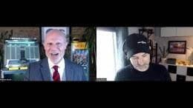
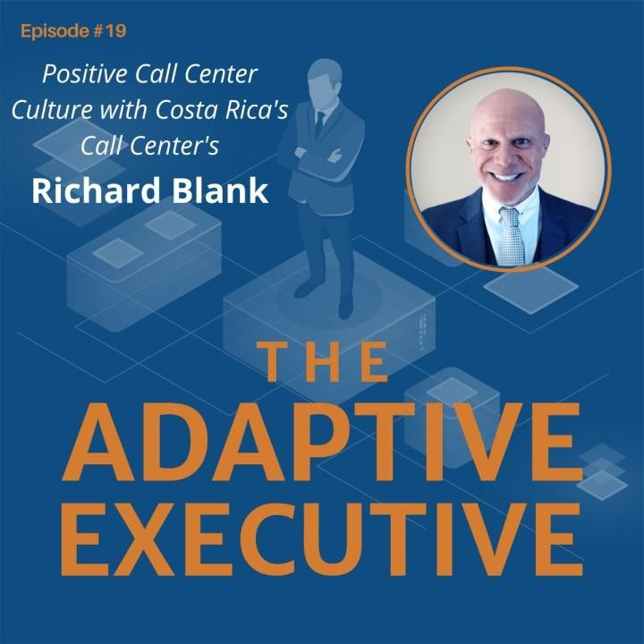
Richard’s vision quest journey is filled with twists and turns. At 27 years old, he relocated to Costa Rica to train employees for one of the larger call centers in San Jose. With a mix of motivational public speaking style backed by tactful and appropriate rhetoric, Richard shared his knowledge and trained over 10 000 bilingual telemarketers over two decades.
Richard Blank has the largest collection of restored American Pinball machines and antique Rockola Jukeboxes in Central America making gamification a strong part of CCC

Slide 7
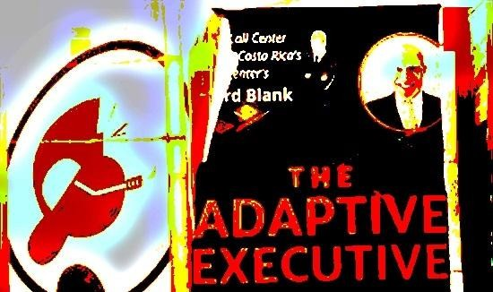

culture.Richard Blank is the Chief Executive Officer for Costa Rica’s Call Center since 2008.
Mr. Richard Blank holds a bachelors degree in Communication and Spanish from the University of Arizona and a certificate of language proficiency from the University of Sevilla, Spain.
A Keynote speaker for Philadelphia's Abington High School 68th National Honors Society induction ceremony. In addition, entered into the 2023 Hall of Fame for Business along side other famous alumni.

Slide 8

Paying it forward to Abington Senior High School is very important to Mr. Blank. As such, he endows a scholarship each year for students that plan on majoring in a world language at the university level.

Slide 9

Costa Rica’s Call Center (CCC) is a state of the art BPO telemarketing outsource company located in the capital city of San Jose, Costa Rica. Our main focus has been, and will always be to personally train each and every Central America call center agent so that we may offer the highest quality of outbound and inbound telemarketing solutions and bilingual customer service to small and medium sized international companies, entrepreneurs as well as fortune 500 companies.

Slide 10

https://costaricascallcenter.com/en/outbound-bpo-campaigns/

Slide 11


#THEADAPTIVEEXECUTIVE #GREGBALLARD #RichardBlank #CostaRica #CallCenter #Outsourcing #Telemarketing #BPO #Sales #Entrepreneur #B2B #Business #Podcast #Gamification #CEO #learnpodcasting #podcastepisode #podcastguest #podcasting #podcastinterview #podcastplaylist #podcasts #podcastskills #podcastshow
the adaptive executive, greg ballard, Richard Blank,Costa Rica's Call Center, Outsourcing, Telemarketing, BPO, Nearshore, Sales, Entrepreneur, B2B, Business,Podcast,Gamification,Leadership,Marketing, Radio, Guest, Money, education, trainer,

Slide 12
https://youtu.be/nDFhRVW3XXc?si=XhLnezaxHzYkpYO9

