Slide 1



Downloaded from: justpaste.it/TheVerifiedPhenomspodcast
The Verified Phenoms podcast by Phillip 'Phenom' Robinson. A Philly long shot with Richard Blank.
Summary:In this captivating episode of the Verified Phenoms podcast, we dive deep into the life and insights of Richard Blank, CEO of Costa Rica's Call Center. From his daring move at 27 to Costa Rica, to building a thriving business,
Here, you'll find valuable insights, actionable tips, and inspiring content to help you simplify your goals, increase productivity, and achieve higher success rates.
Summary:In this captivating episode of the Verified Phenoms podcast, we dive deep into the life and insights of Richard Blank, CEO of Costa Rica's Call Center.

Slide 2

From his daring move at 27 to Costa Rica, to building a thriving business, Richard shares his journey of courage, innovation, and the power of speaking a second language.

Slide 3

Listeners will discover the importance of vulnerability, embracing challenges, and the art of communication in achieving success.

Slide 4

Key Takeaways:Embrace Change: Richard's move to Costa Rica exemplifies the courage to embrace change for personal and professional growth.

Slide 5

Language as a Leverage: Mastery of a second language can be a significant advantage in the global market.

Slide 6


Vulnerability Equals Strength: Openness and authenticity pave the way for meaningful connections and success.

Slide 7

The Power of Persistence: Overcoming challenges through perseverance and a positive mindset
.Importance of Soft Skills: Effective communication and empathy are key in leadership and business.Leveraging Past Experiences: Every past experience can be a stepping stone for future opportunities.

Slide 8

Quotes:"You have to be vulnerable to be powerful." (22:31)"It's not about chasing cash; it's about being authentic." (22:59)"Structure and discipline are the foundations for success."

Slide 9

(26:02)"Mistakes are just lessons in disguise." (30:45)"Every challenge is an opportunity to prove your resilience." (50:26)

Slide 10

Timestamp Chapters:00:00 - Introduction: The Courageous Leap to Costa Rica03:00 - The Impact of Language and Education10:00 -

Slide 11


Building a Business from the Ground Up22:00 - The Role of Vulnerability in Leadership30:00 - Embracing Imperfection and Authenticity40:00 - The Importance of Soft Skills in the Call Center Industry50:00 - Overcoming Challenges with Positivity

Slide 12
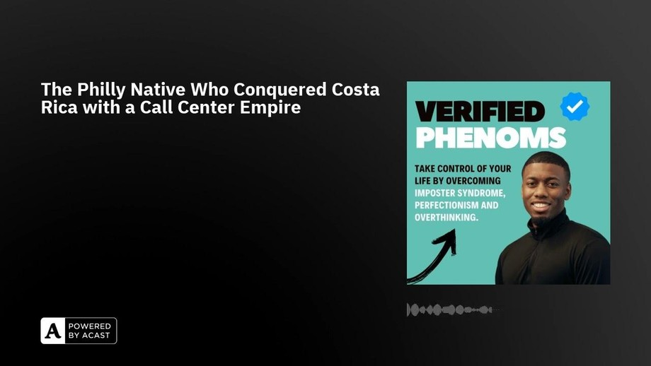
Phillip 'Phenom' Robinson is the author of the book, Ignore The Fluff and now teaches young adults, influencers, and creatives how to simplify their goals to increase productivity for a higher success rate.
Phenom is a North Carolina native that graduated a year early from North Carolina Central University with a degree in Media Broadcast while running Cross Country & Track & Field.

Slide 13
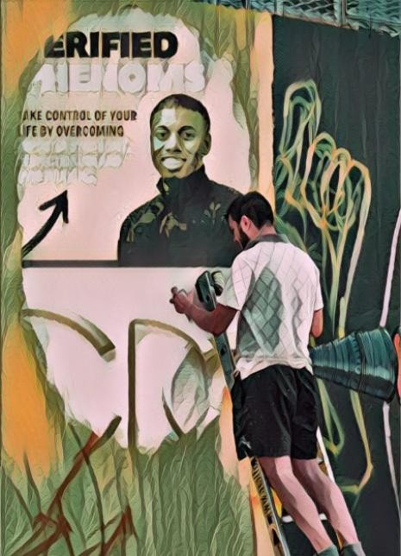
Phenom is a Professional Speaker, 3x Author, 2x TEDx Speaker, Boxer, college Instructor, Mentor, and ESPN+ Producer.

Slide 14

Whether you're seeking personal growth, professional development, or entrepreneurial insights, you'll discover a wealth of knowledge and inspiration here. Together, let's become 1% better.

Slide 15

Phenom started his professional career in television at 14 years old. By age 24 he became an ESPN+ Producer and a camera operator for the ACC Network.

Slide 16


His career in television led him to develop a passion for storytelling.
He used this passion for pushing him to; present two TEDx talks, write three books Be Phenomenal Or Be Forgotten: Taking Your Life To The Next Level, Execute: The Secrets To Fast Success, and Force(d) To Grow, release a motivational album, and host a top 10% globally ranked podcast.

Slide 17

Understanding that everything he had accomplished hadn’t happened by accident, he developed a teachable execution framework.

Slide 18

Phenom became a certified Life Coach to teach others how to reach their goals.
Phillip 'Phenom' Robinson is the author of the upcoming book, "Force(d) To Grow: 6 Steps To Fearless Success" and now teaches young adults, influencers, and creatives how to simplify their goals to increase productivity for higher success rate.

Slide 19

I'm your go-to expert for crafting a life of clarity, purpose, and unstoppable success. Leveraging my extensive background in media, sports, and motivational speaking, I guide young adults to amplify their productivity and establish a strong personal brand for long-term achievement. My speaking topics include:
Building Your Brand: I provide practical tools and strategies to cultivate a brand that resonates with their authentic selves and connects with their desired audience.

Slide 20

Burnout: I used to sleep in the closet at work from exhaustion. It's true, no one cares about burnout until you burn out. Let’s talk about being proactive so you can keep striving.
LinkedIn: If we can be on TikTok and Instagram then we can be on LinkedIn too! Many students are scared of how professional LinkedIn is. Let’s break down those fears and learn how to excel.

Slide 21

Success for All: Success is for everyone but not everyone knows how to achieve it. My life coaching and speaking engagements center around this philosophy, providing inclusive frameworks that help individuals from diverse backgrounds achieve their definition of success.

Slide 22

Richard’s vision quest journey is filled with twists and turns. At 27 years old, he relocated to Costa Rica to train employees for one of the larger call centers in San Jose. With a mix of

Slide 23


motivational public speaking style backed by tactful and appropriate rhetoric, Richard shared his knowledge and trained over 10 000 bilingual telemarketers over two decades.
Richard Blank has the largest collection of restored American Pinball machines and antique Rockola Jukeboxes in Central America making gamification a strong part of CCC culture.Richard Blank is the Chief Executive Officer for Costa Rica’s Call Center since 2008.
Mr. Richard Blank holds a bachelors degree in Communication and Spanish from the University of Arizona and a certificate of language proficiency from the University of Sevilla, Spain.

Slide 24

A Keynote speaker for Philadelphia's Abington High School 68th National Honors Society induction ceremony. In addition, entered into the 2023 Hall of Fame for Business along side other famous alumni. Paying it forward to Abington Senior High School is very important to Mr. Blank. As such, he endows a scholarship each year for students that plan on majoring in a world language at the university level.
Costa Rica’s Call Center (CCC) is a state of the art BPO telemarketing outsource company located in the capital city of San Jose, Costa Rica. Our main focus has been, and will always be to personally train each and every Central America call center agent so that we may offer the highest quality of outbound and inbound telemarketing solutions and bilingual customer service to small and medium sized international companies, entrepreneurs as well as fortune 500 companies.
https://costaricascallcenter.com/en/outbound-bpo-campaigns/
the Verified Phenoms podcast, Phillip 'Phenom' Robinson, Richard Blank, Costa Rica's Call Center, Outsourcing, Telemarketing Call Centre, BPO, Nearshore Contact Center, Sales,

Slide 25

Entrepreneur, B2B, Business, Podcast, Gamification,Leadership, Marketing, CX, Guest, Money, B2C education, BPO trainer,
#theVerifiedPhenomspodcast #PhillipPhenomRobinson #CostaRica #CallCenter #Outsourcing #Telemarketing #BPO #Sales #Entrepreneur #B2B #Business #Podcast #Gamification #CEO #learnpodcasting #podcastepisode #podcastguest #podcasting #podcastinterview #podcastplaylist #podcasts #podcastskills #podcastshow

