Slide 1
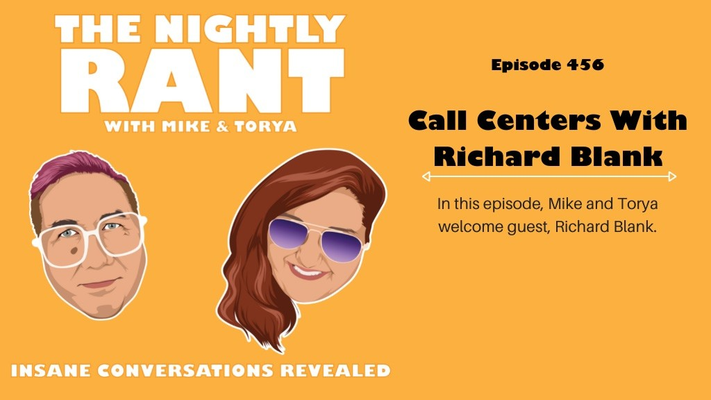
The Nightly Rant podcast: The life of a call centers CEO with Richard Blank! TNR456

Slide 2

Dive into a world where politics, humor, fltness, erotica, and sarcasm collide, curated for the free thinker who marches to the beat of their own drum. The show

Slide 3

where our insane conversations are made public for all to enjoy.
Welcome to Yogi's Podcast Network – where our CEO has more fur than your average

Slide 4

executive and delivers content that bites (with humor, not teeth)! Led by the ﬂuffiest boss in the biz, Yogi's Podcast Network is where kickass content reigns supreme.

Slide 5
Whether you're here to challenge your mind, tickle your funny bone, or get your heart racing, we've got the goods. Strap in for a wild ride with the network shaking up the podcast world, one bark at a time. Join the pack. It's a howling good time!

Slide 6

Michael Mahony opens the show talking about calls from unknown random numbers trying to scam him.

Slide 7

Today’s guest is Richard Blank. Mike introduces him, who is the chief executive officer for CCC, a call center in San Jose, Costa Rica.

Slide 8

Richard and Mike discuss how Richard got into the call center profession.

Slide 9
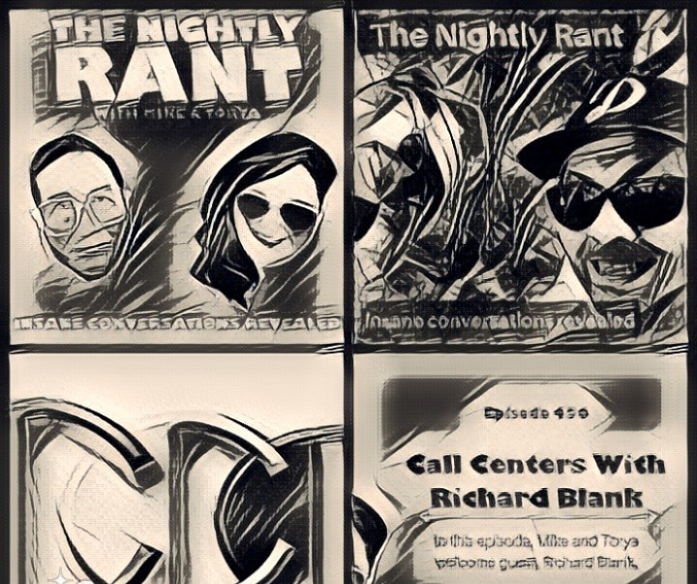
Richard talks about the difference between illegitimate call centers and legitimate call centers. This leads to Mike discussing the scammers that social media

Slide 10

managers and virtual assistant’s come across. The conversation of how to detect scammers is approached.

Slide 11

Next topic of conversation is about telemarketers, call centers off-shore and unethical companies.
Torya asks Richard what his ‘big red is’ and what is his biggest

Slide 12

frustration.
Feeling like a lone wolf in your thoughts? Well, in Yogi's pack, you're in good company!

Slide 13

Do you have a podcast idea that's itching to break free or need a wizard's touch on your current show?

Slide 14

What IS The Nightly Rant?
It is a show that examines social settings and presents them from an extremely unique perspective. It is the insane conversations of Mike and Torya (your hosts) revealed. It is the ﬂagship show for Yogi's Podcast Network!

Slide 15

Nothing is off limits on The Nightly Rant. The crew has discussed their neighbors, people who travel on the Los Angeles Metro trains, friends, soccer parents, criminals and their zoo.

Slide 16
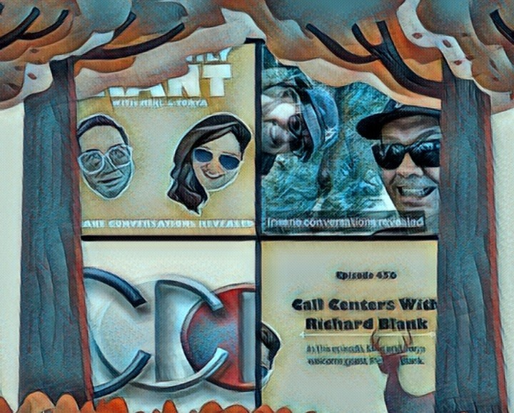
The Nightly Rant is pure comedy that isn't intended to be funny, but you will quickly discover that everyday life is funny.

Slide 17

Advanced telemarketing strategy, conﬂict management, interpersonal soft skills, customer support, rhetoric, gamiflcation, pinball machines, employee

Slide 18

motivation, tell signs through phonetic micro expression reading, the pros and cons of A.I and flnally, The Famous Buffer- Boomerang Technique
Richard’s vision quest journey is fllled with twists and turns. At 27 years old, he relocated to Costa

Slide 19
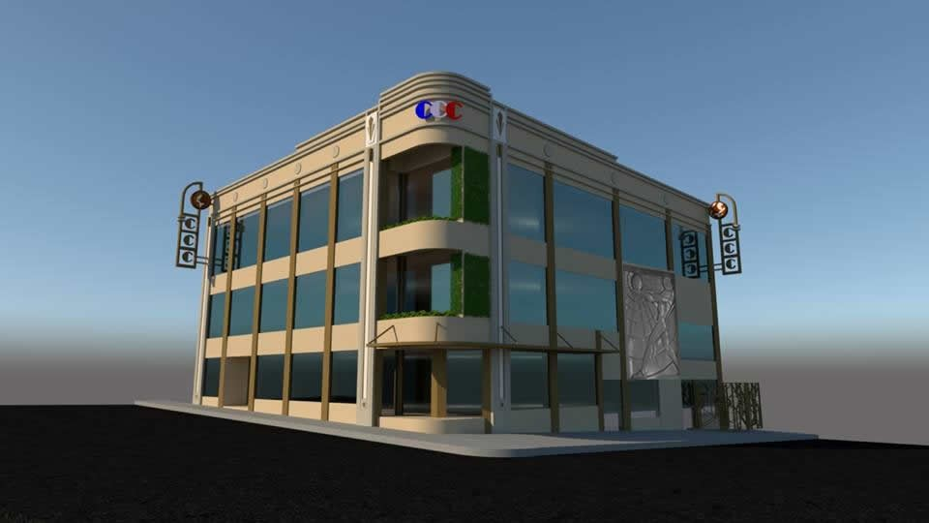
Rica to train employees for one of the larger call centers in San Jose. With a mix of motivational public speaking style backed by tactful and appropriate rhetoric, Richard shared his knowledge and trained over 10 000 bilingual telemarketers over two decades.

Slide 20
Richard Blank has the largest collection of restored American Pinball machines and antique Rockola Jukeboxes in Central America making gamiflcation a strong part of CCC culture.Richard Blank is the Chief Executive Officer for Costa Rica’s Call Center since 2008.

Slide 21

Mr. Richard Blank holds a bachelors degree in Communication and Spanish from the University of Arizona and a certiflcate of language proflciency from the University of Sevilla, Spain.

Slide 22

A Keynote speaker for Philadelphia's Abington High School 68th National Honors Society induction ceremony. In addition, entered into the 2023 Hall of Fame for Business along side other famous alumni. Paying it forward to Abington Senior High School is very important to Mr.

Slide 23

Blank. As such, he endows a scholarship each year for students that plan on majoring in a world language at the university level.
Costa Rica’s Call Center (CCC) is a state of the art BPO telemarketing outsource company located in the capital city of San Jose, Costa Rica. Our main focus has been,

Slide 24
and will always be to personally train each and every Central America call center agent so that we may offer the highest quality of outbound and inbound telemarketing solutions and bilingual customer service to small and medium sized international companies, entrepreneurs as well as fortune 500 companies.

Slide 25
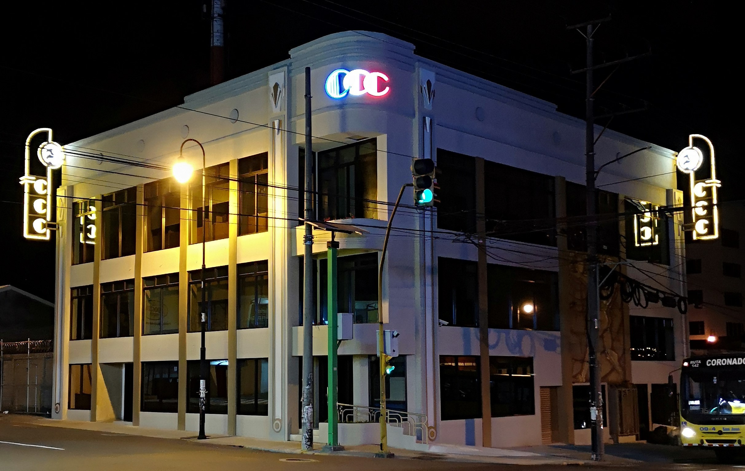
https://costaricascallcenter.com/e n/outbound-bpo-campaigns/
the nightly rant, Richard Blank,Costa Rica's Call Center, Outsourcing, Telemarketing Call Centre, BPO, Nearshore Contact

Slide 26
Center, Sales, Entrepreneur, B2B, Business, Podcast, Gamiflcation,Leadership, Marketing, CX, Guest, Money, B2C education, BPO trainer,
#thenightlyrant #RichardBlank #CostaRica #CallCenter #Outsourcing #Telemarketing #BPO #Sales #Entrepreneur #B2B #Business #Podcast #Gamiflcation #CEO #learnpodcasting #podcastepisode #podcastguest #podcasting #podcastinterview

Slide 27
#podcastplaylist #podcasts #podcastskills #podcastshow
https://youtu.be/1G5PoTpeKa4? si=R-NT7sDXCgQk8CEg

