Slide 1


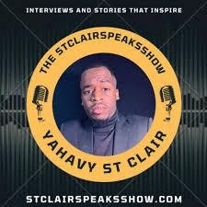
Downloaded from: justpaste.it/TheStclairspeaksshow
The Stclair speaks show featuring YAHAVY ST CLAIR. Special nearshore BPO guest Richard Blank
“No one cares about your brand until they know your story.”
"Turn your Ideas into income, mastering your ideas will master your income." -Yahavy St Clair.
The StclairSpeaksshow is an interview format podcast show where I highlight and showcase professionals in business from across the world, we discuss topics from within their industry expertise and dive into their backstory on how they got to where they are today.

Slide 2
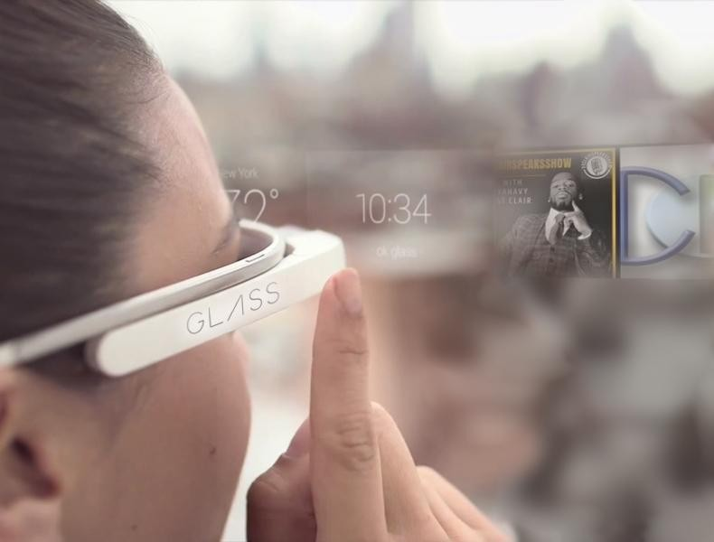
A serial entrepreneur from new york city I sold comedy tickets in the streets of times square new york city for seven years which has helped me turn my obstacles into opportunities with my gift for gab ability naturally I use my personality to showcase my comedic side in my content as a content creator promoting my podcast.

Slide 3
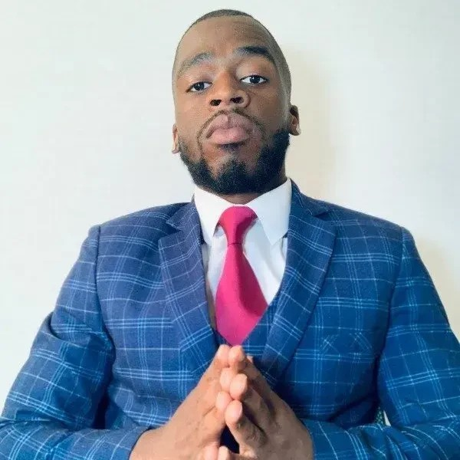
I've done voiceovers for a cartoon project I currently recording in the process I love what I do and how I can pull people in as a speaker.

Slide 4
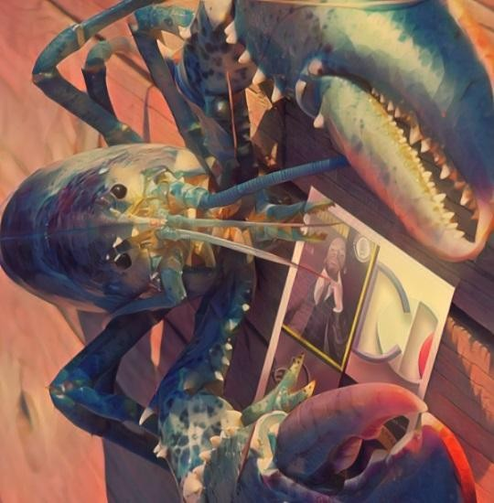
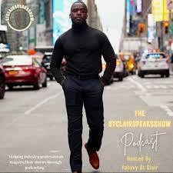
Finding voices.com was the missing puzzle for me to find my power voice and bring life to the characters and roles I play.
Author, Podcaster & Entrepreneur

Slide 5
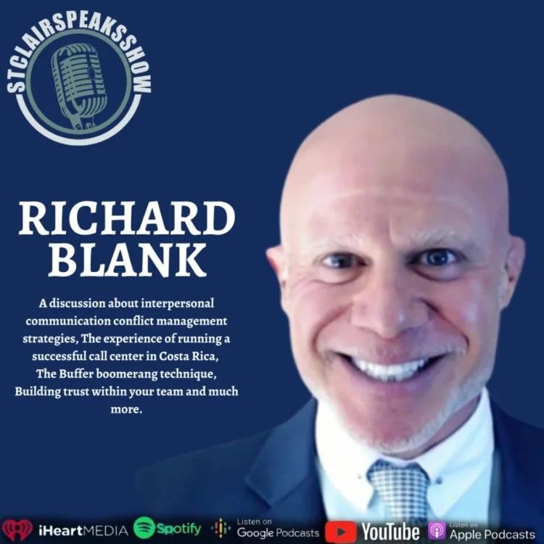
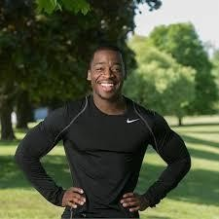
“No one cares about your brand until they know your story.”

Slide 6

Passionate storytelling entrepreneur from New York
City, helping industry professionals magnify their stories and expand their brands through podcasting.
YAHAVY ST CLAIR - BIOGRAPHY
My passion for motivational speaking sparked through my own traumatic experiences of pursuing something much larger than myself.

Slide 7
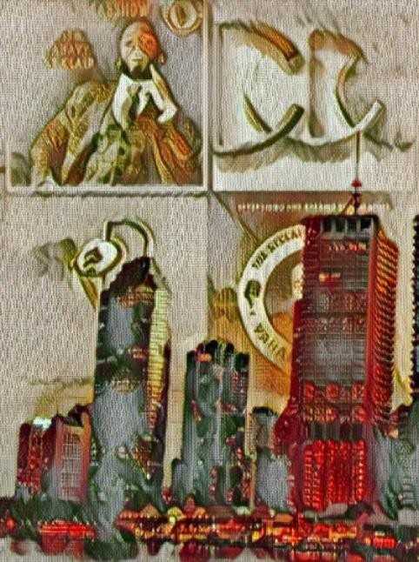
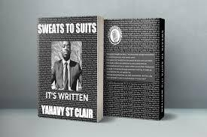
I'm a passionate pioneer who turned his obstacles into opportunities with my gift for gab ability. Growing up from humble beginnings in Queens, NYC.
I went from the streets of times square NYC selling comedy tickets to make ends meet to speaking on stages speaking in front of large crowds.

Slide 8
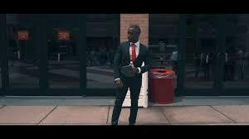
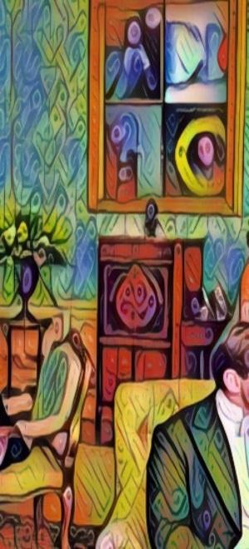
What I've learned from rock bottom prepared me to stand tall on mountain tops today. One of the many topics I educate people about through storytelling is emotional learning. I've discovered how to uncover the power of mastering my emotional mindset.
Allowing my mind to work for me, not against me.

Slide 9
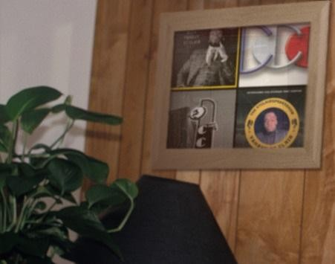
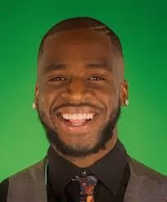
Finding ways to break out of addictions by creating internal ambition. The experience you gain is a real investment. As a marketing consulting client.
YAHAVY ST CLAIR
TOPICS - • Branding • Business • Consulting • Growth
Marketing • Motivation • Sales • Winning YAHAVY ST CLAIR - PROGRAMS

Slide 10
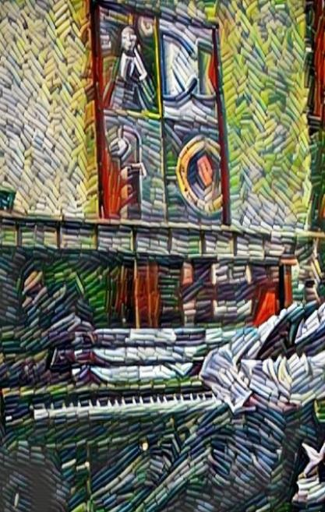
Brand Awareness
Authentic Automation Services

Slide 11
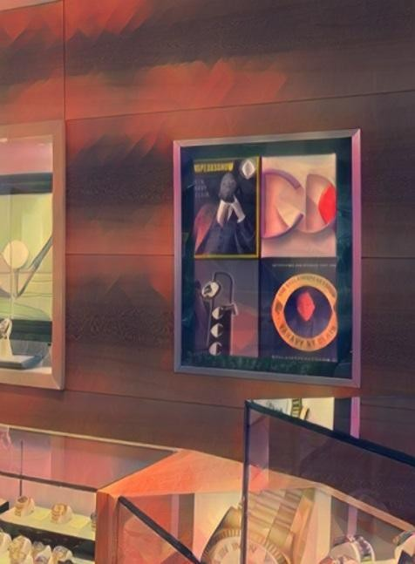
Prospecting Within Your Niche Market Develop and Grow Click Funnel Triggers

Slide 12

The Art of the Up-selling Funnel Numbers Don't Lie

Slide 13

Richard’s vision quest journey is filled with twists and turns. At 27 years old, he relocated to Costa Rica to train employees for one of the larger call centers in San Jose.

Slide 14

With a mix of motivational public speaking style backed by tactful and appropriate rhetoric, Richard shared his knowledge and trained over 10 000 bilingual telemarketers over two decades.

Slide 15
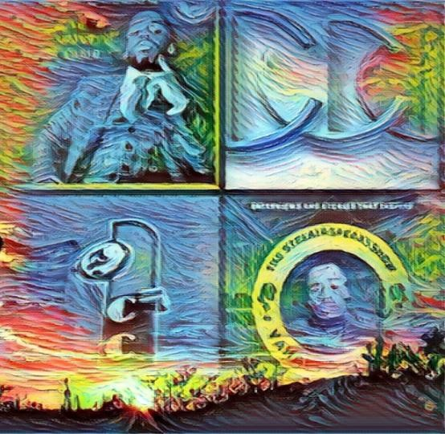
Richard Blank has the largest collection of restored American Pinball machines and antique Rockola Jukeboxes in Central America making gamification a strong part of CCC culture.Richard Blank is the Chief Executive Officer for Costa Rica’s Call Center since 2008.

Slide 16
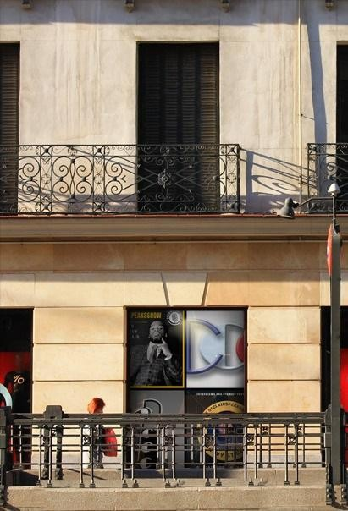
Mr. Richard Blank holds a bachelors degree in Communication and Spanish from the University of Arizona and a certificate of language proficiency from the University of Sevilla, Spain.

Slide 17
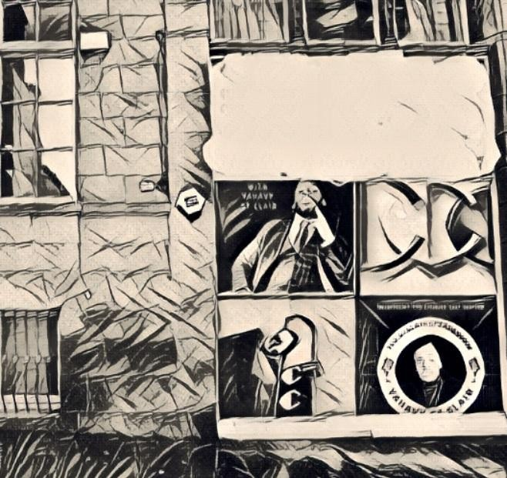
A Keynote speaker for Philadelphia's Abington High School 68th National Honors Society induction ceremony. In addition, entered into the 2023 Hall of Fame for Business along side other famous alumni. Paying it forward to Abington Senior High School is very important to Mr. Blank. As such, he endows a scholarship each year for students that plan on majoring in a world language at the university level.

Slide 18
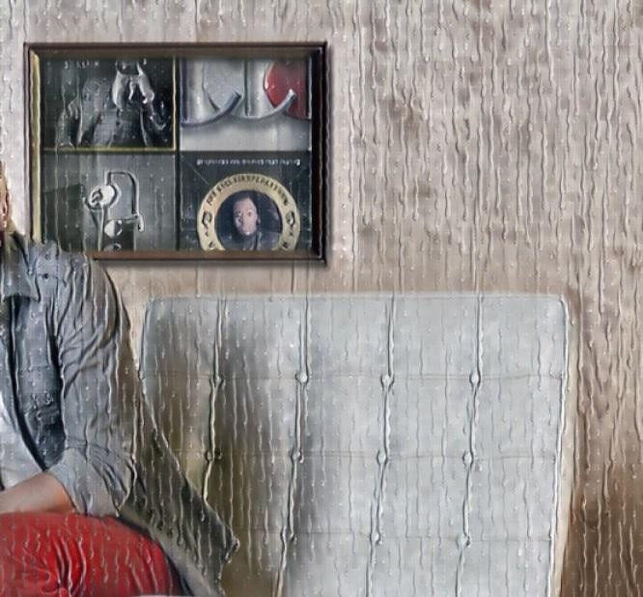
Costa Rica’s Call Center (CCC) is a state of the art BPO telemarketing outsource company located in the capital city of San Jose, Costa Rica. Our main focus has been, and will always be to personally train each and every Central America call center agent so that we may offer the highest quality of outbound and inbound telemarketing solutions and bilingual customer service to small and medium sized international companies, entrepreneurs as well as fortune 500 companies.

Slide 19

https://costaricascallcenter.com/en/outbound-bpo-campaigns/

Slide 20
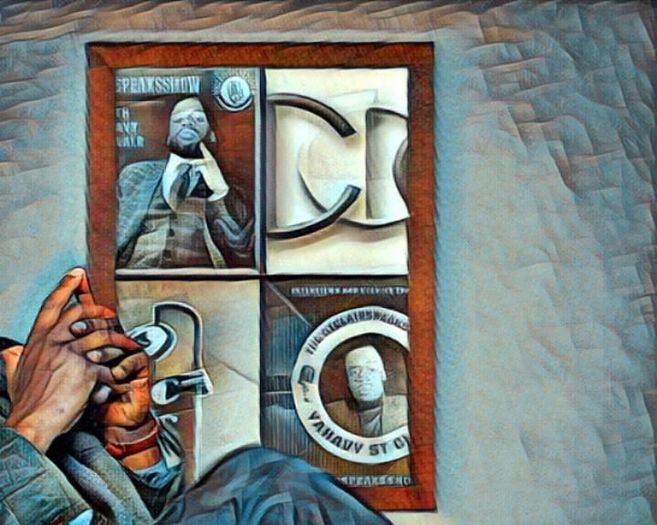
YAHAVY ST CLAIR, The Stclairspeaks show,Richard Blank, Costa Rica's Call Center, Outsourcing, Telemarketing Call Centre, BPO, Nearshore Contact Center, Sales, Entrepreneur, B2B, Business, Podcast, Gamification,Leadership, Marketing, CX, Guest, Money, B2C education, BPO trainer,

Slide 21

#YAHAVYSTCLAIR #TheStclairspeaksshow #RichardBlank #CostaRica #CallCenter #Outsourcing #Telemarketing #BPO #Sales #Entrepreneur #B2B #Business #Podcast #Gamification #CEO #learnpodcasting #podcastepisode #podcastguest #podcasting #podcastinterview #podcastplaylist #podcasts #podcastskills #podcastshow

Slide 22


Slide 23


Slide 24

https://youtu.be/1wFdOrNAuQ4?si=M3dWNtwV0M4BOt8H

Slide 25


Slide 26



Slide 27


