Slide 1



Downloaded from: justpaste.it/WhatTheShitPodcast
What The Shit Podcast Hosted by Darius DC Chambers. Business 101 guest Richard Blank.
What The Shit Podcast is a mancave podcast for the people where we talk to dope people and their life and what they have going on. We also talk and real life and have fun talk and documenting life in our own way. Real Raw and unfiltered. Safe Space Real Talk for Real People. Anyb
What The Shit Podcast is a mancave podcast for the people where we talk to dope people and their life and what they have going on.

Slide 2

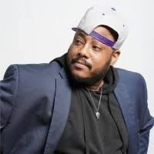
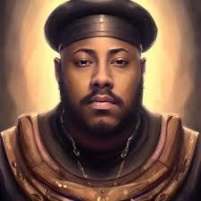
We also talk and real life and have fun talk and documenting life in our own way.
Real Raw and unfiltered. Safe Space Real Talk for Real People. Anybody can these jokes. Hosted By Darius DC Chambers
A Podcast/Talk Show recorded live on Facebook, YouTube and Twitch talking about a wide range of topics and opinions from different points of views.
A Man Cave podcast for everyone to enjoy and relate to. Real Talk for Real People.

Slide 3
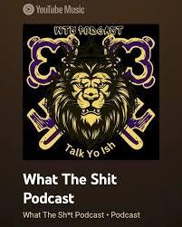
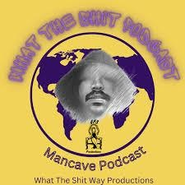

Anybody can these jokes. We have guests who showcase their work.
Welcome to What The Shit Podcast!
Hosted by Darius DC Chambers, this podcast is your go-to destination for real talk and laughter.

Slide 4
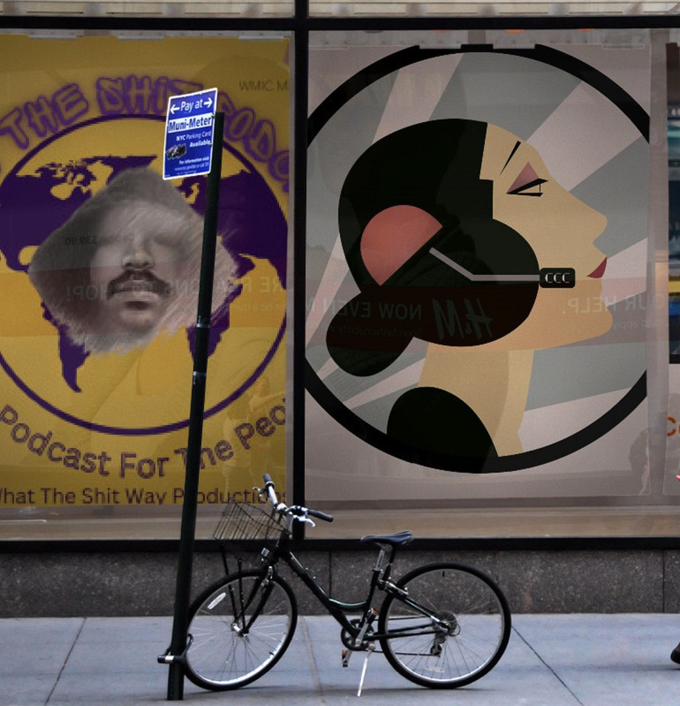
We dive into a wide range of topics, offering diverse opinions and perspectives.

Slide 5

Whether you’re looking for insightful discussions or just a good laugh, we’ve got you covered.

Slide 6

Topics we discuss include:

Slide 7
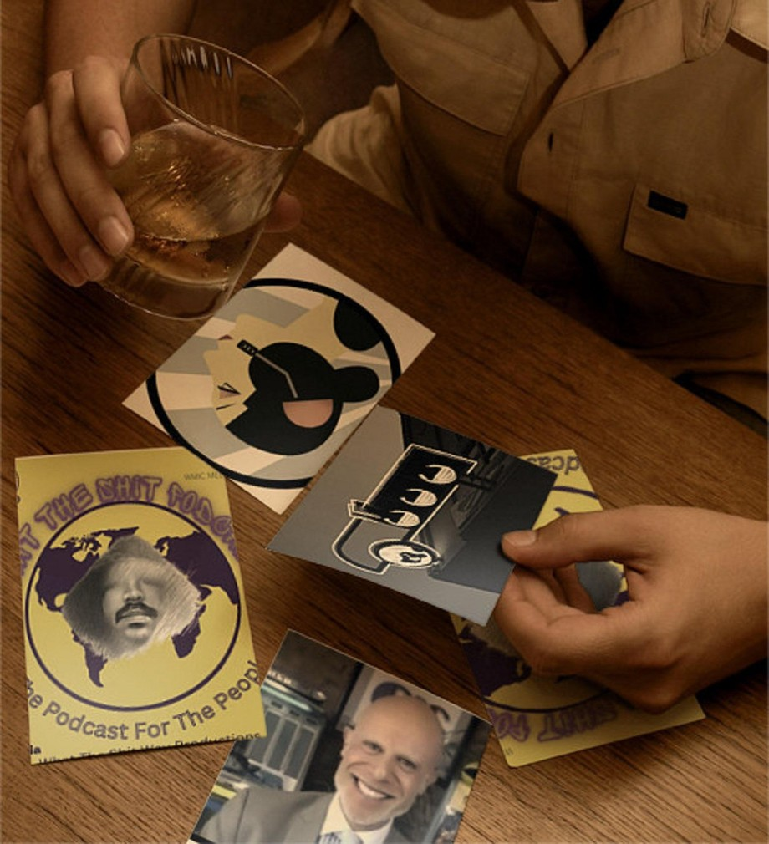
Pop Culture Debates: From Beyoncé vs. Rihanna to Drake vs. Kendrick, we explore the biggest rivalries and trends in music and entertainment.

Slide 8


Slide 9


Parenting Tips: Navigating the challenges of co-parenting, effective discipline strategies, and celebrating fatherhood, especially within the Black community.
Mental Health: Conversations about mental wellness, breaking stereotypes, and providing support for fathers.
Sports: In-depth analysis of iconic sports rivalries and achievements in women’s basketball.

Slide 10

Guest Interviews: Featuring creators, influencers, and experts who share their journeys and insights.
Join us for a mix of humor, heartfelt stories, and thought-provoking discussions. Follow us on social media and be part of the conversation. Real talk for real people.

Slide 11

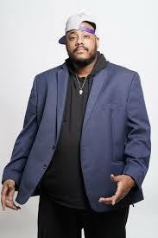
Tune in and enjoy the ride! Darius DC Chambers
Host of What the Shit Podcast a live show every Wednesday at 8pm est on Facebook page What The Stuff Podcast and YouTube WTS Podcast and Twitch wtspodcast and Twitter. Open

Slide 12
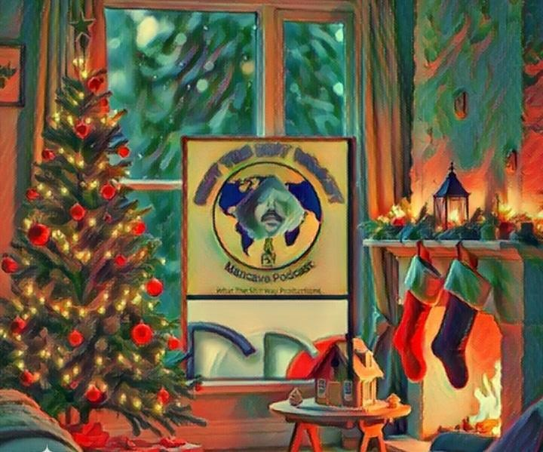
for collaboration and networking. I do all my own editing, producing and promoting and booking of guest.
What The Shit is a 90-120 mins podcast/show that pulls no punches and are honest. From Sports to movies to music and everything in between. We talk to guest and let them tell their story and talk to the people. It’s a live podcast that runs like a radio/talk show. It’s fun for all with plenty of laughs and insight along the way. With original segments like “Get it off your chest” which is out rant segment and “Parting Shots” is the last word and thoughts for the cast and guests.

Slide 13

Being True to Yourself: A Personal Triumph
And the fact that I had done something like this, it might seem selfish or egocentric. But how could it be egocentric, gentlemen, if I'm feeding over 100 families a month and giving them their job security? The fact that I fell in love and married someone in Costa Rica and built a business with her, learned a second language, followed my dreams. Just because I'm a dreamer and I'm a Renaissance man, it doesn't mean that I'm different. It's just I'm once again being exceptionally true to myself. And so I can look at myself in the mirror at the end of the day and raise my head up high, give myself five and say, good job, Richie. You did it again.

Slide 14

Unique Career Paths: Embracing Language and Opportunity
You hire specialists and individuals, you need to delegate. In order to expand, you need branches and roots. But my thing was done a little bit differently, gentlemen. When I was in

Slide 15

Northeast Philadelphia, graduating Abington High School, my favorite class was Spanish. So unlike my friends that were taking finance, law, and medicine and going to Ivy League, I chose the University of Arizona. So I was just doubling down on languages. I interned for Telemundo, worked for the importers of Corona. So obviously... I had the language capacity and the skill set. And so when my friend who gave me a one in a million opportunity at 27 years old, 22 years ago, to come to Costa Rica for two months just to teach English at his call center, of course I was going to go
Interpersonal Communication Conflict Management Strategy
Phonetic Micro Expression reading for mastering verbal tell signs.
The Famous Buffer-Boomerang Technique
Advanced telemarketing strategy, conflict management, interpersonal soft skills, customer support, rhetoric, gamification, pinball machines, employee motivation and phonetic micro expression reading.

Slide 16

Richard’s vision quest journey is filled with twists and turns. At 27 years old, he relocated to Costa Rica to train employees for one of the larger call centers in San Jose. With a mix of motivational public speaking style backed by tactful and appropriate rhetoric, Richard shared his knowledge and trained over 10 000 bilingual telemarketers over two decades.
Richard Blank has the largest collection of restored American Pinball machines and antique Rockola Jukeboxes in Central America making gamification a strong part of CCC culture.Richard Blank is the Chief Executive Officer for Costa Rica’s Call Center since 2008.

Slide 17

Mr. Richard Blank holds a bachelors degree in Communication and Spanish from the University of Arizona and a certificate of language proficiency from the University of Sevilla, Spain.
A Keynote speaker for Philadelphia's Abington High School 68th National Honors Society induction ceremony. In addition, entered into the 2023 Hall of Fame for Business along side other famous alumni. Paying it forward to Abington Senior High School is very important to Mr. Blank. As such, he endows a scholarship each year for students that plan on majoring in a world language at the university level.

Slide 18

Costa Rica’s Call Center (CCC) is a state of the art BPO telemarketing outsource company located in the capital city of San Jose, Costa Rica. Our main focus has been, and will always be to personally train each and every Central America call center agent so that we may offer the highest quality of outbound and inbound telemarketing solutions and bilingual customer service to small and medium sized international companies, entrepreneurs as well as fortune 500 companies.
https://costaricascallcenter.com/en/outbound-bpo-campaigns/
#DariusDCChambers #WhatTheShitPodcast #RichardBlank #CostaRica #CallCenter #Outsourcing #Telemarketing #BPO #Sales #Entrepreneur #B2B #Business #Podcast #Gamification #CEO #learnpodcasting #podcastepisode #podcastguest #podcasting #podcastinterview #podcastplaylist #podcasts #podcastskills #podcastshow
Darius DC Chambers, What The Shit Podcast, Richard Blank, Costa Rica's Call Center, Outsourcing, Telemarketing, BPO, Nearshore, Sales, Entrepreneur, B2B, Business,Podcast,Gamification,Leadership,Marketing, Radio, Guest, Money, education, trainer,

Slide 19

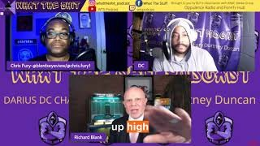

Slide 20
