Slide 1


Downloaded from: justpaste.it/wethrive
weTHRIVE Podcast. A Philadelphia entrepreneur living in Costa Rica has what it takes. Episode 45.
Casey Clark interviews Richard Blank, CEO of Costa Rica's Call Center in episode 45 of the weTHRIVE podcast. We Thrive Podcast has accepted Richard Blank's invitation to join the audience for a solid discussion regarding starting a company from scratch in Costa Rica
Every day, entrepreneurs around the world wonder if they have what it takes.

Slide 2
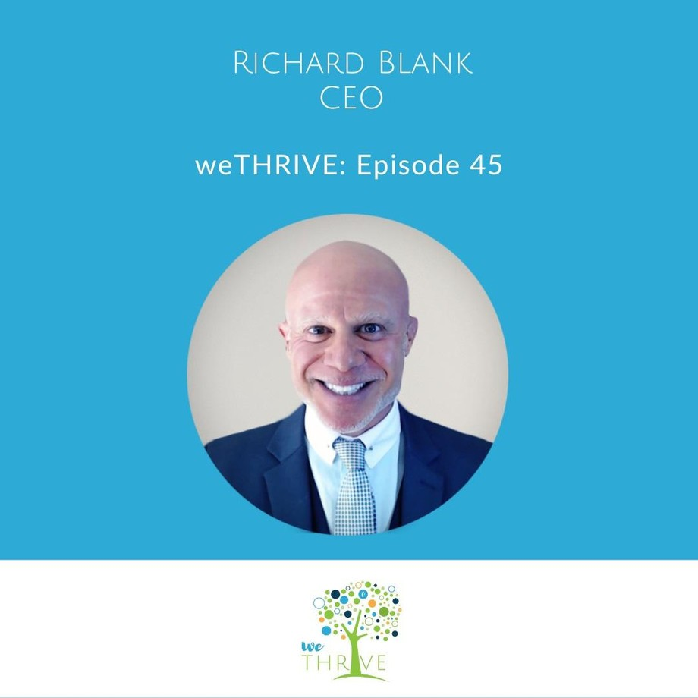
What it takes to put food on the table, keep clothes on their back, keep a roof over their head, build a successful business, and even if they have what it takes to create and be a part of something bigger than themselves.

Slide 3
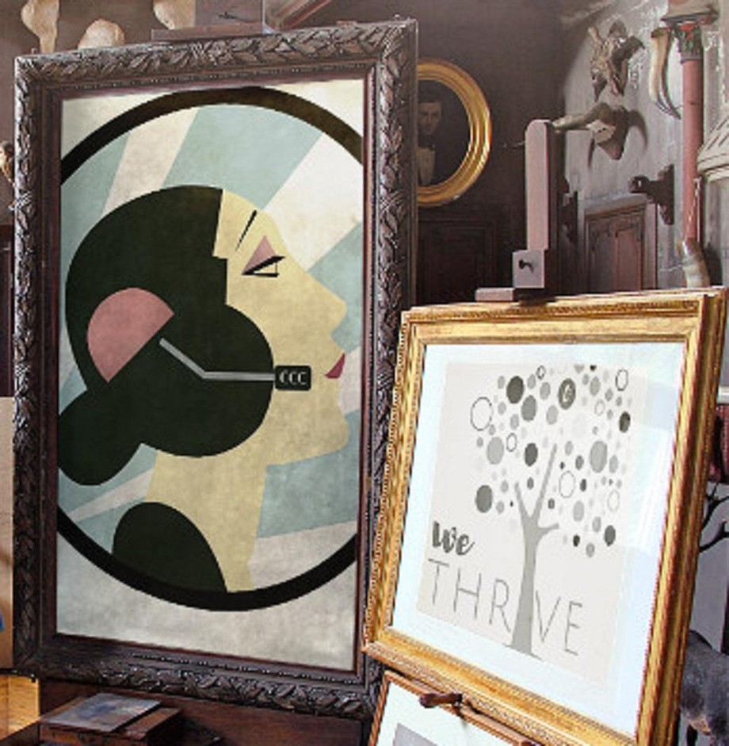
During each episode, Casey Clark, founder of C Clark Consulting, interviews other entrepreneurs to learn more about what it means to them to thrive, how they’re using their business in creating an impactful legacy, and what has tried to get in their way. These stories will resonate with your soul as they inspire you to manifest your vision!

Slide 4
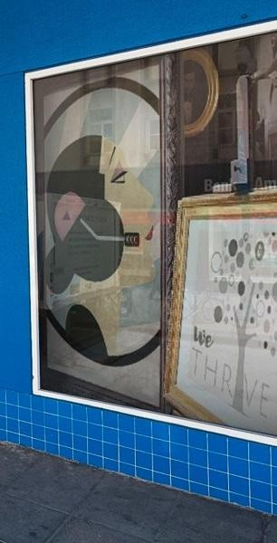
Casey Clark interviews Richard Blank, CEO of Costa Rica's Call Center in episode 45 of the weTHRIVE podcast.
We Thrive Podcast has accepted Richard Blank's invitation to join the audience for a solid discussion regarding starting a company from scratch in Costa Rica as an expat.

Slide 5
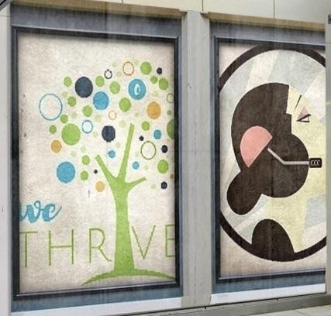
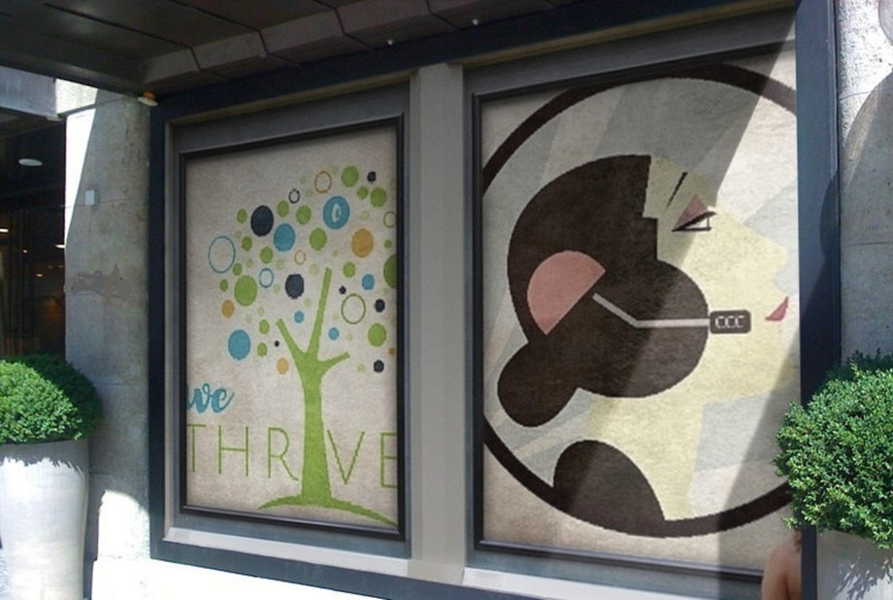
Topics discussed with Richard: advanced telemarketing strategy, conflict management, interpersonal soft skills, customer support, rhetoric, gamification, pinball machines, employee motivation, phonetic micro expression reading.
Richard’s journey in the call center space is filled with twists and turns. When he was 27 years old, he relocated to Costa Rica to train employees for one of the larger call centers in San

Slide 6
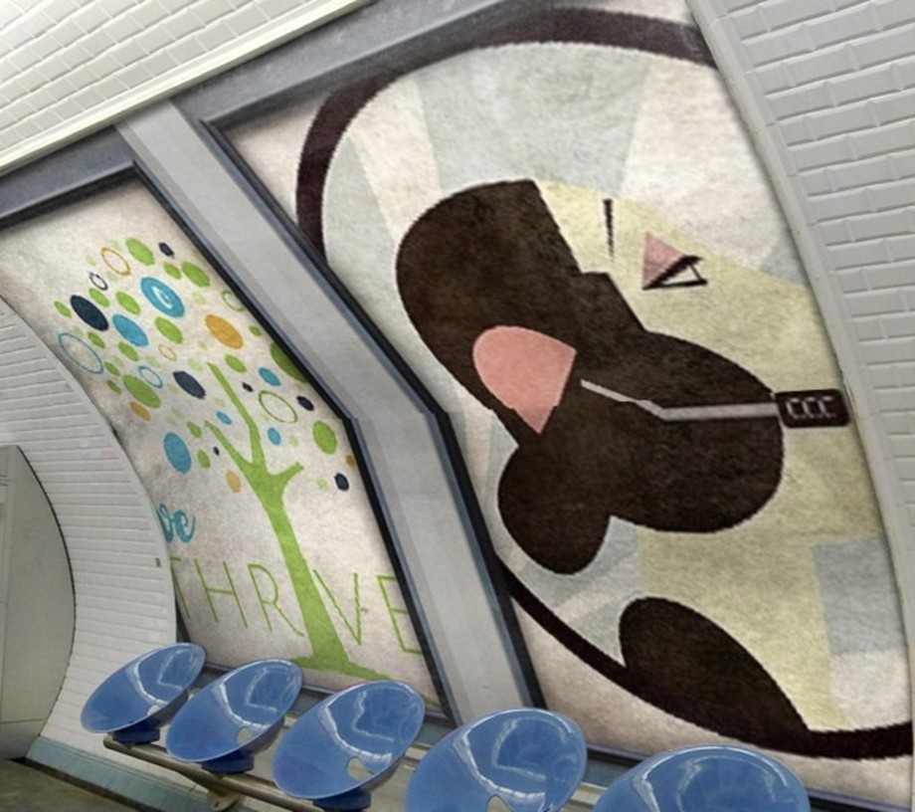
Jose.
With a mix of motivational public speaking style backed by tactful and appropriate rhetoric, Richard shared his knowledge and trained over 10 000 bilingual telemarketers.

Slide 7


Slide 8

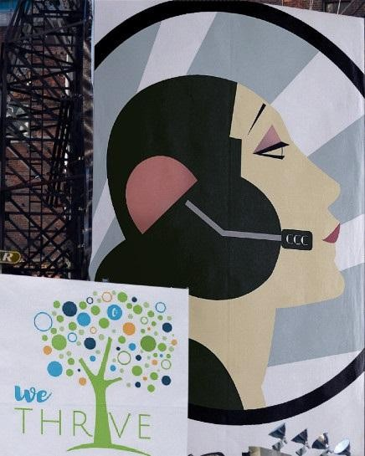
Richard Blank has the largest collection of restored American Pinball machines and antique Rockola Jukeboxes in Central America making gamification a strong part of CCC culture.Richard Blank is the Chief Executive Officer for Costa Rica’s Call Center since 2008.
Mr. Richard Blank holds a bachelors degree in Communication and Spanish from the University of Arizona and a certificate of language proficiency from the University of Sevilla, Spain. A Keynote speaker for Philadelphia's Abington High School 68th National Honors Society induction ceremony.

Slide 9
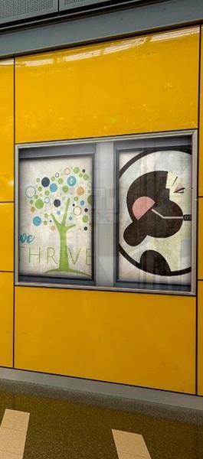
Giving back to Abington Senior High School is very important to Mr. Blank. As such, he endows a scholarship each year for students that plan on majoring in a world language at the university level. Costa Rica’s Call Center (CCC) is a state of the art BPO telemarketing outsource company located in the capital city of San Jose, Costa Rica.

Slide 10


Slide 11
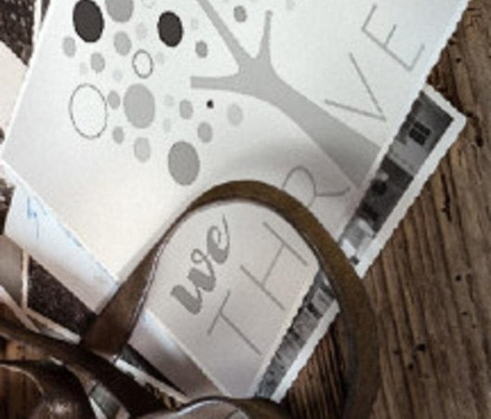
Our main focus has been, and will always be to personally train each and every Central America call center agent so that we may offer the highest quality of outbound and inbound telemarketing solutions and bilingual customer service to small and medium sized international companies, entrepreneurs as well as fortune 500 companies.

Slide 12
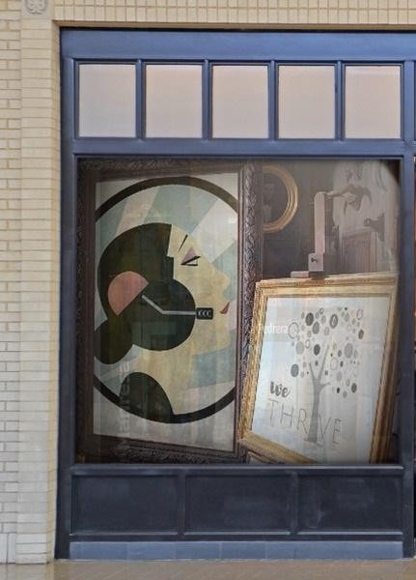
We encourage you to visit one of our call centers on your next personal vacation or business trip to Central America’s paradise, Costa Rica. While you are here, we would recommend taking an extra day of your trip to visit breathtaking virgin beaches, play golf next to the ocean, try your luck at deep sea fishing, explore tropical jungles, climb volcanos or just relax in natural hot springs. Come and see for yourself why call center outsourcing in Costa Rica is a perfect solution for your
Favorite Pinball Games and Arcade Adventures

Slide 13
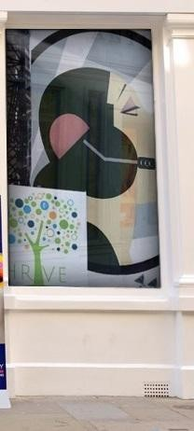
Ooh, the one that I own or the one that I have played? The one that I own is a 1996 NBA Fast Break from Williams. It's a wonderful machine. I enjoy that the most. But when I was in Arizona, they have this amazing arcade that's in Mesa that's got like over 50 pinball machines. And I was able to play some stuff from the old 70s and the 80s and 90s.
Influential Book and Life Lessons
It's a wonderful question. There's so much out there. For me personally, I've dabbled in your self-helps and motivational books, but I'm more into biographies or certain sort of stories of a coming of age. My favorite book of all time was a gift that was given to me. It's from Harvey Allen. It's called Anthony Adverse. It was written in the 1930s. It's a very big, fat, long book.
Anthony Adverse. And they made a movie about it as well from Harvey Allen. And so it was something that I never expected to read. But when I was in Spain, a very good friend of mine gave it to me. So when I was on the trains, I would pull out a few pages here and there. But it was it was really about a wonderful story about a dreamer that lived in since it's very long, a full life. I mean, you really go through the whole book. But it changed me a little bit. It was the discipline of reading a book that was so many pages, but also I resonate towards this main character that was finding himself and needed others where, Casey, success is built on a million thank yous, and I'd be very foolish to think I did this on my own. Show less
growing company and a powerhouse in the BPO industry. Marriage and Video Game Battle Lines
I got Hook. I got a World Cup machine, Street Fighter 2, Jokers, Lethal Weapon 3, Mousing Around, Judge Dredd, State Shuttle. Listen, when you're married to somebody, you got to

Slide 14
choose your battles wisely. My wife can have 99% of battles when the one thing I am going to die on that hill are my video games. And Casey, thank God I got enough room at my office that I can fit them all.
Positive Employee Management
That's just one of so many examples. And also another one I'm going to throw back into the game room. So instead of having a meeting, Casey, where I bring you in and make you feel bad, why don't we take a recess downstairs? Let's get on the Pac-Man machine. Let's play some pinball. Five minutes later, you've let off some steam. You've recharged some batteries. You're saying, thank you, jefe. Thank you. You don't need to thank me. Thank you for allowing me to get you off the floor for a minute away from everybody. So you could calm down and reset yourself. Yeah. That's all. And then let's go back up champ. Let's do what we gotta do.
Strategic Communication and Respect
And the second thing is I'm going to know your name, so I'll give you the dignity. And a lot of the agents will tell me, Richard, you're the first boss that ever knew my name. And I said, unfortunately, that's true. And I might be the last, but at least while you're with me, I will know your name. And also, and also since English is their second language and it's okay that they have a slight accent to me, Casey, it bears the mark of higher education. I really insist on the thesaurus because I want them to properly express themselves. And so there are certain words that can produce a negative trigger, a rabbit hole or an ego defense. And so by using strategic words like guiding, assist and lending a hand versus helping and instead of saying, excuse me, can you repeat that? It's more, Casey, for my clarification. These are some strategic, diplomatic, and very choice structured conversations where we can really prolong conversations, increase conversion ratios. And not only that, increase the fulfillment of the agent's job. Casey, this is a very strict Catholic country. And as much as I want to fulfill the need of the agent, it's really more for the client.
Thriving Through Positive Reinforcement
It's really not about me, my friend. It's really about the others. It's the positive reinforcement that I get. So I could think that I'm the greatest and I'm the one man party and show and I'm the king of the castle. But if nobody shows up for my birthday party at Chuck E. Cheese, I have no friends. And so for me, being in business for 14 years, it's not about how smart I am. how clever I am. It's about the foundation of the people that come back here every day to work with me.

Slide 15

And so thriving for me is when people say, good morning, jefe, or they become supervisors, or they've been with me for a year, five, 10 years, or I get a written letter from a client telling me how amazing my organization is. And so I feed off of the responses of others.
Transforming Negative Tone with Buffer Boomerang

Slide 16


I have a buffer boomerang technique where if somebody asks you a question, sometimes their tone could be negative. So what I would like to do is buffer your tone and make it positive.
So I'd say, Casey, that's an excellent question. My name is Richard Blank. Reinforce it with the question, repeated what you said to show active listening, and then sent it back to you in a positive way.

Slide 17
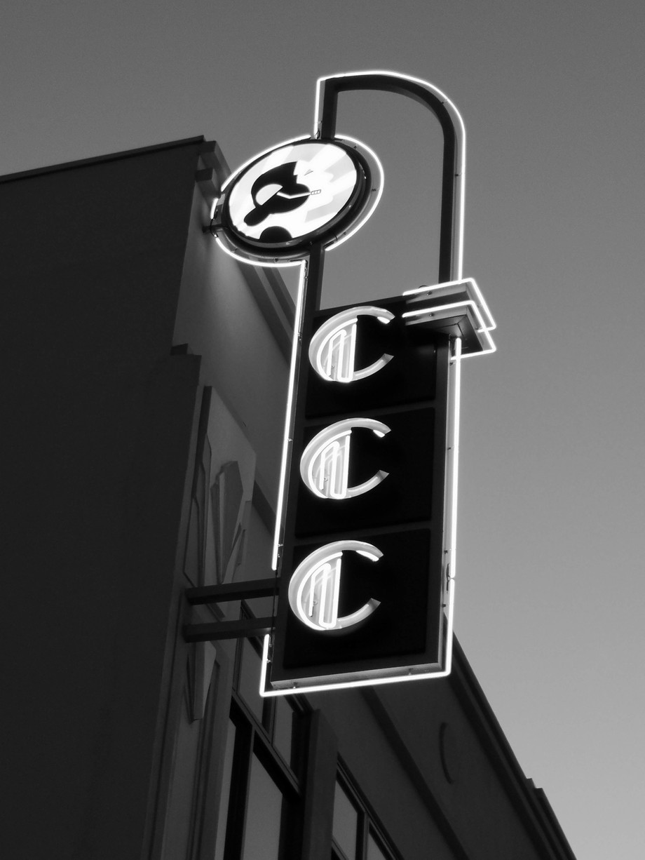
There's positive, there's buffer boomerangs throughout an entire phone call when someone asks you a question and makes a statement.

Slide 18

So then let's say that your assistant's name is Susan. And I answer her question and she likes me and she's willing to transfer the call to you. Prior to that transfer to call Casey at your consulting group, I'm going to let them know that how amazing that they are when I speak with you. So I'm going to be giving a gift and moving with some momentum.

Slide 19

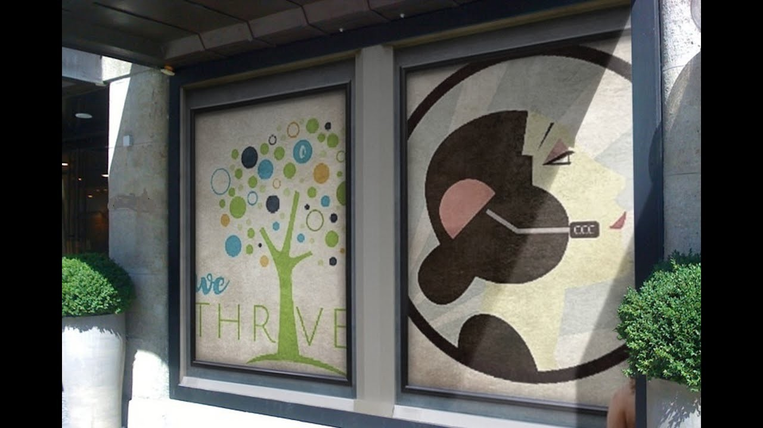

Slide 20
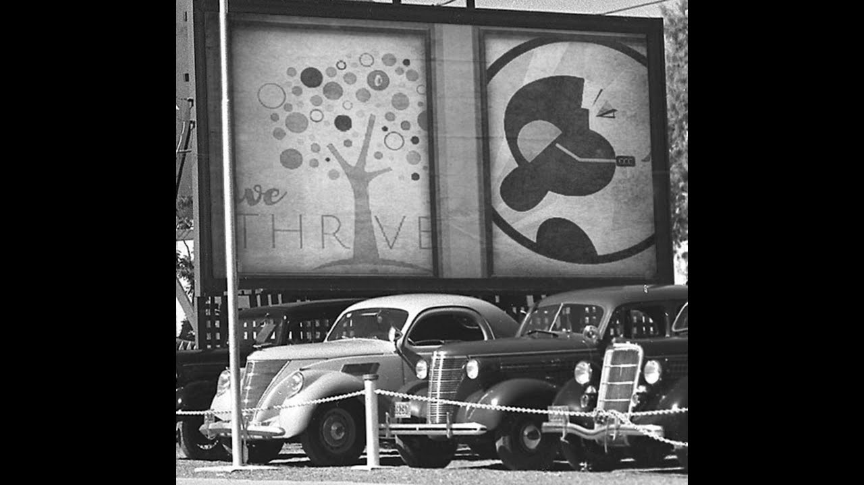
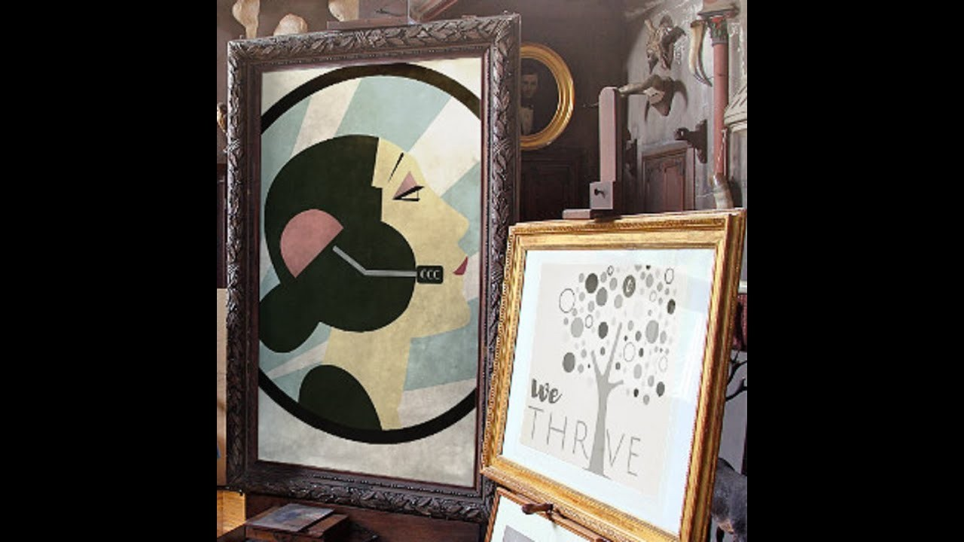

Slide 21
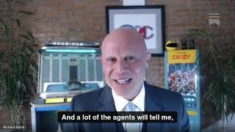
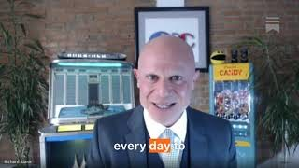

Slide 22
