Slide 1

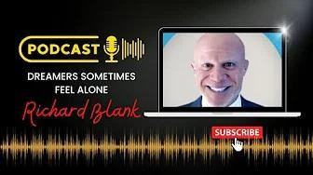
Downloaded from: justpaste.it/victimtovictory
Victim to Victory Podcast Series Interview. Dare to be a dreamer with loyal INXS fan Richard Blank.
Richard Blank's story has a lot of twists and turns. He calls Costa Rica home now as a thriving Entrepreneur. His story is one about coming of age, knowing that dreamers sometimes feel alone, taking a leap of faith to move to a different country and all the challenges & splendors
Victim to Victory Podcast Series Interview
At Victim to Victory, we share inspiring stories of individuals who have transformed their lives by overcoming incredible obstacles.

Slide 2
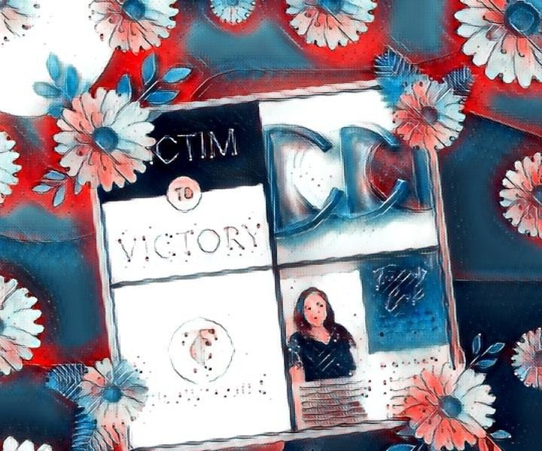
Our channel is dedicated to showcasing real-life experiences of resilience, determination, and triumph. Whether it's beating the odds, rising above challenges, or finding light in the darkest times, these stories are here to motivate and uplift you.

Slide 3

Join our community and discover the power of perseverance. Let these amazing tales encourage you to conquer your own challenges and achieve your dreams.

Slide 4
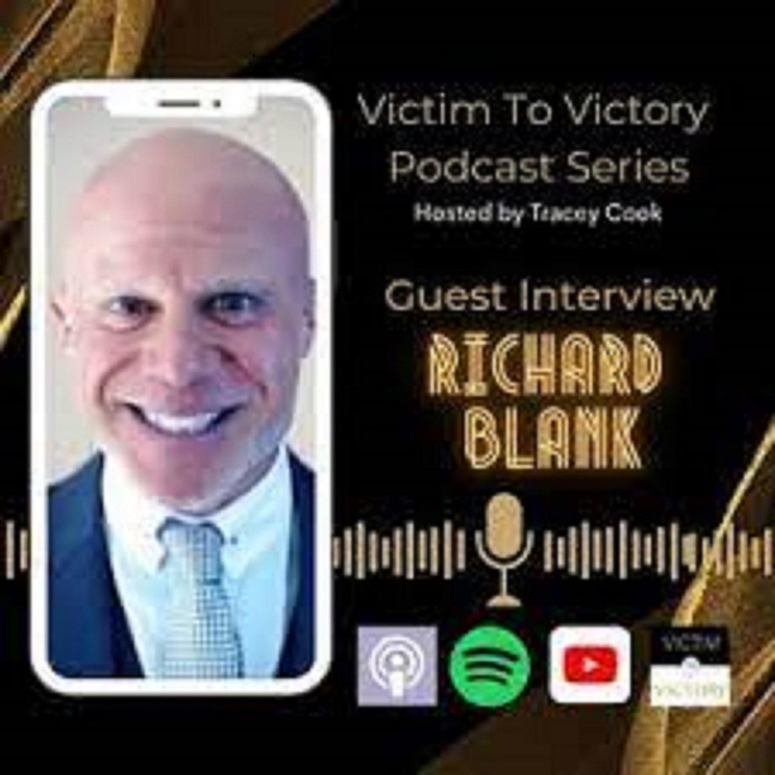
Richard Blank's story has a lot of twists and turns. He calls Costa Rica home now as a thriving Entrepreneur.

Slide 5

His story is one about coming of age, knowing that dreamers sometimes feel alone, taking a leap of faith to move to a different country and all the challenges & splendors that come with that.

Slide 6

00:00 Intro
01:48 Richard's Story
19:19 Motivating in Costa Rica 23:33 How Richard sees life 34:30 Giving back to community 46:19 Sharing life wisdoms 48:58 Outro

Slide 7

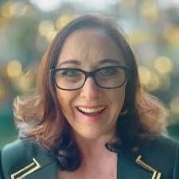
Tracey Cook is a Global Podcast Creator & Brand Storytelling Strategist & CEO of Brand Your Story Academy.
Tracey helps online business owners launch, brand & market their Podcast for Passion, Purpose & Profit.

Slide 8
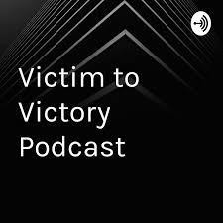
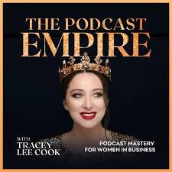

Tracey is an Amazon No 1 Best Selling Author & a sought after speaker & trainer, that has been featured with Les Brown, Dr Joe Vitale and Pat Quinn. Tracey’s (TC) mission is to encourage people to share their stories for deeper authentic connections to make the world a better place.
PODCAST LAUNCH STRATEGIST AT THE PODCAST EMPIRE
I mentor Purpose Driven Women in Business to launch a Profitable Podcast to build their Brand & Influence and generate leads to their business offers
PODCAST MASTERY FOR WOMEN IN BUSINESS PROGRAM
Step into the world of podcasting with confidence by joining our self-paced Podcast Mastery program, designed specifically for women entrepreneurs. This proven 5-step framework delivers video modules on launching, branding, marketing, and monetizing your podcast.

Slide 9

Harness the power of both audio and video podcasts that drives business growth, amplifies your brand and influence, expands your reach, and converts listeners into loyal clients.

Slide 10
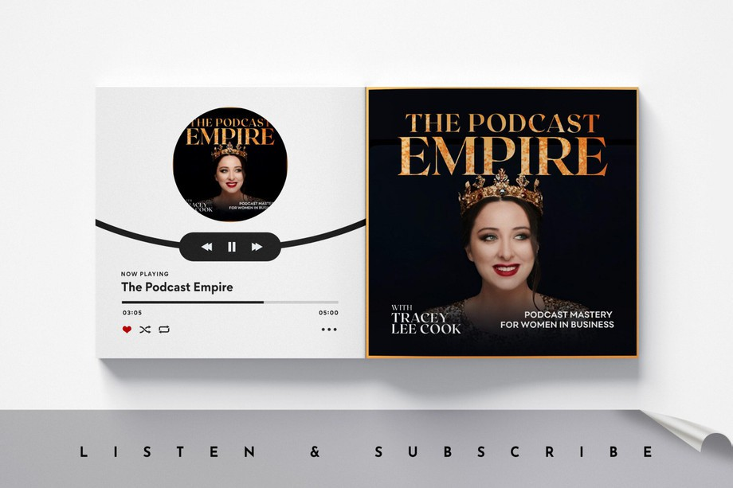
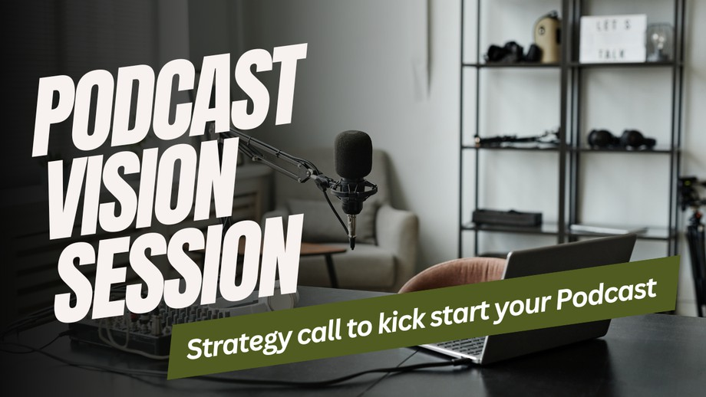
PODCAST VISION SESSION
Book a call to learn more about starting a podcast is a great way for a woman business owner to establish herself as a thought leader in her industry, gain visibility, attract new clients and customers, and ultimately expand her reach and grow her business, despite any fears she

Slide 11
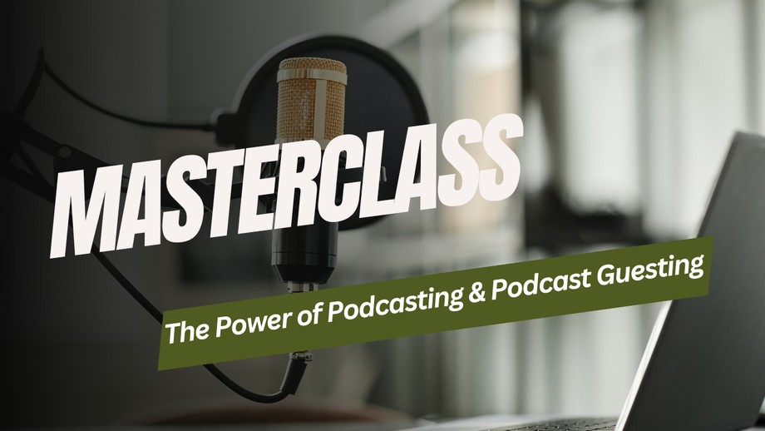
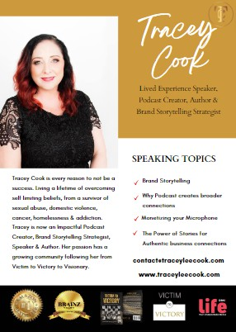
may have about the technical aspects, lack of audience or not having enough interesting content to talk about.
MASTERCLASS WITH TRACEY COOK
If you have an engaged community, membership or team you feel would benefit from a Complimentary Power of Podcasting Masterclass please book a Collaboration Call with Tracey Cook
Meet Tracey

Slide 12

Tracey launched her first Podcast in 2020. After 300 episodes, downloads in the thousands, a best-selling book and creating a Podcast Movement, Tracey has cracked the code for Video Podcast & Content Creation to amplify your Brand.
She is leveraging the power of Video Podcast & Social Media repurpose strategies to help Female Business Owners to launch a Profitable Podcast, even with zero experience or audience inside her Signature Podcast Launch Strategy Mastermind

Slide 13

Now it’s your turn to Launch!

Slide 14

Tracey Cook is a high energy, unique and engaging Speaker.

Slide 15


Tracey tells stories to inspire and create transformations. She gives the audience the direction into transformation, to find their purpose, their voice and compel action.
Tracey’s passion to create a world of love and empathy through our stories, has a growing community following her from Victim to Victory to Victorious.

Slide 16

Tracey is available at a variety of events (virtually and in person) and is based in Perth Western Australia.

Slide 17

Whether you want Tracey to speak on your stage or strategize about how to explode your business with the Power of Podcast, Tracey is happy to learn more about your event & welcomes you to book a call

Slide 18

Richard’s vision quest journey is filled with twists and turns.

Slide 19

At 27 years old, he relocated to Costa Rica to train employees for one of the larger call centers in San Jose.

Slide 20

With a mix of motivational public speaking style backed by tactful and appropriate rhetoric, Richard shared his knowledge and trained over 10 000 bilingual telemarketers over two decades.

Slide 21

Richard Blank has the largest collection of restored American Pinball machines and antique Rockola Jukeboxes in Central America making gamification a strong part of CCC culture.Richard Blank is the Chief Executive Officer for Costa Rica’s Call Center since 2008.

Slide 22

Mr. Richard Blank holds a bachelors degree in Communication and Spanish from the University of Arizona and a certificate of language proficiency from the University of Sevilla, Spain.

Slide 23

A Keynote speaker for Philadelphia's Abington High School 68th National Honors Society induction ceremony. In addition, entered into the 2023 Hall of Fame for Business along side other famous alumni.

Slide 24

Paying it forward to Abington Senior High School is very important to Mr. Blank. As such, he endows a scholarship each year for students that plan on majoring in a world language at the university level.

Slide 25

Costa Rica’s Call Center (CCC) is a state of the art BPO telemarketing outsource company located in the capital city of San Jose, Costa Rica.

Slide 26

Our main focus has been, and will always be to personally train each and every Central America call center agent so that we may offer the highest quality of outbound and inbound

Slide 27


telemarketing solutions and bilingual customer service to small and medium sized international companies, entrepreneurs as well as fortune 500 companies.
https://costaricascallcenter.com/en/outbound-bpo-campaigns/
Victim to Victory Podcast, Tracey Cook, Richard Blank, Costa Rica's Call Center, Outsourcing, Telemarketing Call Centre, BPO, Nearshore Contact Center, Sales, Entrepreneur, B2B, Business, Podcast, Gamification,Leadership, Marketing, CX, Guest, Money, B2C education, BPO trainer,

Slide 28

#VictimtoVictoryPodcast #TraceyCook #CostaRica #CallCenter #Outsourcing #Telemarketing #BPO #Sales #Entrepreneur #B2B #Business #Podcast #Gamification #CEO #learnpodcasting #podcastepisode #podcastguest #podcasting #podcastinterview #podcastplaylist #podcasts #podcastskills #podcastshow
"Dreamers sometimes feel alone" V2V Interview featuring Richard Blank

Slide 29


