Slide 1
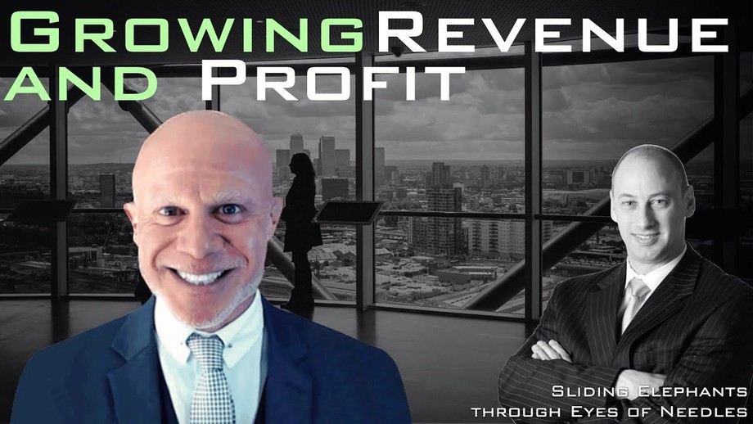

Downloaded from: justpaste.it/growrevenueandprofits
Growing Revenue and Profit Podcast by Damian Andrews. Telesales with expert Richard Blank
Location: Melbourne, Australia Wednesday May 31, 2023 Richard Blank - CEO Costa Rica’s Call Centre
Damian Andrews Growing Revenue and Profit deals with all things that put more money in your business pocket.
Damian interviews business experts from CEOs, business leaders, experts, managers and turn around specialists. Each episode you learn knowledge and actions used by the best and most successful businesses and leaders to ensure ongoing profit security.

Slide 2
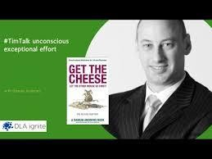
There are simple and easy steps to business success. Damian Andrews shares the key principles that long term successful business use to achieve ongoing profit security.
Location: Melbourne, Australia Wednesday May 31, 2023
Richard Blank - CEO Costa Rica’s Call Centre

Slide 3
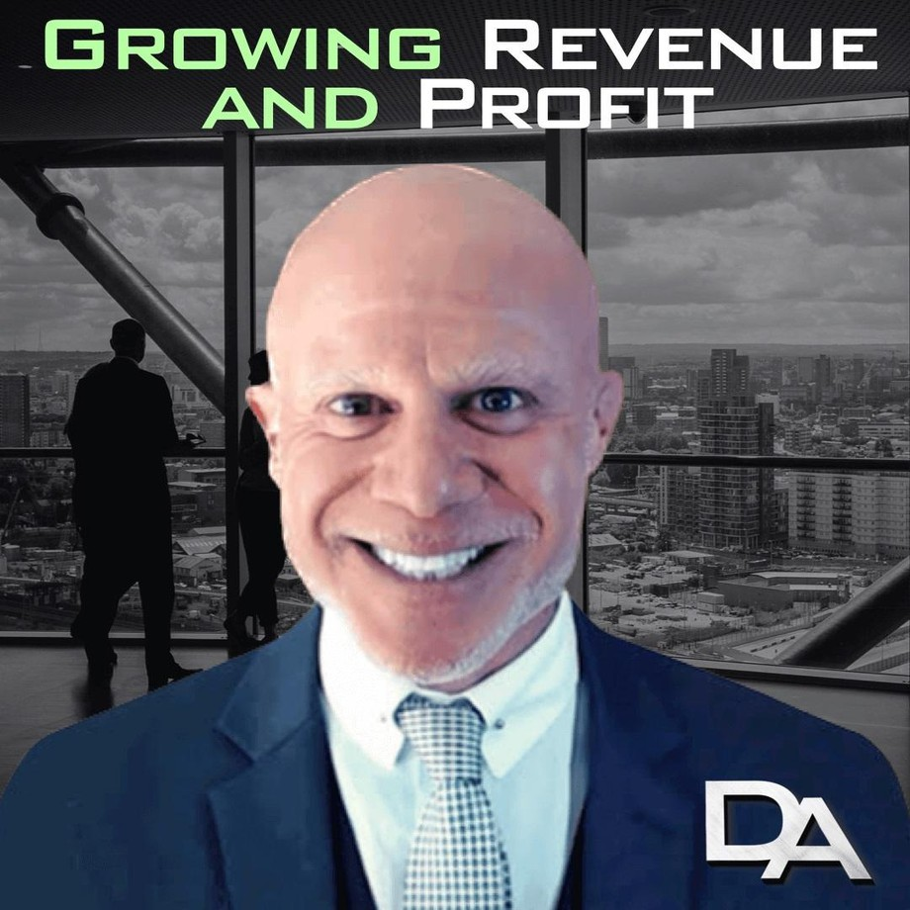
Growing Revenue and Profit, Damian Andrews, Richard Blank, Costa Rica's Call Center, Outsourcing, Telemarketing Call Centre, BPO, Nearshore Contact Center, Sales, Entrepreneur, B2B, Business, Podcast, Gamification,Leadership, Marketing, CX, Guest, Money, B2C education, BPO trainer,call centre, contact centre, contact center,trend, trending

Slide 4

Damian Andrews Podcast & Radio
“Sharing the simple and easy steps to increasing your business revenue and profit” Damian Andrews Growing Revenue and Profit deals with all things that put more money in your business pocket. Damian interviews business experts from CEOs, business leaders, experts, managers and turn around specialists. Each episode you learn knowledge and actions used by the best and most successful
What if life was really simply?

Slide 5
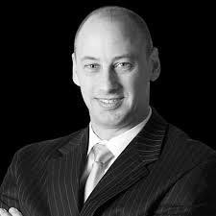
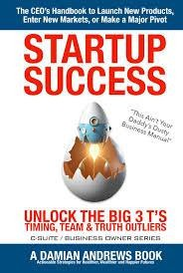
Simplicity is hidden in the complexities we create. People often supersize the elephant and shrink the needle. But, if you create the problems, you can uncreate them. Come slide elephants through eyes of needles with me. As Confucius said, “Life is very simple, but we insist on making it complicated.”
Damian is the author of:
Get the Cheese: Let the Other Mouse Go First Get Sh*t Done: Stop Asking Why
StartUp Success: Unlock the Big 3 T's Sliding Elephants through Eyes of Needles
The genesis of extraordinary business results. Making what seems impossible, possible is found at DamianAndrews.com. Outstanding success comes via an optimally balanced ‘Business Wheel’ where Revenue, Operations, Culture and Profit harmoniously spin.

Slide 6

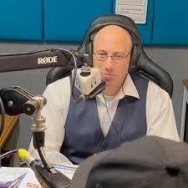
Our team demystifies complexities and transforms challenges into opportunity. From solving revenue riddles, profit puzzles, operational oddities, or cultural conundrums, we are your partner in achieving remarkable growth.
Achieving excellence requires unwavering dedication, continuous refinement, and a persistent pursuit of greatness. With this ethos, we forge a path toward distinction.Merging innovation with proven strategies, DamianAndrews.com offers a range of premium services, meticulously tailored to your unique needs. We equip you with the tools to thrive and succeed.
Benefits of Engaging Us
Damian Andrews – Growing Revenue and Profit’ provides businesses with Improved Revenue Generation, Profit Optimization, Operational Excellence and Compelling Cultures. Key advantages include:
INCREASED REVENUE AND PROFIT
Experience greater financial stability, higher profitability, and enhanced business growth. Our Services

Slide 7
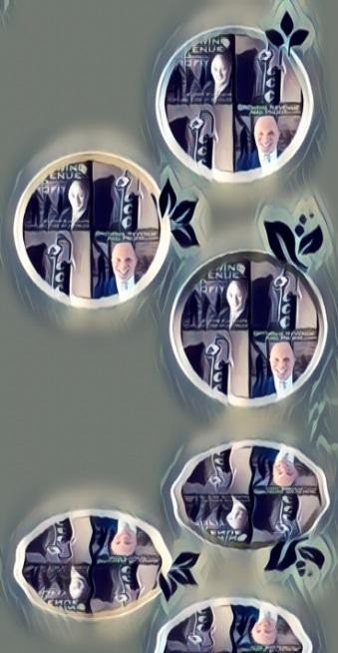
Revenue Generation
We prevent you missing growth opportunities which result in struggles to compete. Businesses that prioritize revenue growth significantly outperform their competitors.
We leverage proven strategies to attract new customers, expand market share, and achieve sustainable revenue growth.

Slide 8

Profit Optimisation
We stop shrinking profit margins that put your businesses at a disadvantage. Businesses that optimise profit margins consistently outperform industry peers.
We provide you with the tools and strategies necessary to maximise profitability and achieve long-term success.
Operational Excellence

Slide 9
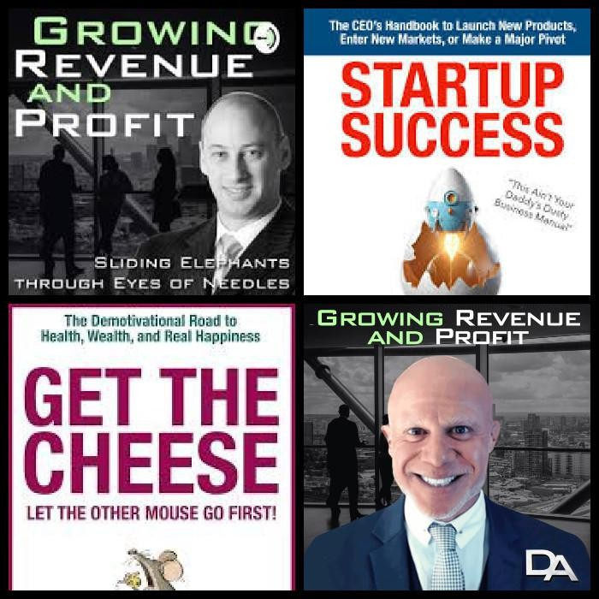
We end inefficiencies, increased costs, and decreased customer satisfaction. Businesses that improve operational efficiency experience higher productivity levels and increased customer satisfaction.
We give you streamlined processes, reduced costs, and exceptional customer experiences. Compelling Culture

Slide 10

We put a stop to disengaged employees, high turnover rates, and a lack of innovation. Businesses with engaged employees outperform their competitors in all metrics.
We create a culture that fosters engagement, innovation, and high-performance.
"The culture of your organisation makes or breaks its future. Neglecting to prioritize a positive culture puts your business at risk of failure." - Fast Company

Slide 11
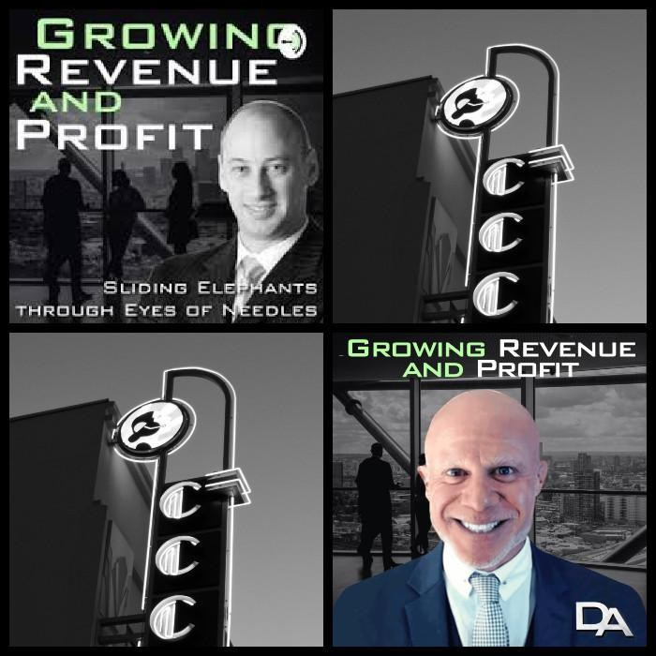
Our approach
Merging innovation with proven strategies, DamianAndrews.com offers a range of premium services, meticulously tailored to your unique needs. We equip you with the tools to thrive and succeed.
TrainTheTrainer InteractiveWorkshops ExecutiveCoaching leverage our experience

Slide 12

Partner with DamianAndrews.com – Growing Revenue and Profit and make the seemingly impossible, possible. Sliding elephants through eyes of needles is the pinnacle of excellence and achievement. Together with our experience, your business is empowered to break through barriers and achieve remarkable growth.
Discover a new paradigm of Growing Revenue and Profit. Our unwavering commitment as your preferred partner ensures you’ll navigate complex landscapes and maximise your revenue and profit potential.

Slide 13


AUTHOR
Get the Cheese: Let the Other Mouse Go First Get Shit Done: Stop Asking, 'Why?'
StartUp Success: Unlock the Big 3 T's

Slide 14

National and international companies, their leaders, managers and staff pay big $$ to use my technologies for easier, more successful and fulfilled lives and profitability.
I’ve taken the revenue of a small family company from $8m to $25m in 18 months, during COVID lockdowns.
In two weeks I took all company employees (including old men who didn’t like change) happily from hand written time cards to apps on their phones, dramatically improving efficiency and reducing cost.
Men driving down the street have come to a screeching halt and got out of their Pick-Up to say ‘thank-you’ to me for saving their business.
With a little guidance I’ve revived marriages returning them to nights of explosive passion.
Life is not hard.
However, while there are simple principles that make life easy, knowing them is not enough. You need to implement.
Big companies have large budgets to pay for implementation.

Slide 15
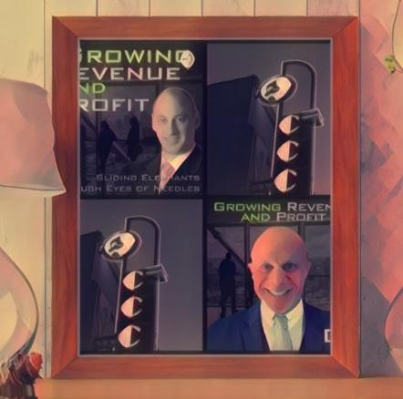
As others trudge uphill in a blizzard, frozen wet feet sinking deep into soggy mush. You can glide down perfectly groomed, lightly powdered ski slopes basking under a beautiful azure sky with an endless smile on your face.
I’m a CEO, International Speaker, philanthropist and father and I demystify the simple and easy life and business steps to growing your revenue and profit.
I speak to audiences around the globe bringing fresh life to often overlooked fundamental
principles essential for rapid success. Unleash Your Potential
Let me help you Slide Elephants through Eyes of Needles My background includes:

Slide 16
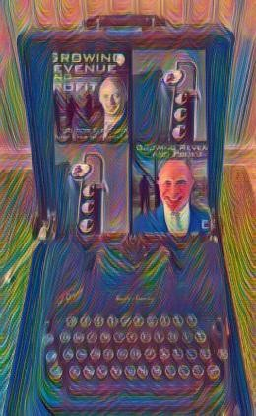
Australian Army - Special Air Service Regiment (SAS) Corporate Recovery Specialist
Construction Commercial and Contracts Expert Operational Efficiency Professional
Founding CEO - Family Peace Foundation
Founder - SHAIR.care (Strong Healthy and Inspiring Relationships) Founder & CEO - DamianAndrews.com
Author and Educator
Business sectors include manufacturing, property holdings, IT, retail, professional services, large retail fitouts, apartments, commercial, civil, infrastructure, road, rail and renewable energy.

Slide 17

Richard’s journey in the call center space is filled with twists and turns. When he was 27 years old, he relocated to Costa Rica to train employees for one of the larger call centers in San Jose. With a mix of motivational public speaking style backed by tactful and appropriate rhetoric, Richard shared his knowledge and trained over 10 000 bilingual telemarketers. CEO of Costa Rica's Call Center since February 2008.

Slide 18

Mr. Richard Blank holds a bachelors degree in Communication and Spanish from the University of Arizona and a certificate of language proficiency from the University of Sevilla, Spain. A Keynote speaker for Philadelphia's Abington High School 68th National Honors Society induction ceremony. In addition, inducted into the 2023 Hall of Fame for Business. Giving back to Abington Senior High School is very important to Mr. Blank. As such, he endows a scholarship each year for students that plan on majoring in a world language at the university level.

Slide 19

Hired bassist Garry Gary Beers of INXS.

Slide 20
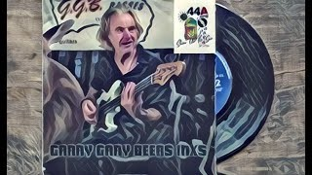
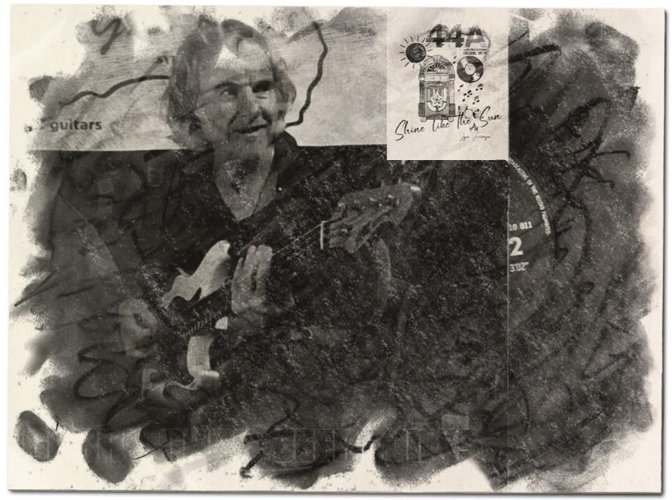
Costa Rica’s Call Center (CCC) is a state of the art BPO telemarketing outsource company located in the capital city of San Jose, Costa Rica. Our main focus has been, and will always be to personally train each and every Central America call center agent so that we may offer the highest quality of outbound and inbound telemarketing solutions and bilingual customer

Slide 21

service to small and medium sized international companies, entrepreneurs as well as fortune 500 companies.
We encourage you to visit one of our call centers on your next personal vacation or business trip to Central America’s paradise, Costa Rica. While you are here, we would recommend taking an extra day of your trip to visit breathtaking virgin beaches, play golf next to the ocean, try your luck at deep sea fishing, explore tropical jungles, climb volcanos or just relax in natural hot springs. Come and see for yourself why call center outsourcing in Costa Rica is a perfect solution for your growing company and a powerhouse in the BPO industry.

Slide 22

https://costaricascallcenter.com/en/outbound-bpo-campaigns/ #GrowingRevenueandProfit #DamianAndrews #RichardBlank #CostaRica #CallCenter #Outsourcing #Telemarketing #BPO #Sales #Entrepreneur #B2B #Business #Podcast

Slide 23

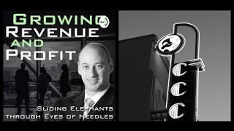
#Gamification #CEO #trend #trending

