Slide 1


Downloaded from: justpaste.it/welcometoabetterlifestyle
Welcome To A Better Lifestyle podcast by My Men Richard. The Success Story of expat Richard Blank.
Richard’s vision quest journey is filled with twists and turns. At 27 years old, he relocated to Costa Rica to train employees for one of the larger call centers in San Jose. With a mix of motivational public speaking style backed by tactful and appropriate rhetoric
It's time to say Thank God it's Monday instead of Thank God it's Friday !

Slide 2
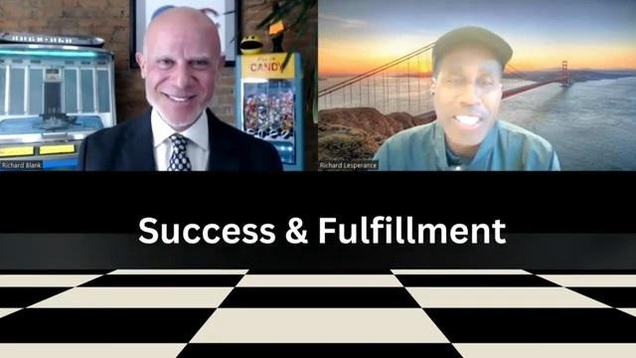
Welcome to a better lifestyle, where we empower you to be authentic in your professional journey and equip you with the essential tools to achieve greater success in both your life and career.

Slide 3

Each episode brings actionable insights, inspiring stories and expert advice to help you embrace your true self & unlock your full potential.

Slide 4
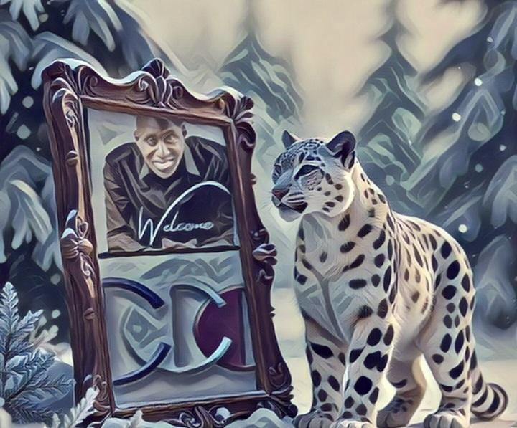
We cover a wide range of topics, including business, entrepreneurship, real estate & more, offering you the mindset, strategies and skills you need to thrive personally and professionally.

Slide 5
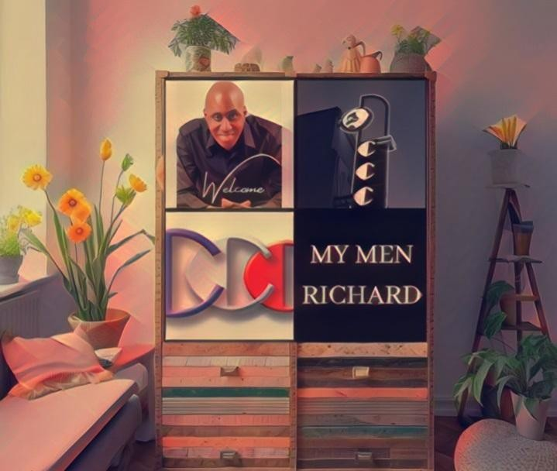
Richard’s vision quest journey is filled with twists and turns. At 27 years old, he relocated to Costa Rica to train employees for one of the larger call centers in San Jose.

Slide 6

With a mix of motivational public speaking style backed by tactful and appropriate rhetoric, Richard shared his knowledge and trained over 10 000 bilingual telemarketers over two decades.

Slide 7

Richard Blank has the largest collection of restored American Pinball machines and antique Rockola Jukeboxes in Central America making gamification a strong part of CCC culture.

Slide 8

Richard Blank is the Chief Executive Officer for Costa Rica’s Call Center since 2008.

Slide 9

Mr. Richard Blank holds a bachelors degree in Communication and Spanish from the University of Arizona and a certificate of language proficiency from the University of Sevilla, Spain.

Slide 10

A Keynote speaker for Philadelphia's Abington High School 68th National Honors Society induction ceremony. In addition, entered into the 2023 Hall of Fame for Business along side other famous alumni. Paying it forward to Abington Senior High School is very important to Mr. Blank. As such, he endows a scholarship each year for students that plan on majoring in a world language at the university level.

Slide 11


Costa Rica’s Call Center (CCC) is a state of the art BPO telemarketing outsource company located in the capital city of San Jose, Costa Rica. Our main focus has been, and will always be to personally train each and every Central America call center agent so that we may offer the highest quality of outbound and inbound telemarketing solutions and bilingual customer service to small and medium sized international companies, entrepreneurs as well as fortune 500 companies.
https://costaricascallcenter.com/en/outbound-bpo-campaigns/
Richard Lesperance, Welcome To A Better Lifestyle, My Men Richard, Richard Blank, Costa Rica's Call Center, Outsourcing, Telemarketing Call Centre, BPO, Nearshore Contact Center,

Slide 12

Sales, Entrepreneur, B2B, Business, Podcast, Gamification,Leadership, Marketing, CX, Guest, Money, B2C education, BPO trainer,

Slide 13

#RichardLesperance #WelcomeToABetterLifestyle #MyMenRichard #CostaRica #CallCenter #Outsourcing #Telemarketing #BPO #Sales #Entrepreneur #B2B #Business #Podcast #Gamification #CEO #learnpodcasting #podcastepisode #podcastguest #podcasting #podcastinterview #podcastplaylist #podcasts #podcastskills #podcastshow

Slide 14
