Slide 1

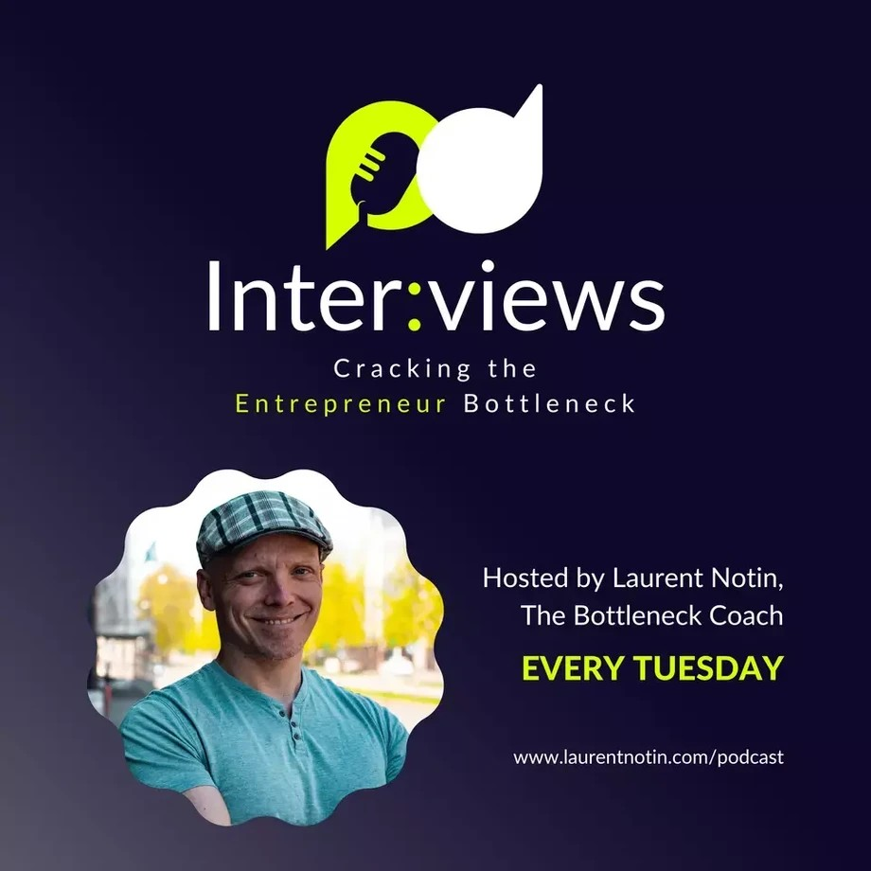
Downloaded from: justpaste.it/CrackingTheEntrepreneurBottlenec
Cracking The Entrepreneur Bottleneck with Laurent Notin. A business created on grit by Richard Blank
Interviews, Cracking The Entrepreneur Bottleneck. A successful business needs consistency and grit.
The Secrets of Business Growth from 16 Years of Successful Entrepreneurship with Richard Blank

Slide 2


Laurent Notin is a Coach to entrepreneurs, start-up mentor, and the host of Inter:views, Cracking The Entrepreneurship Code podcast.
Being an entrepreneur is a calling. You either have it in you, or you don’t. There's no alternative. And it’s one of the hardest jobs!

Slide 3
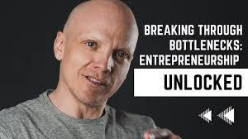

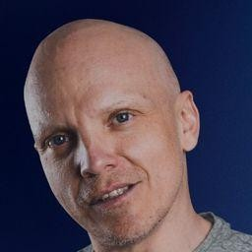
You’ve got to wear many hats, acquire many skills, and make many decisions – fast. All whilst under extreme pressure to deliver quality work for your clients, take care of your employees, and ensure you don’t run out of cash flow.
Your biggest risk?
Becoming the bottleneck in your business.
Many people will tell you it’s cash flow or unsuccessful marketing tactics. But it’s not. Having run several SMEs and mentored hundreds of business owners – I can tell you - the biggest risk your business will ever face is YOU!
Why? Because as the entrepreneur, you are responsible for setting the company’s direction, ensuring everyone follows the course and delivers what’s promised.
Everything relies on you.

Slide 4
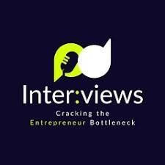

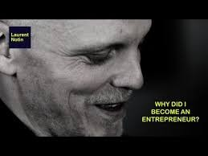
How much of the bottleneck in your business are you? Log on to my website and take The Bottleneck Index to find out.
Studying the data and analyzing the charts to decide which part of the business needs delegation could take much time, or the CEO's ego might be stopping them from letting go of certain weights in the business. In this episode with Richard Blank, he tells us how we can navigate that with his 16+ years of business experience.
100% of Entrepreneurs will eventually be the bottleneck in their business. Not just once, but several times!
The hardest bit? Identifying you're being one. The easy bit? Getting out of it. And that's all about awareness.
This podcast is dedicated to getting you unstuck as an entrepreneur. In each episode, I invite seasoned entrepreneurs to speak candidly about how they overcame being the bottleneck in their business.

Slide 5

I don't just hype up their success. I ask the questions you want the answers to but wouldn't dare ask!
By listening to these episodes, you'll discover what it means to be a bottleneck, how it manifests, and most importantly, how to get out of it.

Slide 6


This isn't fluff. We dive deep, get under the hood, and learn what it really takes to blast through the bottlenecks and scale a business.
A successful business needs consistency and grit from setbacks, letting go of some weights that make you become the bottleneck, embracing change through trials and error while having fun, and not being too hard on yourself.

Slide 7
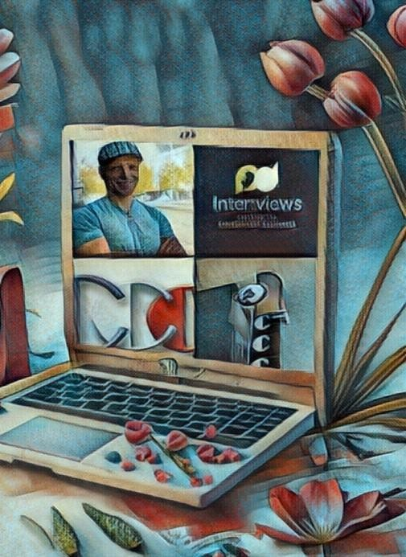
However, most entrepreneurs still need help with this. Studying the data and analyzing the charts to decide which part of the business needs delegation could take much time, or the CEO's ego might be stopping them from letting go of certain weights in the business. In this episode with Richard Blank, he tells us how we can navigate that with his 16+ years of business experience.

Slide 8

Richard Blank has been the Chief Executive Officer of Costa Rica’s Call Center since 2008. He holds a bachelor's degree in Communication and Spanish from the University of Arizona and a language proficiency certificate from the University of Sevilla, Spain. He is a keynote speaker for Philadelphia's Abington High School 68th National Honors Society induction ceremony.

Slide 9

In addition, he was inducted into the 2023 Hall of Fame for Business. Giving back to Abington Senior High School is very important to Mr. Blank. As such, he endows a scholarship each year for students who plan on majoring in a world language at the university level.

Slide 10

Tune in.
Key Highlights from The Show
[03:40] Richard Blank & his collection of Pinball machines & antique Rockola Jukeboxes [04:34] Richard’s passion for pinball games

Slide 11

[07:04] Bottlenecks in business explained [10:58] Why Richards's Startup sucked
[16:35] How he deals with resistance to change in the call center business [19:37] Why letting go was his hardest bottleneck

Slide 12

[25:49] Top 3 growth milestones for the growth of his business [33:28] Practical recommendations to other entrepreneurs

Slide 13
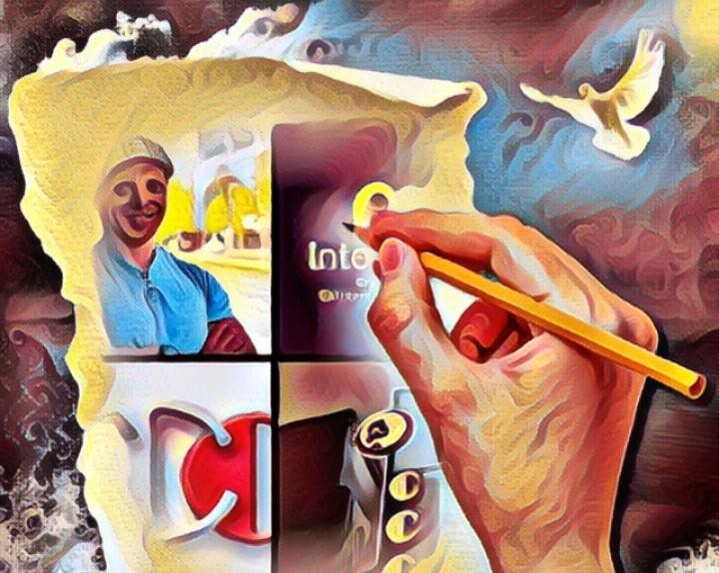
[39:01] How to reach out and connect with Richard [40:24] Wrap up and calls to action
Notable Quotes
Do not be too hard on yourself.

Slide 14

Bottleneck is really about letting go of certain weights in your business. You are only as good as your options.
When you are vulnerable, you are powerful.

Slide 15
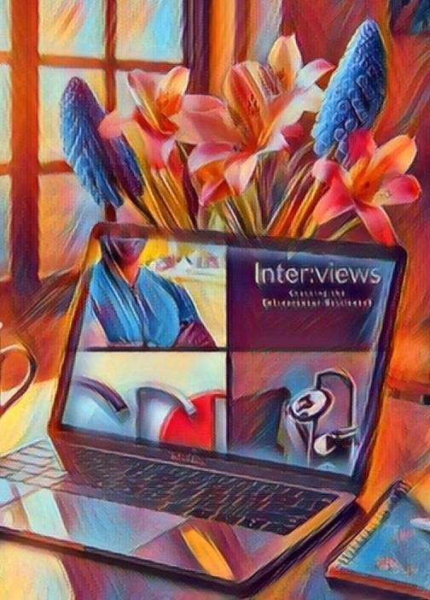
Being an entrepreneur isn't just a career; it's a calling that demands resilience, adaptability, and the courage to lead.
Yet, the journey comes with its unique challenges: Entrepreneurs juggle numerous roles, rapidly acquire diverse skills, and make critical decisions - fast - under the pressure of ensuring client satisfaction, employee welfare, and financial health.

Slide 16

It's no wonder that the most significant risk to your business is YOU! Not cash flow or marketing tactics.
It's the risk of becoming the bottleneck in your business.

Slide 17

With extensive experience running SMEs—spanning 150 employees across three countries— and coaching countless business owners, I've witnessed firsthand that the primary obstacle to a business's growth often lies within the entrepreneurs themselves. When you're stuck, your business mirrors your stagnation.
Do you recognize yourself here?

Slide 18

Cannot let go and have difficulties to delegate?

Slide 19


Lost in operational details, overlooking the strategic vision? Sacrificing personal well-being and social time for work?
Constantly putting out fires instead of focusing on growth? Disconnected from your customers and staff?
Giving more credit to the critical voice in your head? Addressing these bottlenecks is where transformation begins.
As the Bottleneck Coach, I partner with entrepreneurs eager to thrive. Using effective questioning techniques, I help you step back and shift your perspective.

Slide 20

The myth that entrepreneurs must go it alone is pervasive yet unfounded. True progress requires the right mindset, actionable strategies, and sometimes, a guiding hand.
My aim? To equip you with the insights and tools to navigate past bottlenecks, unlock the full potential of your venture, and thrive.
Together, we can propel your business to new heights.
Richard’s vision quest journey is filled with twists and turns. At 27 years old, he relocated to Costa Rica to train employees for one of the larger call centers in San Jose. With a mix of motivational public speaking style backed by tactful and appropriate rhetoric, Richard shared his knowledge and trained over 10 000 bilingual telemarketers over two decades.
Richard Blank has the largest collection of restored American Pinball machines and antique Rockola Jukeboxes in Central America making gamification a strong part of CCC culture.Richard Blank is the Chief Executive Officer for Costa Rica’s Call Center since 2008. Mr. Richard Blank holds a bachelors degree in Communication and Spanish from the University of Arizona and a certificate of language proficiency from the University of Sevilla,

Slide 21

Spain.
A Keynote speaker for Philadelphia's Abington High School 68th National Honors Society induction ceremony. In addition, entered into the 2023 Hall of Fame for Business along side other famous alumni. Paying it forward to Abington Senior High School is very important to Mr. Blank. As such, he endows a scholarship each year for students that plan on majoring in a world language at the university level.
Costa Rica’s Call Center (CCC) is a state of the art BPO telemarketing outsource company located in the capital city of San Jose, Costa Rica. Our main focus has been, and will always be to personally train each and every Central America call center agent so that we may offer the highest quality of outbound and inbound telemarketing solutions and bilingual customer service to small and medium sized international companies, entrepreneurs as well as fortune 500 companies.
https://costaricascallcenter.com/en/outbound-bpo-campaigns/
#RichardBlank #CostaRica #CallCenter #Outsourcing #Telemarketing #BPO #Sales #Entrepreneur #B2B #Business #Podcast #Gamification #CEO #learnpodcasting #podcastepisode #podcastguest #podcasting #podcastinterview #podcastplaylist #podcasts #podcastskills #podcastshow
, Richard Blank,Costa Rica's Call Center, Outsourcing, Telemarketing, BPO, Nearshore, Sales, Entrepreneur, B2B, Business,Podcast,Gamification,Leadership,Marketing, Radio, Guest, Money, education, trainer,

