Slide 1


Downloaded from: justpaste.it/walkinvictory
Walk In Victory Podcast with Pastor NaRon Tillman.The gift of paying it forward with Richard Blank
Customer Care can be a rollercoaster ride of frustration and disbelief however, in this Walk In Victory episode we dive into the BEST customer care experience tips ever! In this MUST WATCH podcast, we share unbelievable stories with our guest Richard Blank.
Welcome to the Walk In Victory Podcast—where transformation meets inspiration, and every episode is a step closer to living your best life.
But make no mistake: we're not just a podcast.

Slide 2


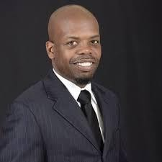
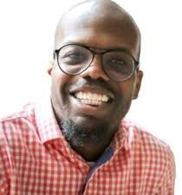
We’re a family—a community bound by the shared pursuit of purpose, growth, and victory in every area of life. Powered by Principal Matters Production, Inc., our mission is to deliver content that not only informs but also transforms, equipping you with the tools to walk confidently in your victory.
The BEST Mindful Customer Care Tips & Experiences Ever
Customer Care can be a rollercoaster ride of frustration and disbelief however, in this Walk In Victory episode we dive into the BEST customer care experience tips ever!

Slide 3
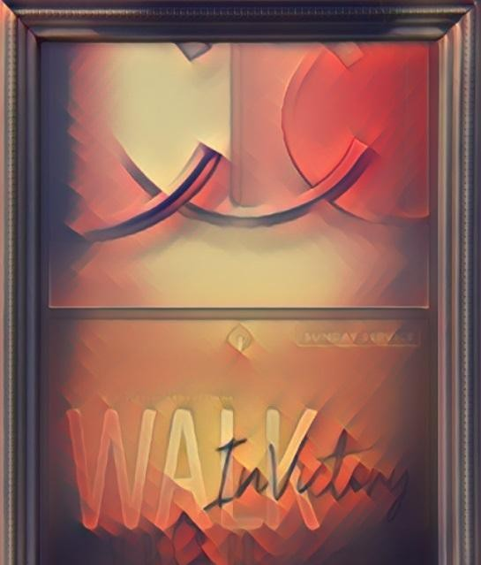
In this MUST WATCH podcast, we share unbelievable stories with our guest Richard Blank as we discuss beset service practices that will leave you and your business or organization with a great competitive advantage.
The conversation delves deep into Blank's journey from Philadelphia to Costa Rica, overcoming challenges to establish a successful business. Blank shares insights on the importance of customer care, the value of effective communication, and the impact of empathetic service.

Slide 4

Join us as we explore real-life scenarios that demonstrate just how low customer care can sometimes go. Whether you're a customer who has faced similar issues or a business owner wanting to learn these best practices, this video is for you!

Slide 5
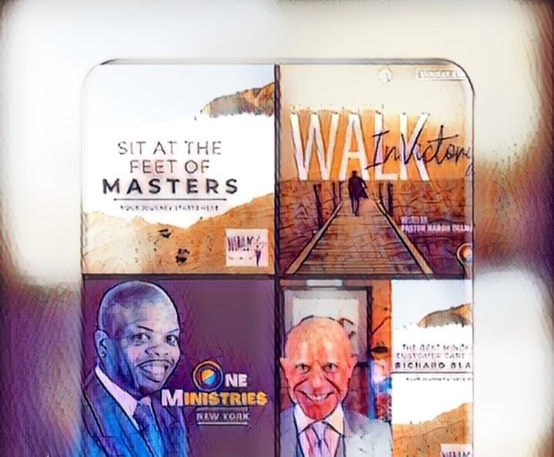
00:00 Introduction to the Walk in Victory Podcast 00:37 NaRon Tillman on Transitioning Careers

Slide 6

06:49 The Importance of Customer Care
07:40 Guest Introduction: CEO of Costa Rica's Call Center 11:53 Building a Business from the Ground Up
15:40 Soft Skills and Customer Support Training

Slide 7
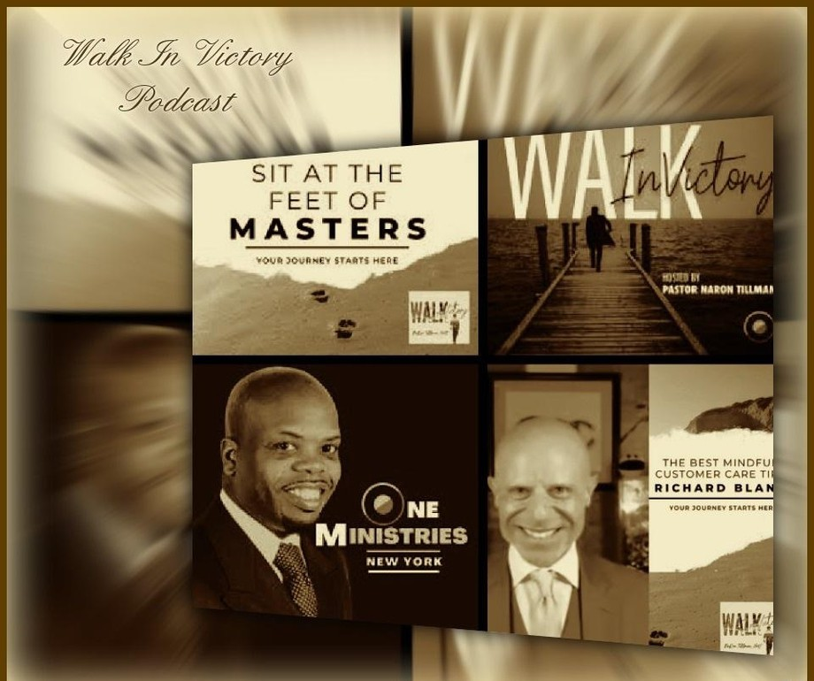
20:34 Competing with Industry Giants
24:29 Embracing New Opportunities in Costa Rica 28:08 Starting Fresh: Moving and Storage Tips 28:31 Customer Research Strategies

Slide 8
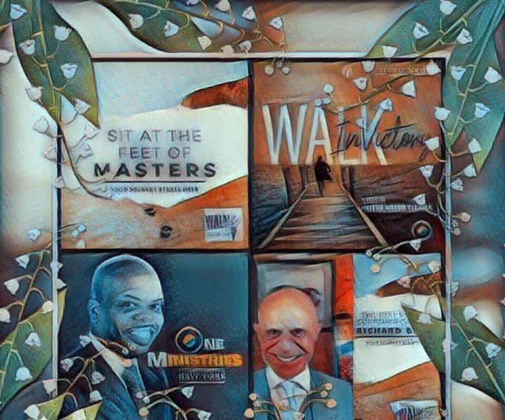
28:56 The Secret Sauce of Success 29:45 Mastering Phone Call Techniques
33:18 Cultural Nuances in Communication 39:17 Effective Training Methods 42:55 Balancing Work and Life

Slide 9
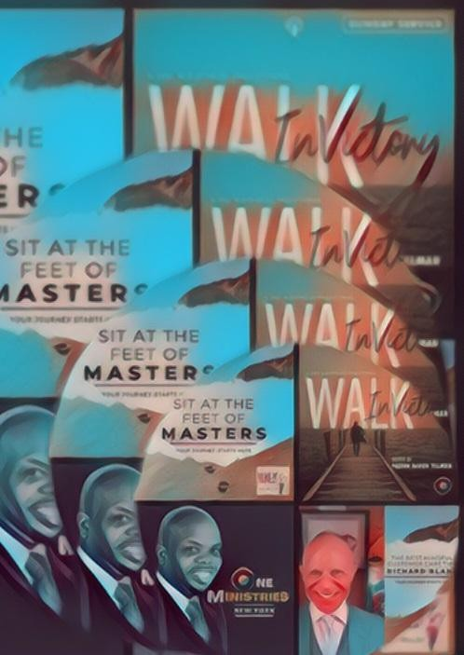
49:17 The Power of Second Chances 51:47 Final Thoughts and Inspirations Join The Victory Walk
Why Join the Walk In Victory Family?

Slide 10
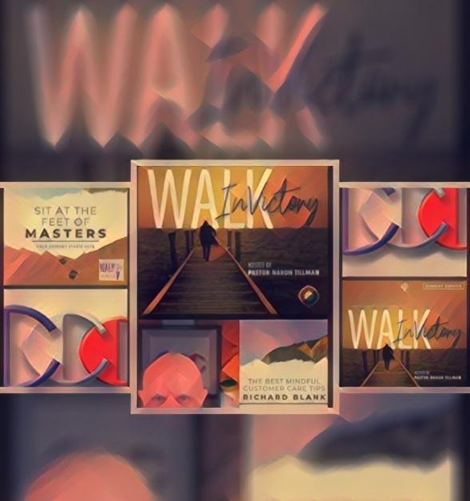
Walk In Victory isn’t just about listening; it’s about connecting with a movement. Led by NaRon Tillman, a visionary leader, pastor, mindfulness coach, and media mogul, our podcast dives deep into the intersection of spirituality, financial wisdom, mindfulness, and entrepreneurship. We tackle real-life issues with actionable advice, all grounded in strong spiritual principles that guide you toward holistic success.

Slide 11
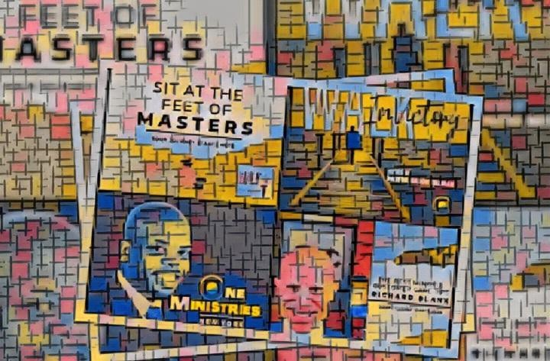
Every episode is a carefully crafted conversation designed to inspire, uplift, and empower you. Whether you’re seeking guidance on how to navigate life’s challenges, tips to enhance your financial well-being, or practical steps to grow spiritually, Walk In Victory is your go-to source.

Slide 12
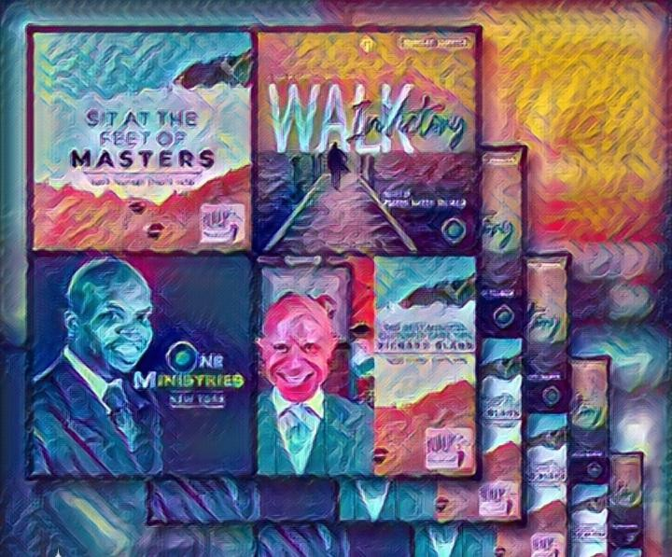
Here, we believe that victory isn’t just an end goal—it’s a journey. And we’re committed to walking that journey with you, every step of the way.
A Family That Grows Together

Slide 13

When you tune into Walk In Victory, you’re not just listening to a podcast; you’re joining a supportive community that’s as invested in your growth as you are.

Slide 14

Our listeners are family—connected by a shared belief in the power of faith, the importance of mindfulness, and the pursuit of purposeful living. We encourage you to engage, share your stories, and be an active part of our family because your victory is our victory.

Slide 15

Powered by Principal Matters Production, Inc.

Slide 16
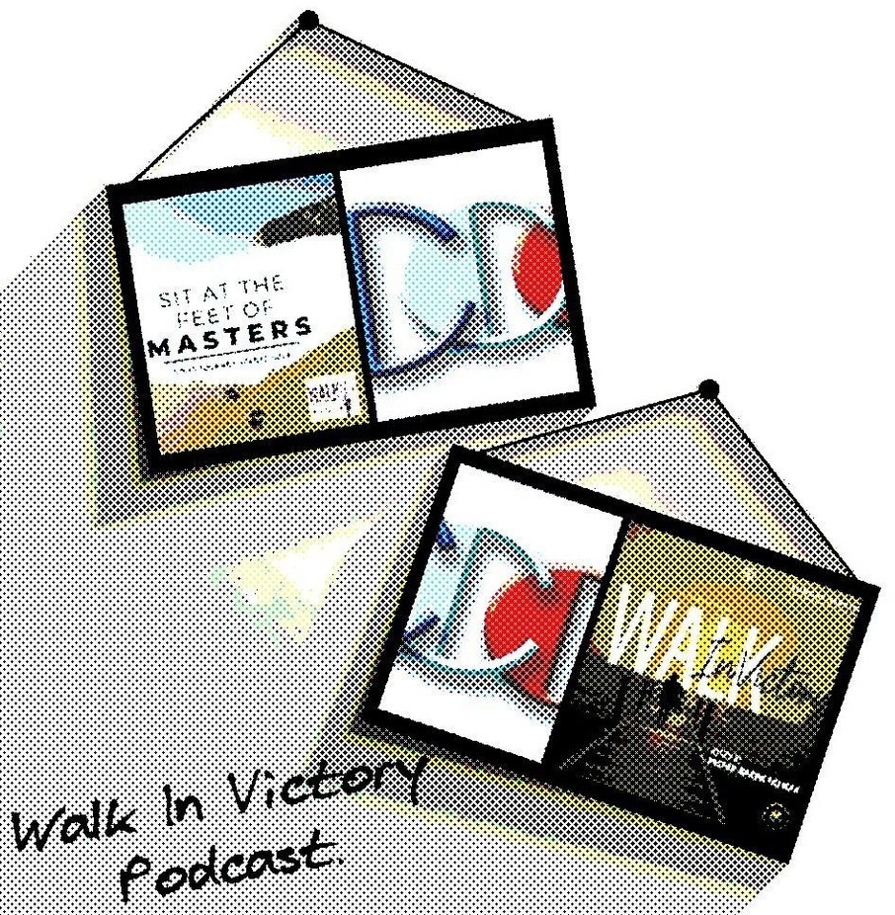
The Walk In Victory Podcast is brought to you by Principal Matters Production, Inc., a powerhouse in creating content that educates, inspires, and empowers.

Slide 17
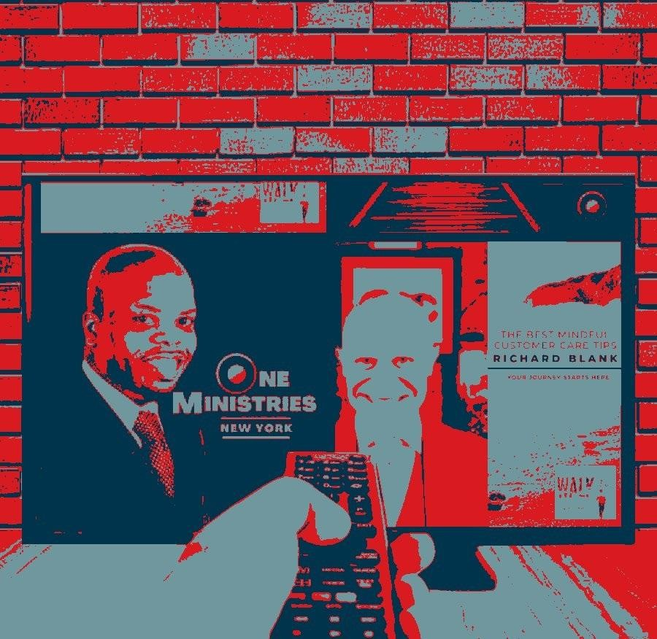
With a commitment to excellence and a passion for uplifting voices, Principal Matters ensures that each episode of Walk In Victory is not just informative, but transformative.

Slide 18

So why wait? Dive into our episodes, engage with our community, and take the first step towards your next victory. At Walk In Victory, we’re not just talking about success—we’re walking in it, together.

Slide 19
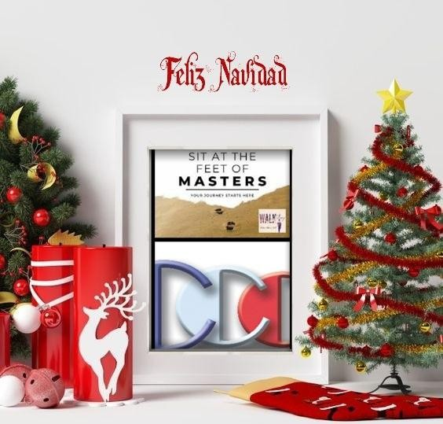
NaRon Tillman is a multifaceted leader who merges spirituality, mindfulness, and media expertise to empower holistic growth. As the Pastor of One Ministries in NYC, a yoga & mindfulness coach (Director of Urban Yogis), and a media mogul (CEO of Principal Matters, Inc), NaRon delivers transformative content through the Walk In Victory Podcast.

Slide 20
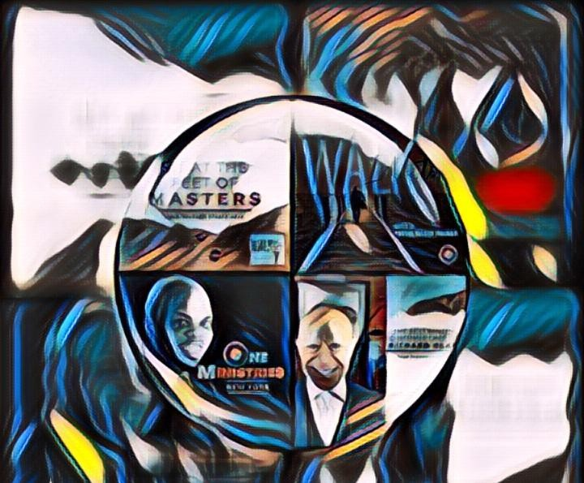
With a deep understanding of the reformed gospel, NaRon offers practical advice on finance, entrepreneurship, and daily lifestyle enhancements. His mission is to inspire individuals to lead purpose-driven lives rooted in faith and financial wisdom.

Slide 21
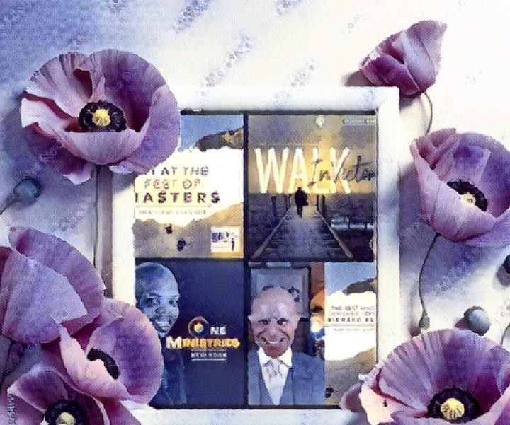
Beyond his professional endeavors, NaRon is a husband of over 25 years with three children. He has a passion for music, having engaged in public performances as a singer, vocal coach, and director. NaRon is also a Knick, Mets, Jets, and Rangers fan, bringing his love for sports and victory into every aspect of his life.

Slide 22

Walk In Victory Podcast, NaRon Tillman, Host - Looking to build a brand and endure hardships? Do you want to grow your personal brand and understand how to build a brand?

Slide 23
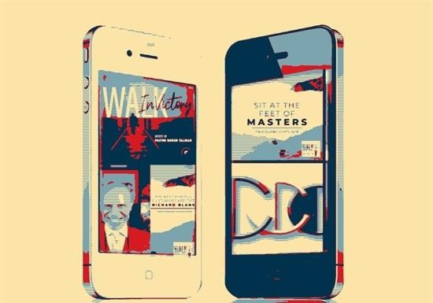

Then this is the perfect podcast for you. This is not your typical lame business talk.... come laugh, learn, and prepare for your Victory Walk.Walk In Victory Podcast will help you unlock your purpose with the power of listening.
New York City's own NaRon Tillman, our host and creator of the Mindful Marketer training course, interviews with some of the worlds best, brightest, and most successful people.
Subscribe now and begin your journey on our Victory Walk.

Slide 24

Richard’s vision quest journey is filled with twists and turns. At 27 years old, he relocated to Costa Rica to train employees for one of the larger call centers in San Jose. With a mix of motivational public speaking style backed by tactful and appropriate rhetoric, Richard shared his knowledge and trained over 10 000 bilingual telemarketers over two decades.
Richard Blank has the largest collection of restored American Pinball machines and antique Rockola Jukeboxes in Central America making gamification a strong part of CCC culture.Richard Blank is the Chief Executive Officer for Costa Rica’s Call Center since 2008.

Slide 25

Mr. Richard Blank holds a bachelors degree in Communication and Spanish from the University of Arizona and a certificate of language proficiency from the University of Sevilla, Spain.

Slide 26


A Keynote speaker for Philadelphia's Abington High School 68th National Honors Society induction ceremony. In addition, entered into the 2023 Hall of Fame for Business along side other famous alumni. Paying it forward to Abington Senior High School is very important to Mr. Blank. As such, he endows a scholarship each year for students that plan on majoring in a world language at the university level.
Costa Rica’s Call Center (CCC) is a state of the art BPO telemarketing outsource company located in the capital city of San Jose, Costa Rica. Our main focus has been, and will always be to personally train each and every Central America call center agent so that we may offer the highest quality of outbound and inbound telemarketing solutions and bilingual customer

Slide 27

service to small and medium sized international companies, entrepreneurs as well as fortune 500 companies.
https://costaricascallcenter.com/en/outbound-bpo-campaigns/
NaRon Tillman, Walk In Victory Podcast, Richard Blank, Costa Rica's Call Center, Outsourcing, Telemarketing Call Centre, BPO, Nearshore Contact Center, Sales, Entrepreneur, B2B, Business, Podcast, Gamification,Leadership, Marketing, CX, Guest, Money, B2C education, BPO trainer,
#NaRonTillman #WalkInVictoryPodcast #CostaRica #CallCenter #Outsourcing #Telemarketing #BPO #Sales #Entrepreneur #B2B #Business #Podcast #Gamification #CEO #learnpodcasting #podcastepisode #podcastguest #podcasting #podcastinterview #podcastplaylist #podcasts #podcastskills #podcastshow

Slide 28


