Slide 1


Downloaded from: justpaste.it/sharkbitebizpodcast
The Shark Bite Biz Podcast with David Strausser. A Tropical contact center with Richard Blank
Shark Bite Biz, hosted by David Strausser, started as a show on how to navigate to your business during the Covid Pandemic and now focusing on "the 3 G's": personal growth, professional growth, and business growth.
This show has hosted many CEO's, VP's, Managers, and Small Business Owners all giving their insight as a subject matter expert in their field. The show has had legendary music

Slide 2
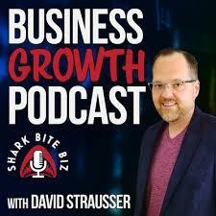
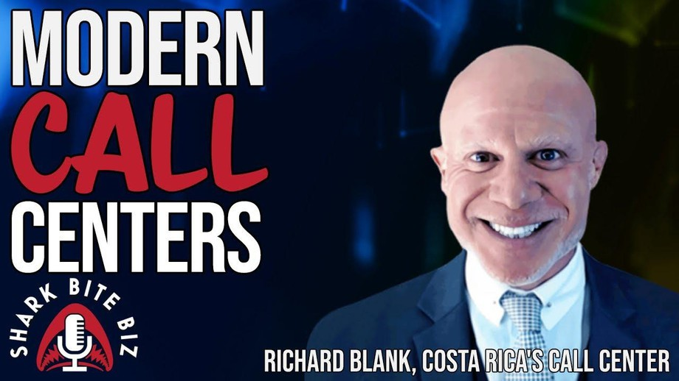
producer Jack Douglas, Soledad O'Brien, film director James Cullen Bressack, Recruiter.com and CNBC Contributor Evan Sohn and many more. Strausser is a member of the Forbes Business Development Council.
Are call centers alive or dead after covid with work-from-home going strong. Today's interview may surprise you as Shark Bite Biz's David Strausser chats with Richard Blank of Costa Rica's Call Center. Episode #213 Modern Call Centers.
Shark Bite Biz is a podcast dedicated to helping businesses achieve growth in the roaring 20's. In a world full of sharks, learn how to bite first!
This vodcast focuses on personal, professional, & business growth during the on-going global pandemic. We focus on bringing some of the top experts and small business owners to the show to tell their stories about how they broke through barriers preventing growth and got their business to the next level.

Slide 3
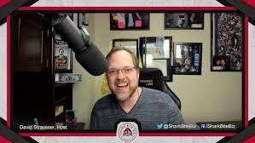
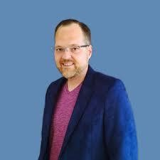

More about the Host: David Strausser is an expert at enabling small businesses to drive growth via the promise of technology. David empowers his customers to digitally transform by automating business processes and maximizing business intelligence. David writes on Forbes as a member of the Forbes Business Development Council and a member of the Harvard Business Review Advisory Council.
David was born and raised in Pottsville, Pennsylvania, the heart of coal country. At a young age David realized that the small city life wasn’t for him. He yearned for something larger and 6 weeks after the September 11th attacks, while barely 18, he decided to pack up and move to a new life.
“Viva la Mexico”. David moved to Tijuana, Baja California, Mexico. Why? Simple. He was able to live in Mexico and then work in San Diego, right across the U.S. / Mexico International Border Crossing at the San Ysidro Port of Entry.
Since his first job at the age of 14, David has always been enthusiastic about sales. He had worked at places like Foot Locker at the age of 15 and then Sears while a young adult. Just like he wanted more while living in Pottsville, he also felt that the retail life was not for him.

Slide 4

Yes, he could do it and excelled at it, often being the top sales representative in his store, but he felt he could achieve bigger and better things.
During the economic depression of 2008 – 2010, David found himself searching for answers. He moved to Peru for about a year, where he met his wife, Raquel Strausser. From there David immigrated Raquel to Mexico and they re-established themselves in the Baja Cali Megaregion. Employment was tough and while David could ultimately earn a living that was good enough for living in Mexico, their ultimate goal was to move to San Diego. The current wage environment at that time did not support him being able to make such a move.
That’s when David realized that after 10 years of living in Mexico at that point that he had some unique skills. Not only was David fluent in Spanish and had a Mexican legal status as a Residente Permanente (Mexican Legal Permanent Resident), but he had many contacts in business throughout Mexico, Peru, and the rest of Latin America.
Instead of taking a position where he would be grossly underpaid for his skillset out of necessity, David went another route. He started the business “Strausser Consulting Services” and began independent consulting. The goal of the company was to assist American companies trying to find growth throughout Latin America with their products and technologies. The start though wasn’t that simple. The very first contract David got was with a Sprint retailer who saw his vast retail experience and hired him as an independent consultant to help turn around 7 of their newly acquired stores in San Diego County. It was a six-month contract but it gave David something solid to run off of if he was successful.

Slide 5

Success happened and from there David acquired separate large contracts over a 6 year period. While many of the projects were fixed-term and project based, some of the contracts were long-term. Some of these contracts were with companies like P.I.N.T., Inc., doing business development to help them break into the Mexican market, Kodenshi AUK, a Japanese and Korean semiconductor manufacturer looking to break into Latin America, TAAG Industries, BorderTraffic / LaLineaEnVivo, and BajaBound. This all was the passion of what David does best, help small to medium size business grow. He was creating new channels and opportunities for these businesses that they did not know how to achieve on their own.

Slide 6

Interestingly enough, because of the unique border situation with the Baja-Cali megaregion of Tijuana and San Diego David was specializing at one point not just in technology, but border crossing technology. This lead to David developing extensive relationships with the Mexican Government, which led to him being contracted as the “Consejero Binacional” (Binational Advisor) to the Secretary of Tourism for Baja, California, Mexico where he worked in making lives easier for American Tourists while visiting Baja, Mexico with the promise of technology.
David assisted trying to modernize the Tourist Visa process online for Americans visiting Mexico and even helped transform the fishing permit license so that Americans can obtain the licenses digitally online.

Slide 7

All impressive feats at the time with a government that is notoriously slow in adopting new technology. In fact, David is one of the few non-Latino American citizens with a written letter of recommendation from the Mexican Government.

Slide 8

During that time also, David realized that there was a huge education gap in Mexico. Latinas, Mexican women specifically, were behind in their knowledge of how technology works.
Although with the younger generation it was getting better, at that time if you were 25 or older and female, your understanding of basic technology was little to none. That’s when David and his wife Raquel created a tech blog called TechChicas that was dedicated to helping Latinas around the world understand basic technology that they could access to make their lives easier. The site was a success winning multiple awards including one from Penn State University. That service was sold in 2015 when David took another turn in his career.

Slide 9

As successful as he was, the consulting world was a tiring one for David. Not only was he working 40 to 50 hours a week for clients, but he was also working an addition 20+ hours a week just trying to find new projects and bidding on new work. It was relentless and gave David no work / life balance.
After 6 long years of sacrificing all his time working to give his family the life he felt they deserved, David finally got offered a position that would give him what he was searching for. David and his family moved to Los Angeles in December of 2015 to start with Vision33, Inc.

Slide 10
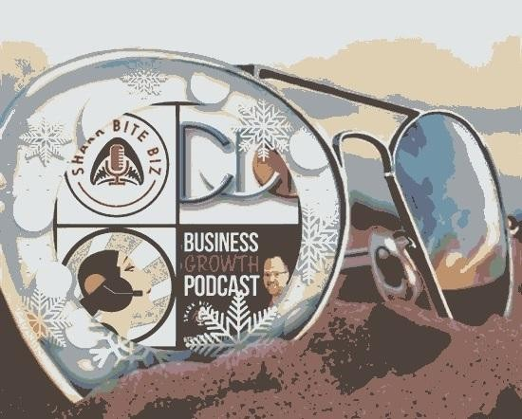
This brings a brand new chapter. Finally, David was able to use his networking skills, business development skills, sales and marketing strategies for one dedicated company. David was new to the ERP (enterprise resource planning) business but he had a thorough understanding of technology due to his degree from Penn State University in Information Sciences & Technologies with a focus on Business.

Slide 11

David was able to use innovative techniques to turn a barren region of Los Angeles to a powerhouse for Vision33. Creating millions and millions of dollars a year in revenue that Vision33 never saw from that region previously. He did this because of the way he builds personal relationships with his clients and how he manages a sales cycle. There were very few opportunities David lost. In fact, he became the king of creating his own pipeline by doing creative events like his “Executive Luncheon” that had an anti-luncheon type there where desert was served first and used out of the box type of speakers that brought true value to all the businesses that came to learn how to grow their business and breakthrough the barriers preventing growth.

Slide 12
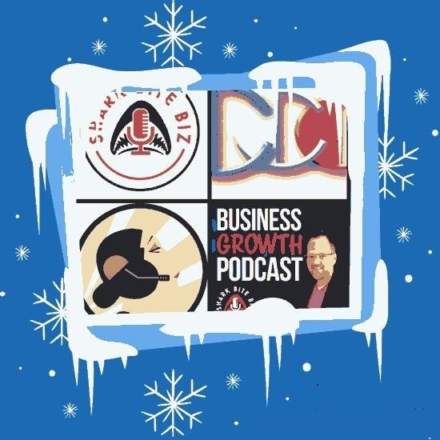
After 4 years, David was given the opportunity to move back home. Vision33 had a new region that needed a General Manager to oversee it and that is the Northeast. Since March of 2018, David has been managing the Northeast from sales, implementations, customer service, everything where he is growing the business at a record pace.

Slide 13
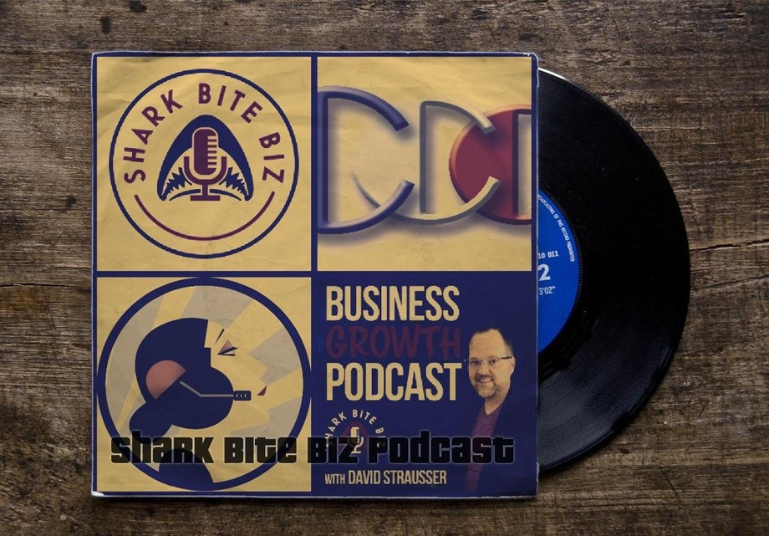

Even with the position that David currently has, he still feels that he has more to offer in order to help businesses grow and therefore on July 6, 2020, David launched the business podcast entitled Shark Bite Biz. This podcast is a discussion with subject matter experts and business owners discussing what works and what doesn’t in a global pandemic world.

Slide 14

Overall, David has had a tough, but fun career. It has always focused around one main topic though. Helping small to midsize businesses grow. There are many ways to do this and David uses his outside the box methodology in order to help his clients achieve that growth.
Richard’s vision quest journey is filled with twists and turns. When he was 27 years old, he relocated to Costa Rica to train employees for one of the larger call centers in San Jose. With a mix of motivational public speaking style backed by tactful and appropriate rhetoric, Richard shared his knowledge and trained over 10 000 bilingual telemarketers. Richard Blank has the largest collection of restored American Pinball machines and antique Rockola Jukeboxes in Central America making gamification a strong part of CCC culture.Richard Blank is the Chief Executive Officer for Costa Rica’s Call Center since 2008.

Slide 15

Mr. Richard Blank holds a bachelors degree in Communication and Spanish from the University of Arizona and a certificate of language proficiency from the University of Sevilla, Spain. A Keynote speaker for Philadelphia's Abington High School 68th National Honors Society induction ceremony. In addition, inducted into the 2023 Hall of Fame for Business. Giving back to Abington Senior High School is very important to Mr. Blank. As such, he endows a scholarship each year for students that plan on majoring in a world language at the university level.

Slide 16

https://costaricascallcenter.com/en/outbound-bpo-campaigns/

Slide 17

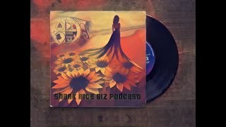
#RichardBlank #CostaRica #CallCenter #Outsourcing #Telemarketing #BPO #Sales #Entrepreneur #B2B #Business #Podcast #Leadgeneration #Appointmentsetting #SacrificetoSuccess #Sharkbitebizpodcast
Shark bite biz, Richard Blank,Costa Rica's Call Center, Outsourcing, Telemarketing, BPO, Nearshore, Sales, Entrepreneur, B2B, Business,Podcast,Gamification,Leadership,Marketing, Radio, Guest, Money, education, trainer,

