Slide 1

Downloaded from: justpaste.it/EvolvepreneurAIAdvantageShow
The Evolvepreneur AI Advantage Show . The future of
A.I. vs telemarketing with Richard Blank
the Evolvepreneur AI Advantage Show empowers you to embrace the future, optimize operations, and unlock your business's growth potential. What do you get when you combine talent, drive and personality? A good answer would be Richard Blank, the man behind 'Costa Rica's Call Center
Welcome to the Evolvepreneur AI Advantage Show, the ultimate destination for entrepreneurs seeking to harness the full potential of Artificial Intelligence.

Slide 2
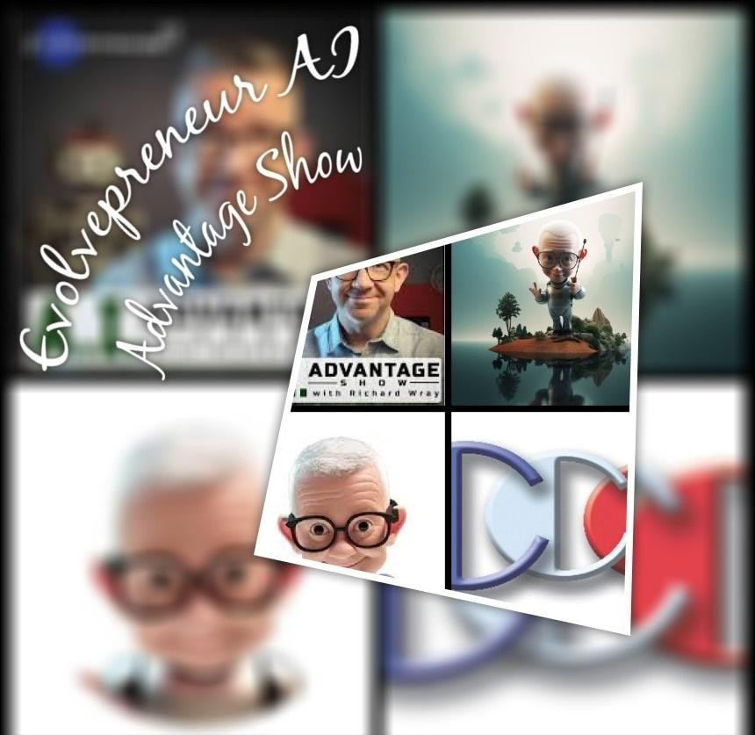
Join us on this captivating journey as we delve into the realm where innovation meets intelligence.

Slide 3

In each episode, we dive deep into the transformative power of AI, unveiling the strategies, insights, and tools that propel businesses forward. From deciphering AI algorithms to unlocking data-driven decision-making, our show equips you with the knowledge and skills to leverage AI as a game-changing force.

Slide 4
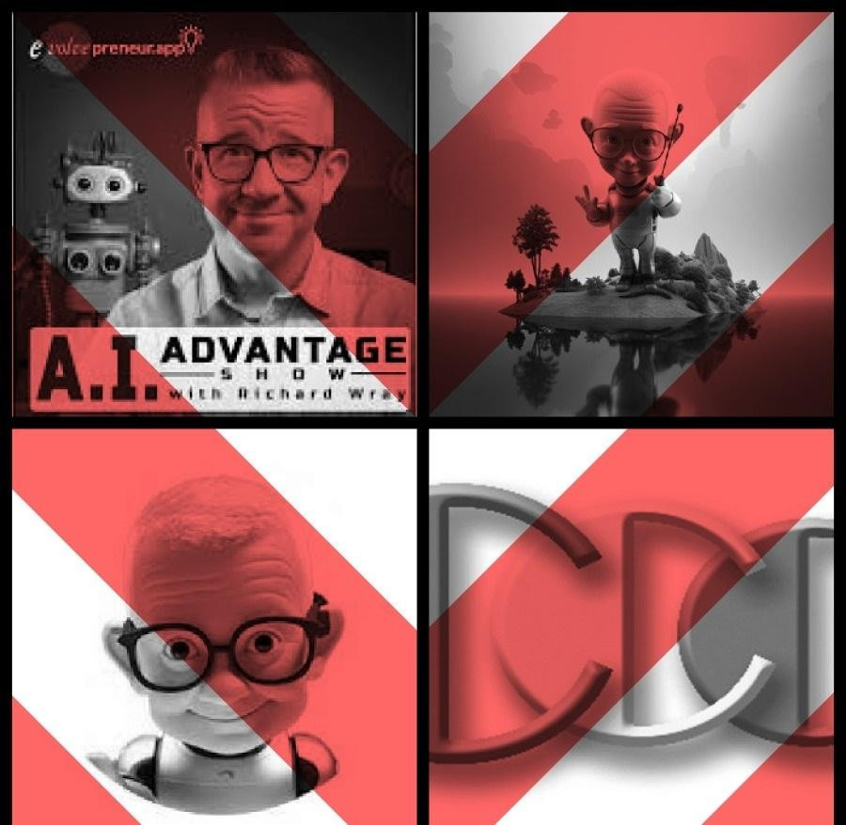
Engage with industry experts, thought leaders, and fellow entrepreneurs as we explore real- world applications, share success stories, and decode the latest AI trends. Whether you're a seasoned business owner or an aspiring entrepreneur, the Evolvepreneur AI Advantage Show empowers you to embrace the future, optimize operations, and unlock your business's growth potential.

Slide 5
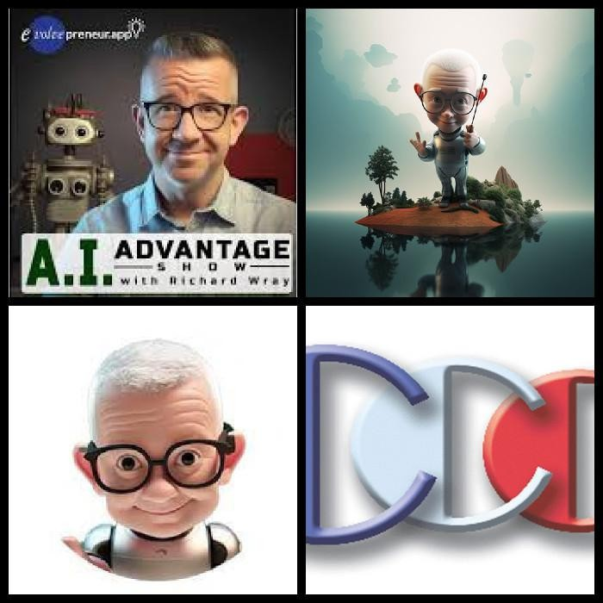
What do you get when you combine talent, drive and personality? A good answer would be Richard Blank, the man behind 'Costa Rica's Call Center'.

Slide 6
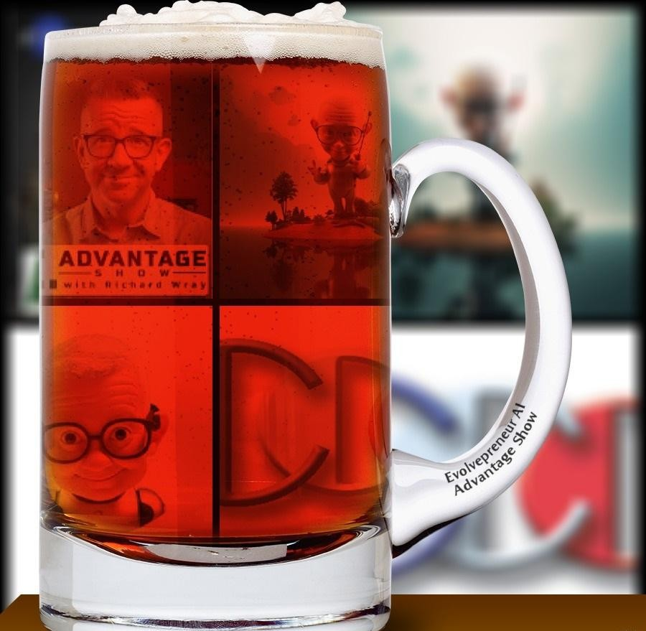
The A.I. Advantage Show Welcome!!!
You have arrived at the premier platform for entrepreneurs ready to learn about Artificial Intelligence. Join us as we explore the intersection of innovation and intelligence, diving into AI's transformative power. Each episode uncovers strategies, insights, and tools that drive business growth. We engage with experts and entrepreneurs, discussing real-world applications, success stories, and AI trends.

Slide 7

Whether you're an established business owner or an aspiring entrepreneur, our show helps you harness AI's potential, optimize operations, and boost growth.
In the next A.I. Advantage podcast we talk about so much more than just A.I. A truly inspirational individual!

Slide 8
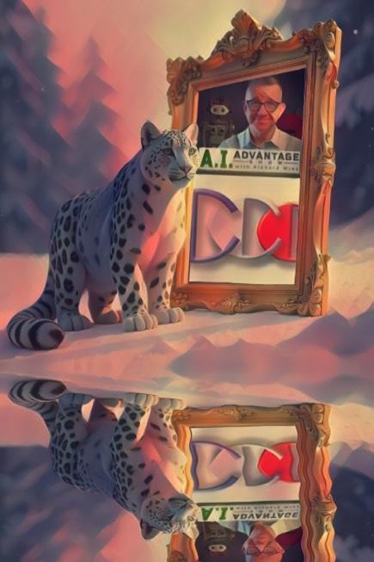
Welcome to the Evolvepreneur A.I. Advantage Show
Join me, Richard Wray, to gain the A.I. Advantage today where we dive deep into the transformative power of A.I. to help fast-track your business.
My very special guest today is Richard Blank ...

Slide 9
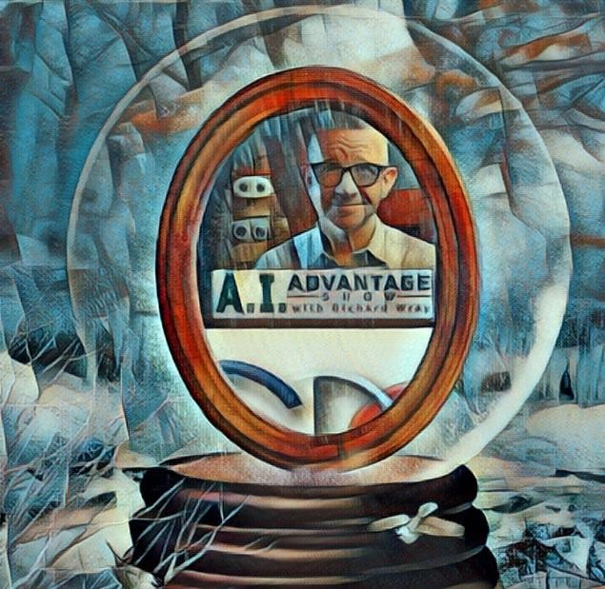
Richard Blank, an entrepreneur who moved from the northeastern U.S. to Costa Rica and found success running a call center business there. Richard discusses the challenges of moving away from home and taking risks, as well as his views on the role of technology and AI in customer service. He emphasizes the importance of maintaining the human touch and personal connections, even as technology advances. Blank also shares some of his other business ventures, like working with a musical group. Overall, the conversation explores the balance between embracing technology and preserving the personal, analog aspects of life and work.

Slide 10
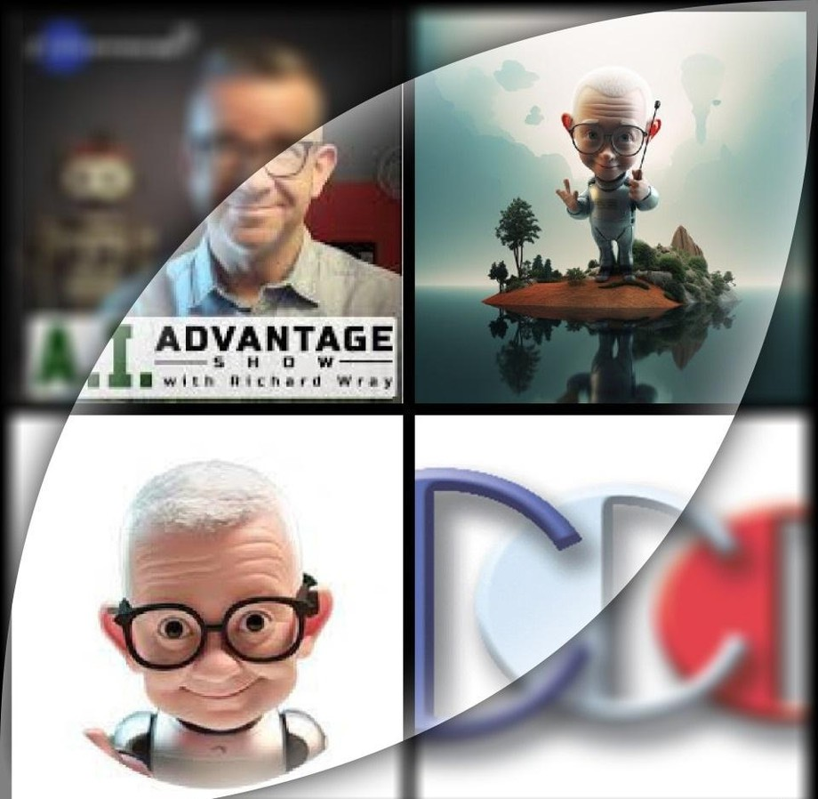
Key Moments:
The guest, Richard Blank, moved from the northeast US to Costa Rica and found great success there, including starting a call center business.
Blank emphasizes the importance of taking risks and following your passions, even if it means leaving your comfort zone and family/social expectations.
Blank discusses the role of technology and AI in business, noting both the benefits and potential downsides. He advocates for finding the right balance.

Slide 11

Blank believes in the value of human connection and interpersonal communication, even as technology advances. He sees a continued role for personalized service.
Blank shares his perspective on the call center industry, highlighting the need for efficiency and metrics while also maintaining a human touch.
Blank is passionate about language and writing, seeing them as important skills even in an
increasingly automated world.
Blank cautions against getting caught up in comparisons to tech giants and instead encourages finding your own path to success and happiness.
Blank emphasizes the importance of integrity, hard work, and doing things with "honorable intentions" in order to feel good about yourself.

Slide 12
Blank promotes the benefits of Costa Rica as a business location, citing factors like the neutral English accent and infrastructure.
Blank shares his experience of collaborating with a renowned musician, highlighting his diverse interests and talents.
Get ready to revolutionize your entrepreneurial journey with the AI Advantage. Tune in and join the Evolvepreneur community today!
Richard Wray
Steering the helm at evolvepreneur.app as a Senior Sales Manager, my journey encompasses shaping the AI landscape for entrepreneurs. Hosting a podcast that serves as a beacon for innovation, I delve into AI's transformative power, offering strategies and insights to fuel

Slide 13

business growth. The episodes are a treasure trove of knowledge, featuring expert discussions and success stories that guide listeners to harness AI effectively.
Previously, as Business Development Manager for APAC at Agora, my focus was on fostering connections that transcended borders through real-time engagement solutions. This role honed my proficiency in customer success and reinforced my commitment to advancing technology's role in facilitating human interactions. At evolvepreneur.app, we're on a mission to optimize operations and amplify growth for businesses ready to step into the future with A
Richard’s vision quest journey is filled with twists and turns. At 27 years old, he relocated to Costa Rica to train employees for one of the larger call centers in San Jose. With a mix of motivational public speaking style backed by tactful and appropriate rhetoric, Richard shared his knowledge and trained over 10 000 bilingual telemarketers over two decades.

Slide 14


Richard Blank has the largest collection of restored American Pinball machines and antique Rockola Jukeboxes in Central America making gamification a strong part of CCC culture.Richard Blank is the Chief Executive Officer for Costa Rica’s Call Center since 2008. Mr. Richard Blank holds a bachelors degree in Communication and Spanish from the University of Arizona and a certificate of language proficiency from the University of Sevilla, Spain.
A Keynote speaker for Philadelphia's Abington High School 68th National Honors Society induction ceremony. In addition, entered into the 2023 Hall of Fame for Business along side other famous alumni. Paying it forward to Abington Senior High School is very important to Mr.

Slide 15

Blank. As such, he endows a scholarship each year for students that plan on majoring in a world language at the university level.

Slide 16

Costa Rica’s Call Center (CCC) is a state of the art BPO telemarketing outsource company located in the capital city of San Jose, Costa Rica. Our main focus has been, and will always be to personally train each and every Central America call center agent so that we may offer the highest quality of outbound and inbound telemarketing solutions and bilingual customer service to small and medium sized international companies, entrepreneurs as well as fortune 500 companies.
https://costaricascallcenter.com/en/outbound-bpo-campaigns/
the Evolvepreneur AI Advantage Show, Richard Wray, Richard Blank, Costa Rica's Call Center, Outsourcing, Telemarketing Call Centre, BPO, Nearshore Contact Center, Sales,

Slide 17

Entrepreneur, B2B, Business, Podcast, Gamification,Leadership, Marketing, CX, Guest, Money, B2C education, BPO trainer,
#theEvolvepreneurAIAdvantageShow #RichardWray #CostaRica #CallCenter #Outsourcing #Telemarketing #BPO #Sales #Entrepreneur #B2B #Business #Podcast #Gamification #CEO #learnpodcasting #podcastepisode #podcastguest #podcasting #podcastinterview #podcastplaylist #podcasts #podcastskills #podcastshow

Slide 18

https://youtube.com/shorts/azSqNhzUbnU https://youtube.com/shorts/y9duZQeJVCw https://youtube.com/shorts/ScVKOJptw1o https://youtube.com/shorts/elFhd6suM9Q https://youtube.com/shorts/hAeEuXYiL_g https://youtube.com/shorts/9VgRqqXSmyg https://youtube.com/shorts/t_Bv6W2tjRs

