Slide 1



Downloaded from: justpaste.it/techyourbusinesspodcastguest
Tech Your Business Podcast with Peter Banigo. An Outsourcing Operations Overseas with Richard Blank.
Tech Your Business
A weekly podcast simplifying & amplifying tech trends and innovations for Business owners overwhelmed by Technology.
In this episode of the Tech Your Business podcast, Peter Banigo chats with Richard Blank, CEO of the Costa Rica Call Center, about outsourcing operations like sales, customer service and back office support. Show #27. Outsourcing Operations Overseas.

Slide 2
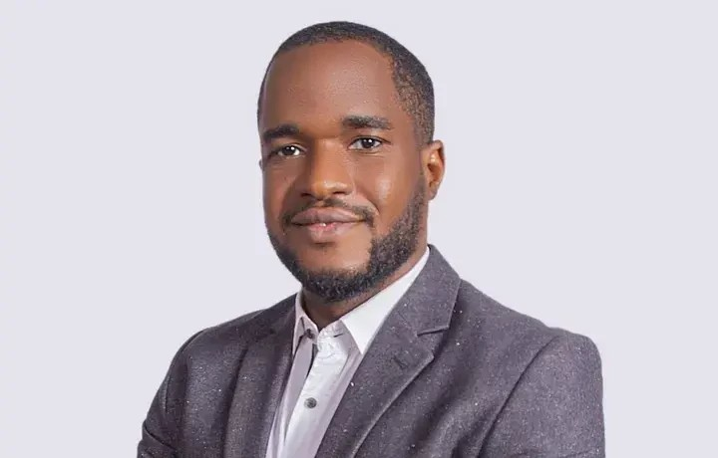

Get tips on outsourcing operations overseas from call center expert Richard Blank of the Costa Rica Call Center!
In this episode, Richard shares 16+ years of lessons learned on managing remote teams effectively, competing with industry giants like Amazon, and the pros and cons of outsourcing vs handling operations in-house.
Gain insights into building company culture, empathy and flexibility when leveraging global talent to drive efficiency and results for your business!
Richard shares lessons learned from 16+ years running a call center abroad, including the importance of company culture, empathy, flexibility and frugality.
They discuss strategies for competing with industry giants, tips for effective remote team management, and the pros and cons of outsourcing vs handling operations in-house.

Slide 3

An insightful conversation on leveraging talent globally to improve efficiency and boost results!
Hosted by Peter, an accomplished tech and business expert, the 'Tech Your Business' podcast is your go-to resource for all things tech, business, and growth. Brought to you by Target ICT Ltd, a leading provider of innovative tech solutions and consulting services dedicated to empowering businesses to reach new heights.
If the Tech you use in your business overwhelms or frustrates you, if you want to learn about new ways to implement Technology to boost productivity and profitability without getting bogged down in technical jargon? This is the place for you.

Slide 4

Target ICT was launched in 2018 after the founder's journey through 8 years of running multiple businesses. While tech tools offer a distinct advantage to every business, they are often presented in a way that makes them difficult and overwhelming to adopt, with an overload of industry jargon. This creates a situation where clients are unable to fully utilize these tools due to the added complexity.
Target ICT was founded by someone who has owned both online and brick-and-mortar businesses and can fully empathize with the struggles and frustrations of fellow business owners. The Tech Your Business podcast was launched in 2022 as a free resource to help this demographic!

Slide 5

Target ICT was started to apply the founder's decade of experience in using Tech to stay ahead in business. If you are tired of Tech providers who don't understand the needs of your business, too good to be true guarantees and fancy, jargon-filled presentations from service providers who don't deliver, You are in the right place. We are registered with the Companies House in England and Wales
At Target ICT, our core values revolve around clarity, empathy, integrity, innovation and client satisfaction. We are committed to ensuring client fulfillment by providing clear, jargon-free communication and tailored solutions that genuinely address the unique needs of each business. We approach every interaction with empathy, recognizing the distinct challenges our clients face. Operating with transparency and honesty, we build trust through consistent and reliable service. By staying at the forefront of technology, we offer the most innovative solutions to help our clients achieve their business goals.
One windy day in February, 2018, while taking a stroll down New Walk in the middle of Leicester, our founder got the idea for Target ICT Ltd.

Slide 6

This was to combine his lifetime love for Technology, decade of starting businesses where technology gave an edge, ability to break down and communicate complex concepts simply as well as his love for problem solving.
The Problem
You start a business to render a service you're good at.
In today's world, you typically need technology to get things running more efficiently and you end up spending so much time picking the right Tech or fixing Tech that breaks (which it does all the time).
This can be a frustrating and time wasting experience for any business owner. More Of The Problem
Many businesses turn to tech consultants for help. The issue? These consultants often have deep technical knowledge but lack business insight. This leads to communication gaps filled with jargon and solutions that don’t quite fit your needs. It’s a mismatch that costs time, money, and peace of mind.

Slide 7

About Us
After starting businesses in various continents in food, procurement, ecommerce, IT and Fashion over a decade where Tech was his unfair advantage, our founder saw the struggles others faced with technology. He started Target ICT to bridge this gap. We’re here to be your tech partner, speaking your language, and focusing on what matters most: your satisfaction. No jargon, just solutions that work for your business. We are registered with the Companies House in England and Wales with Company Number 11224642 and VAT Number GB 435228308.
Our Mission
At Target ICT, our mission is to empower businesses by making technology accessible and effective. We strive to provide clear, jargon-free communication and tailored solutions that meet the unique needs of each business, ensuring they can focus on what they do best.

Slide 8

Our Vision
Our vision is to be the leading tech partner for forward thinking businesses globally.
We aim to create a world where technology seamlessly supports business growth, innovation, and efficiency without causing stress or confusion..
Our Values How We Work
At Target ICT, our core values revolve around clarity, empathy, integrity, innovation and client satisfaction. We are committed to ensuring client fulfillment by providing clear, jargon-free communication and tailored solutions that genuinely address the unique needs of each business. We approach every interaction with empathy, recognizing the distinct challenges our clients face. Operating with transparency and honesty, we build trust through consistent and reliable service. By staying at the forefront of technology, we offer the most innovative solutions to help our clients achieve their business goals.

Slide 9

Interpersonal Communication Conflict Management Strategy
Phonetic Micro Expression reading for mastering verbal tell signs.
The Famous Buffer-Boomerang Technique

Slide 10

Advanced telemarketing strategy, conflict management, interpersonal soft skills, customer support, rhetoric, gamification, pinball machines, employee motivation and phonetic micro expression reading.
Richard’s vision quest journey is filled with twists and turns. At 27 years old, he relocated to Costa Rica to train employees for one of the larger call centers in San Jose. With a mix of motivational public speaking style backed by tactful and appropriate rhetoric, Richard shared his knowledge and trained over 10 000 bilingual telemarketers over two decades.
Richard Blank has the largest collection of restored American Pinball machines and antique Rockola Jukeboxes in Central America making gamification a strong part of CCC culture.Richard Blank is the Chief Executive Officer for Costa Rica’s Call Center since 2008. Mr. Richard Blank holds a bachelors degree in Communication and Spanish from the University of Arizona and a certificate of language proficiency from the University of Sevilla, Spain.

Slide 11

A Keynote speaker for Philadelphia's Abington High School 68th National Honors Society induction ceremony. In addition, entered into the 2023 Hall of Fame for Business along side other famous alumni. Paying it forward to Abington Senior High School is very important to Mr. Blank. As such, he endows a scholarship each year for students that plan on majoring in a world language at the university level.

Slide 12

https://costaricascallcenter.com/en/outbound-bpo-campaigns/
#techyourbusiness #PeterBanigo #RichardBlank #CostaRica #CallCenter #Outsourcing #Telemarketing #BPO #Sales #Entrepreneur #B2B #Business #Podcast #Gamification #CEO #learnpodcasting #podcastepisode #podcastguest #podcasting #podcastinterview #podcastplaylist #podcasts #podcastskills #podcastshow
tech your business podcast, Peter Banigo, Richard Blank,Costa Rica's Call Center, Outsourcing, Telemarketing, BPO, Nearshore, Sales, Entrepreneur, B2B, Business,Podcast,Gamification,Leadership,Marketing, Radio, Guest, Money, education, trainer,

Slide 13


Slide 14


