Slide 1
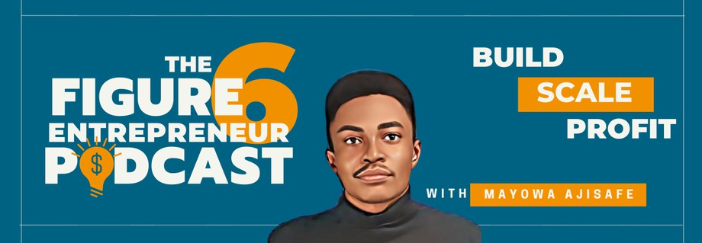
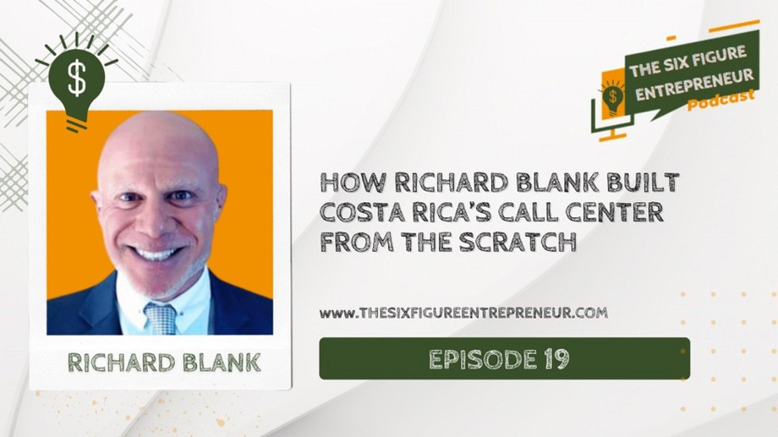
Downloaded from: justpaste.it/TheSixFigureEntrepreneurPodc
The Six Figure Entrepreneur Podcast presented by Mayowa Ajisafe. Sales Episode #19 with Richard Blan
In this episode of The Six Figure Entrepreneur Podcast, Mayowa Ajisafe, host of The Six Figure Entrepreneur Podcast, sits down virtually with Richard to share the stories of his amazing entrepreneurial journey. The Six Figure Entrepreneur Podcast is super excited to host Richard
Here’s a Glimpse of What You’ll Hear: How Richard got started as an entrepreneur How Richard started his business slowly but consistently.

Slide 2
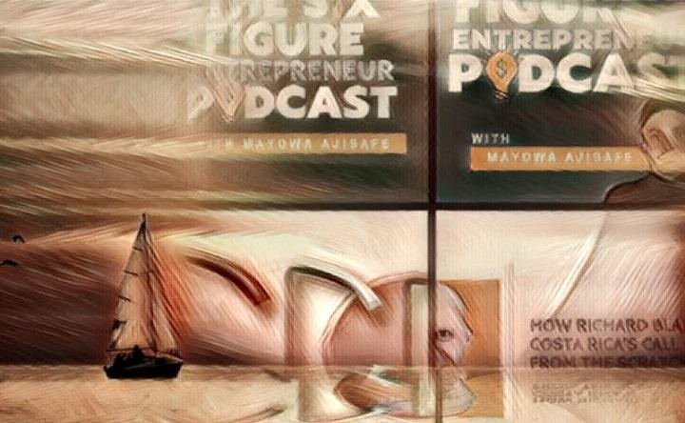
The lessons Richard has learned throughout his entrepreneurial journey His book recommendations. His best tip for all entrepreneurs.
More people than ever are building cool stuff from the scratch online, building businesses that are solving problems, and they are making a lot of money in the process.On this podcast, your host - Mayowa Ajisafe sits down virtually with amazing six and seven-figure consultants, coaches, and founders of successful online businesses as they share not only stories of their entrepreneurial journey, the challenges they face while building their businesses, and their ideas, opportunities, tips and strategies they are taking advantage of to get ahead in business so the rest of us can do the same.

Slide 3

In this episode of The Six Figure Entrepreneur Podcast, Mayowa Ajisafe, host of The Six Figure Entrepreneur Podcast, sits down virtually with Richard to share the stories of his amazing entrepreneurial journey. The Six Figure Entrepreneur Podcast is super excited to host Richard Blank.

Slide 4
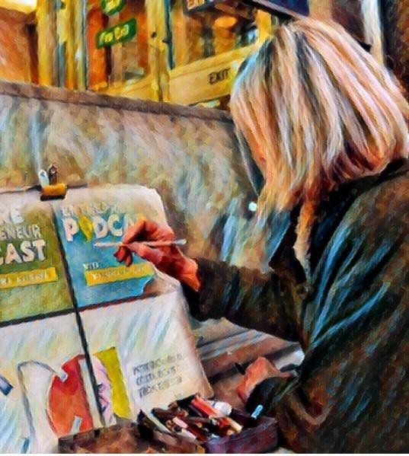
Listen to episodes of The Six Figure Entrepreneur Podcast and learn the tips, strategies, and tactics entrepreneurs who have built businesses from scratch to 6, 7, and 8 are using to build and grow their businesses land more clients and make more money in the process.

Slide 5

Discover Exclusive Insights, Tips and Strategies From Successful Entrepreneurs For Taking Your Business Beyond 6 and 7-Figures
Here’s a Glimpse of What You’ll Hear:
How Richard got started as an entrepreneur
How Richard started his business slowly but consistently.

Slide 6

The lessons Richard has learned throughout his entrepreneurial journey His book recommendations.
His best tip for all entrepreneurs. Resources Mentioned in This Episode Richard’s Costa Rica Call Center

Slide 7
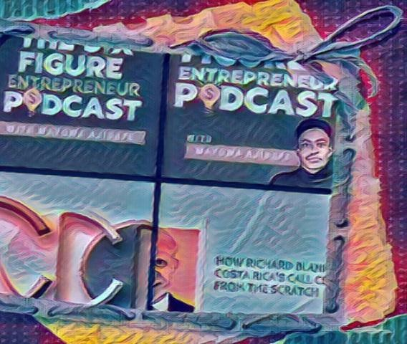
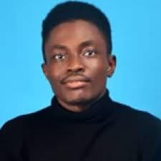
The Book Cot founder, Mayowa Ajisafe, has been in the book publishing space and advising about book publishing since 2014.
We’re a professional publishing agency that makes the process of writing and publishing a book an easy walk for busy entrepreneurs who know the power of a published book, want to write and publish one but are too busy having fun running their businesses.

Slide 8
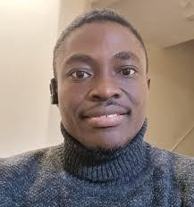
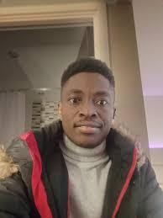
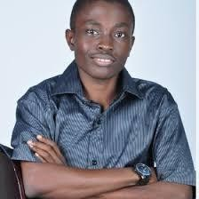
Since 2018, our proven system has helped hundreds of entrepreneurs, thought leaders, coaches, consultants, and experts become instant authority while leveraging their published books to get speaking gigs, invited to speak at conferences and guests on top podcasts.
What do you need to write and publish your best business card – a book with your name? When you use our proven system, all you need is an idea, your expertise, and the end goal you want from having a published book.
We handle the content, and production processes like writing, editing, proofreading, cover design, publishing, and distribution – you need to block off some hours of your time for a week to “speak” your book. Then we handle the rest of the process.
And we don’t stop at that!

Slide 9

We also give you a proven blueprint you can copy to use your book to get more visibility, get on podcasts as a guest to share your expertise, and get more leads and paying clients for your business.
We focus on ensuring you have a direct path to ROI, which is the most important component. Plus, our entire book production system takes any heavy lifting of writing, preparing, and publishing a book off your plate.
We have also made business networking and becoming a published author work together in one single way.
How?

Slide 10

For busy and successful entrepreneurs who might not be ready to take on a solo book project, we also have many multi-author book projects they can join as co-author for a fraction of the time and financial resources it will take to write and publish a solo book.

Slide 11
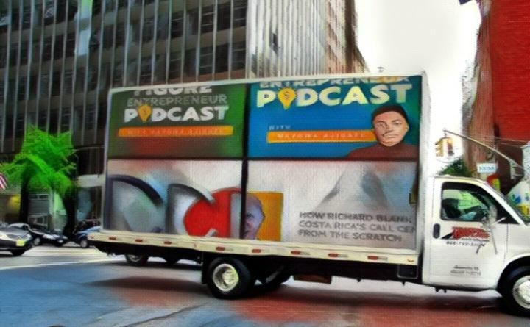
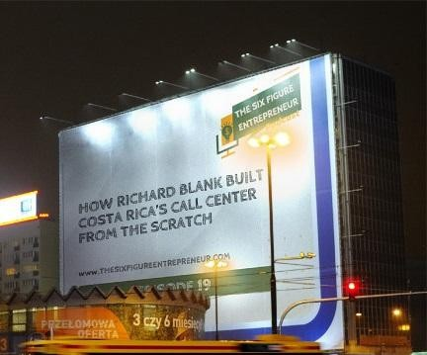
We have created a system for like-minded experts, thought leaders, coaches, and consultants to share their stories and expertise in one book.
The relationships you form through these multi-author book projects on their own are worth more than their weight in gold.
You can become an instant authority in your field or niche while connecting with 10 to 20 amazing entrepreneurs like you with whom you share the same passion and getting exposure to the audience they have built for years.

Slide 12
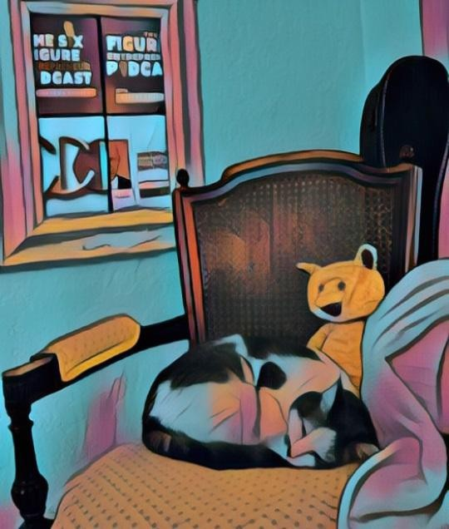
You can find details of our ongoing multi-book project you can join here.
Are you considering having a book in your name for more visibility, credibility, and the instant authority you get from becoming a published author? Would you like to work with a book publishing agency that wants you to win?

Slide 13
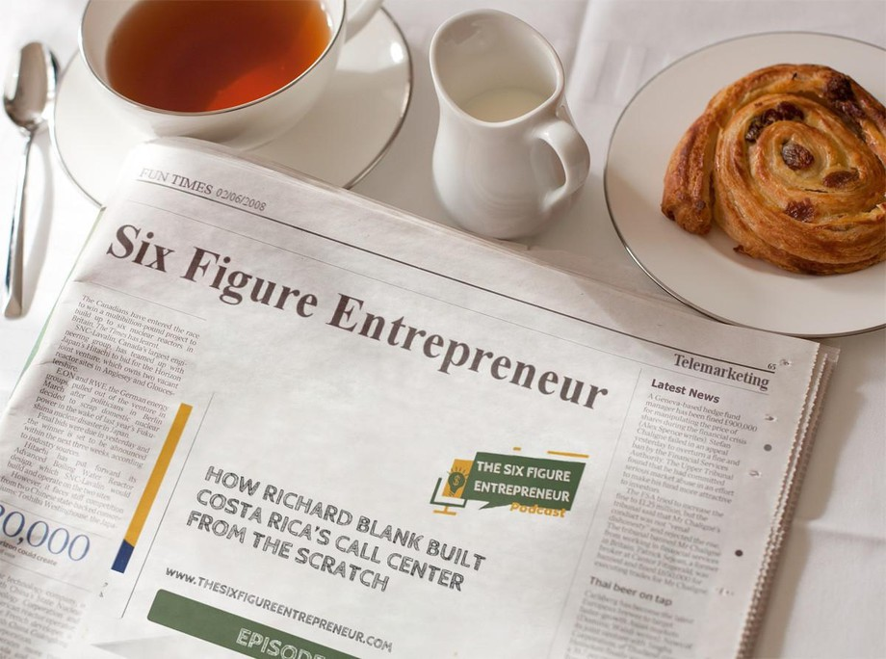
For the last 12 years, I have worked as a content and book publishing strategist and a digital lead generation consultant in publishing, B2C and B2B agencies, and marketing event spaces.

Slide 14


My strengths include Strategic Content Marketing, thigh ticket Client Acquisition, Project Management, Podcasting, Collaboration-Based Client Acquisition, Business Development, Facebook and Google Display Ads Marketing, and Marketing Strategy.
I've worked in agency, in-house, remote, hybrid, and in-house settings all these years. I excel at using my human-to-human conversations and content-based networking to create marketing solutions that produce results.

Slide 15

I’ve led and worked with teams to create result-driven projects across various channels. Richard’s vision quest journey is filled with twists and turns. At 27 years old, he relocated to Costa Rica to train employees for one of the larger call centers in San Jose. With a mix of motivational public speaking style backed by tactful and appropriate rhetoric, Richard shared his knowledge and trained over 10 000 bilingual telemarketers over two decades.

Slide 16
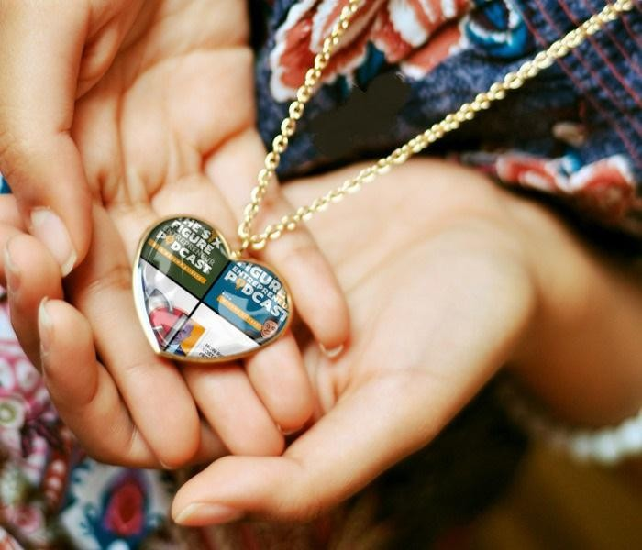
Richard Blank has the largest collection of restored American Pinball machines and antique Rockola Jukeboxes in Central America making gamification a strong part of CCC culture.Richard Blank is the Chief Executive Officer for Costa Rica’s Call Center since 2008.

Slide 17

Mr. Richard Blank holds a bachelors degree in Communication and Spanish from the University of Arizona and a certificate of language proficiency from the University of Sevilla, Spain.

Slide 18
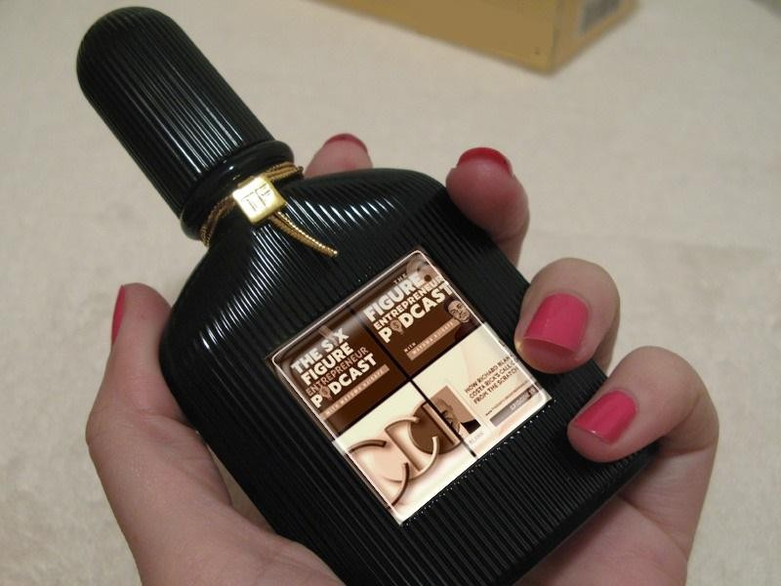
A Keynote speaker for Philadelphia's Abington High School 68th National Honors Society induction ceremony. In addition, entered into the 2023 Hall of Fame for Business along side other famous alumni. Paying it forward to Abington Senior High School is very important to Mr. Blank. As such, he endows a scholarship each year for students that plan on majoring in a world language at the university level.

Slide 19

Costa Rica’s Call Center (CCC) is a state of the art BPO telemarketing outsource company located in the capital city of San Jose, Costa Rica. Our main focus has been, and will always be to personally train each and every Central America call center agent so that we may offer the highest quality of outbound and inbound telemarketing solutions and bilingual customer service to small and medium sized international companies, entrepreneurs as well as fortune 500 companies.

Slide 20

https://costaricascallcenter.com/en/outbound-bpo-campaigns/

Slide 21

Mayowa Ajisafe, The Six Figure Entrepreneur Podcast ,Richard Blank, Costa Rica's Call Center, Outsourcing, Telemarketing Call Centre, BPO, Nearshore Contact Center, Sales,

Slide 22


Entrepreneur, B2B, Business, Podcast, Gamification,Leadership, Marketing, CX, Guest, Money, B2C education, BPO trainer,
#MayowaAjisafe #TheSixFigureEntrepreneurPodcast #RichardBlank #CostaRica #CallCenter #Outsourcing #Telemarketing #BPO #Sales #Entrepreneur #B2B #Business #Podcast #Gamification #CEO #learnpodcasting #podcastepisode #podcastguest #podcasting #podcastinterview #podcastplaylist #podcasts #podcastskills #podcastshow

Slide 23

https://youtu.be/eo0jG9k7GGE?si=SlM1wzrL9dNTJFSk

