Slide 1

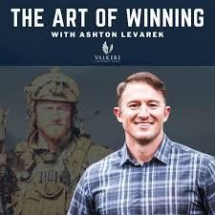
Downloaded from: justpaste.it/artofwinningpodcastguestricblank
The Art of winning with Ashton Levarek. More Than a Call: Genuine Business with Richard Blank.
What it takes to transform a small startup into a successful, people-centric business? In today’s episode, we explore the journey of Richard Blank, who ventured into the world of call centers in Costa Rica,
This is the Art of winning podcast. Ashton has spent the last 21 years working with our nation's most elite athletes, leaders and warriors. Ashton has met men and women that live and even die by the phrase 'failure is not an option.' Join us as we explore the mental disciplines, physical practices, and financial tools employed by the true winners of our time, as well as have fun, exploring success and what it takes to win in this thing called life.

Slide 2
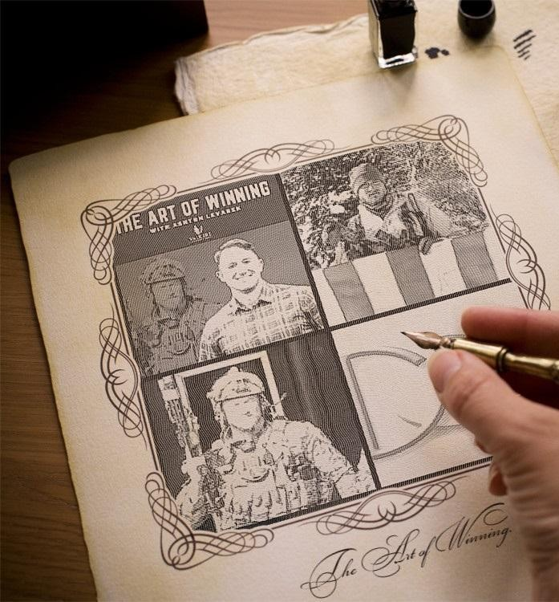
What it takes to transform a small startup into a successful, people-centric business? In today’s episode, we explore the journey of Richard Blank, who ventured into the world of call centers in Costa Rica, fostering an atmosphere of camaraderie and compassion that turned his company into a family. From valuable insights on leadership and employee motivation to the power of storytelling in business, Richard's experiences and wisdom offer a unique perspective on building a brand that's not just about numbers, but about connections. Discover how creating an environment of empathy and personal growth can unlock untapped potential in both employees and clients, making business not just profitable, but fulfilling.

Slide 3
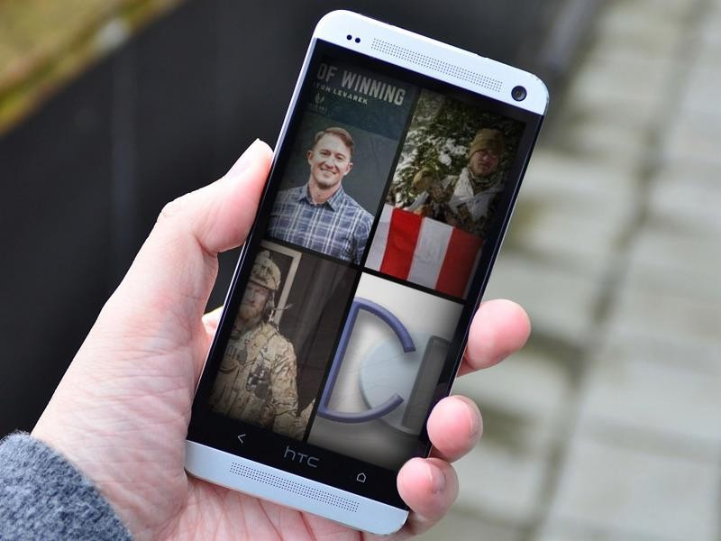
Tune in for a dose of inspiration and actionable advice from a business leader who believes that success is rooted in both self-love and giving back. Episode 116 on the Art of Winning podcast.

Slide 4
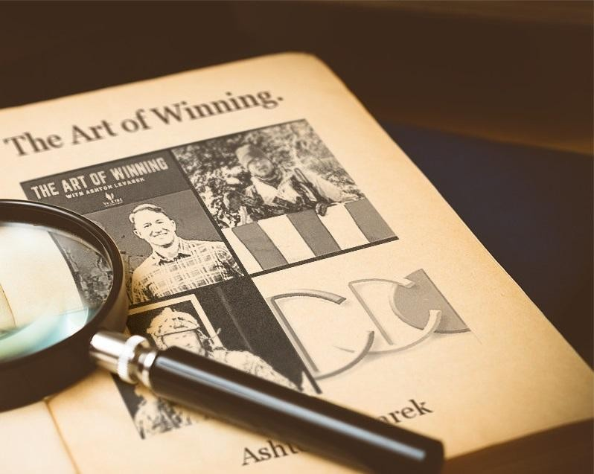
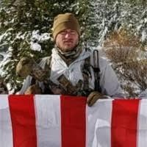
Building a group of financially free veterans, independent leaders, husbands and fathers through superior mindset, training, and investing. From $25k to $90M in rentals The Art of Winning Podcast for more.
Focused on creating cashflow through strategic real estate investments in order to sponsor Special Operations Veterans as they return home from war.
Valkere Investment Group.
Top Real Estate Investing and Investment Properties.
Funding the fight against PTSD through strategic real estate investments.

Slide 5
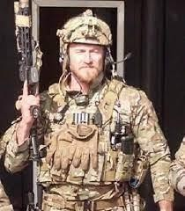
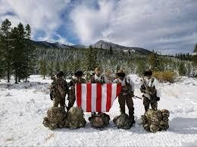
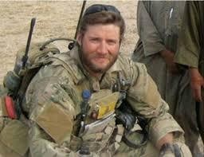
Twenty year Special Operations veteran, Experienced Team Lead with a demonstrated history of working in Special Operations. Skilled in Management, Military Operations, Leadership, Project Management, and Team Building.
Strong emergency medical professional with a BS of Sports and Health Science focused in Kinesiology and Exercise Science from American Public University System.
What it takes to transform a small startup into a successful, people-centric business? In today’s episode, we explore the journey of Richard Blank, who ventured into the world of call centers in Costa Rica, fostering an atmosphere of camaraderie and compassion that turned his company into a family.

Slide 6
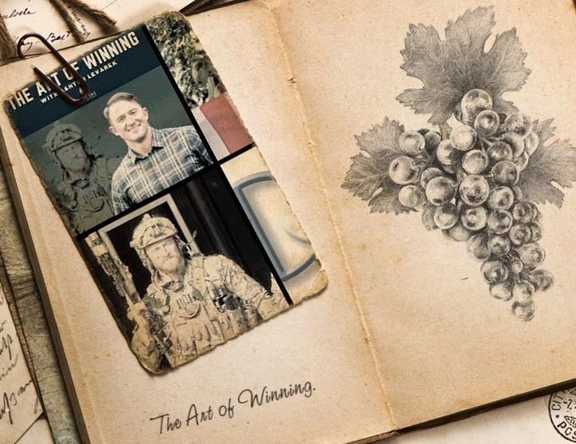
From valuable insights on leadership and employee motivation to the power of storytelling in business, Richard's experiences and wisdom offer a unique perspective on building a brand that's not just about numbers, but about connections.

Slide 7
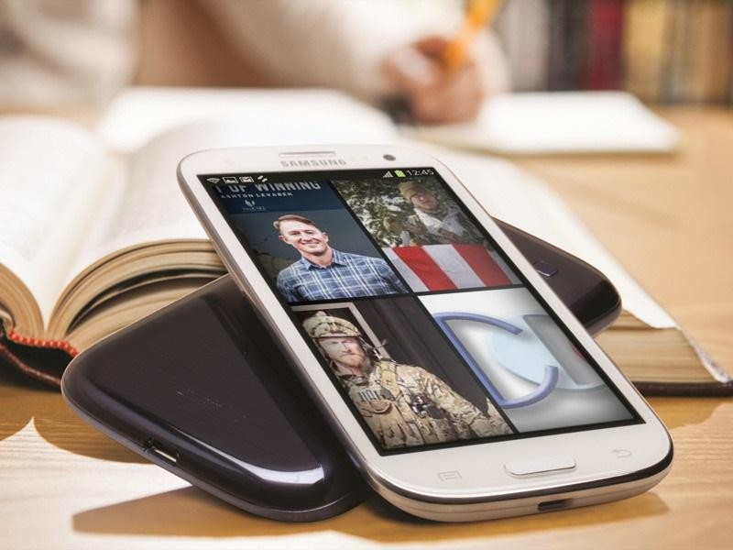
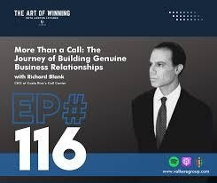
Discover how creating an environment of empathy and personal growth can unlock untapped potential in both employees and clients, making business not just profitable, but fulfilling.
Tune in for a dose of inspiration and actionable advice from a business leader who believes that success is rooted in both self-love and giving back
[00:00 – 18:08] Preserving the Art of Communication
Richard’s success in the call center industry stemmed from his ability to leverage his second language skills for effective communication and relationship-building.

Slide 8
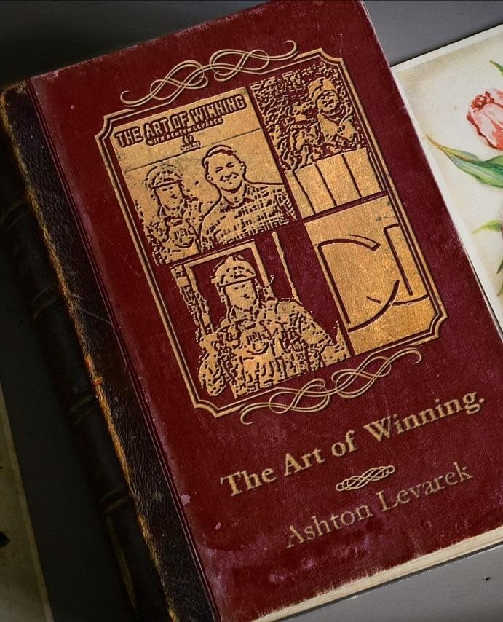
Call centers retain value through personalized interactions that AI can't replicate, maintaining the importance of human touch and emotional connection.a

Slide 9
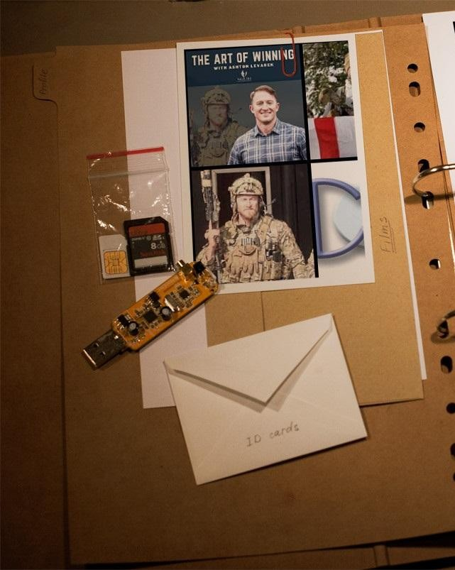
Successful telemarketing requires honing soft skills, such as active listening and using descriptive vocabulary to engage customers effectively over the phone.

Slide 10

Richard aimed to preserve the art of speech in call centers, emphasizing the significance of genuine interactions and relationships for customer satisfaction and business growth. [18:09 - 37:48] Creating Connection
Building rapport through positive tone, empathy, and personalized interaction is essential for effective communication.

Slide 11

Effective cold calls involve due diligence, individualized approaches, and genuine interest in prospects.
Integrating games and camaraderie in the workplace fosters teamwork, relaxation, and engagement among employees.

Slide 12

Identifying deception by analyzing answering speed offers insight into genuine responses

Slide 13

during conversations.
[37:49 – 01:09:27] Embracing Life's Complexities
· The key to effective coaching and motivation lies in establishing personal connections with team members, fostering receptivity and growth.
Sharing personal stories, triumphs, and experiences is a powerful tool to build rapport and motivate both employees and clients.
Self-actualization, belief in oneself, and focusing on personal well-being are essential for sustained success and fulfillment.
Life is like a Rube Goldberg machine, requiring continuous adjustments to ensure elements harmoniously contribute to forward movement and success.

Slide 14

Interpersonal Communication Conflict Management Strategy
Phonetic Micro Expression reading for mastering verbal tell signs.
The Famous Buffer-Boomerang Technique
Advanced telemarketing strategy, conflict management, interpersonal soft skills, customer support, rhetoric, gamification, pinball machines, employee motivation and phonetic micro expression reading.
Richard’s vision quest journey is filled with twists and turns. At 27 years old, he relocated to Costa Rica to train employees for one of the larger call centers in San Jose. With a mix of motivational public speaking style backed by tactful and appropriate rhetoric, Richard shared his knowledge and trained over 10 000 bilingual telemarketers over two decades.

Slide 15

Richard Blank has the largest collection of restored American Pinball machines and antique Rockola Jukeboxes in Central America making gamification a strong part of CCC culture.Richard Blank is the Chief Executive Officer for Costa Rica’s Call Center since 2008. Mr. Richard Blank holds a bachelors degree in Communication and Spanish from the University of Arizona and a certificate of language proficiency from the University of Sevilla, Spain.
A Keynote speaker for Philadelphia's Abington High School 68th National Honors Society induction ceremony. In addition, entered into the 2023 Hall of Fame for Business along side other famous alumni. Paying it forward to Abington Senior High School is very important to Mr. Blank. As such, he endows a scholarship each year for students that plan on majoring in a world language at the university level.
Costa Rica’s Call Center (CCC) is a state of the art BPO telemarketing outsource company located in the capital city of San Jose, Costa Rica. Our main focus has been, and will always be to personally train each and every Central America call center agent so that we may offer the highest quality of outbound and inbound telemarketing solutions and bilingual customer

Slide 16
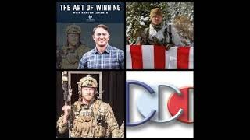
service to small and medium sized international companies, entrepreneurs as well as fortune 500 companies.
https://costaricascallcenter.com/en/outbound-bpo-campaigns/
#Art of winning #Ashton Levarek #RichardBlank #CostaRica #CallCenter #Outsourcing #Telemarketing #BPO #Sales #Entrepreneur #B2B #Business #Podcast #Gamification #CEO #learnpodcasting #podcastepisode #podcastguest #podcasting #podcastinterview #podcastplaylist #podcasts #podcastskills #podcastshow
Art of winning, Ashton Levarek, Richard Blank,Costa Rica's Call Center, Outsourcing,
Telemarketing, BPO, Nearshore, Sales, Entrepreneur, B2B, Business,Podcast,Gamification,Leadership,Marketing, Radio, Guest, Money, education, trainer,

