Slide 1


Downloaded from: justpaste.it/ThebusinessbrainpodcastbyST
The business brain podcast by ST Rappaport of LifePix University. A Fun-tastic Workplace Culture wit
If you’re an ADHD entrepreneur who wants to optimize your brain to grow your business with more ease, you’re in the right place. Who says work has to be boring? Richard Blank shares with us how he built his cool business and building relationships at the same time.
ST Rappaport - LifePix University
If you’re an ADHD entrepreneur who wants to optimize your brain to grow your business with

Slide 2


more ease, you’re in the right place. Here we discuss how to optimize ADHD by working on the core of the issue instead of putting on a band-aid. You're brain will learn how to understand time, be organized, get things done efficiently, and more, all while getting the incredible benefits of ADHD!
Who says work has to be boring? Richard Blank shares with us how he built his cool business and building relationships at the same time. A Workplace Culture via play: Building a Thriving Business Environment.
Get ready for some real change as with each episode we’ll discuss a real-life challenge, why you might be struggling with it, and give you practical strategies so all areas of your life will improve.
Hey! I'm ST Rappaport
I help ADHD entrepreneurs optimize their brain to grow their business with ease.
The reason you are struggling with ADHD is because some of your thinking skills are weak.

Slide 3

You see, thinking is not one big thing.
Thinking is made up of 28 thinking skills called cognitive functions.
Naturally, we all have stronger and weaker cognitive functions. These weak cognitive functions can get in our way of doing what we want to do.
But it doesn't have to stay that way!
By improving the thinking skills behind the challenging tasks, it all becomes a lot easier. Yes, even focusing, time management and impulsivity!
Subscribe to the channel to learn how to optimize your brain and run your business with more ease.
Helping ADHD entrepreneurs optimize their brain to grow their business with more ease. | Brain Engineer
Are you frustrated because your procrastination has led to a loss of business and opportunities?

Slide 4

Imagine being an ambitious entrepreneur who has found a way to handle clients, business operations AND marketing with ease.
You actually experience the freedom you started the business for. More time for family and friends. More time to do what you love.
Not because you're playing it small. But because everything is in place.
Podcast episodes for the next 3 months are recorded.
Marketing emails for the next month are written.

Slide 5


And short-form social media videos? Those were done ages ago!
You connect with your clients in a way that others haven’t been able to. You understand them in deeper ways and serve them in the best way possible. Your clients get such high results that referrals are always coming in.
And when those new clients come in? The onboarding process is smooth and meaningful. You focus on building the relationship right away because you don’t have to get bogged down with administrative tasks.
Although you know problems will arise (‘cuz that’s part of life!), you never have to worry about them. You know you're equipped to deal with any challenging situation and will figure out a creative solution quickly.

Slide 6

You have a team of employees who are well-trained and motivated to help run and expand the business. You developed a positive and productive work culture, where the employees get the work done on time, feel valued for who they are, and are willing to do anything for the company.
You don't break a sweat.
While everyone else panics, you stay calm.
You're the walking embodiment of personal excellence and high performance…
And because of that, you're in a goal-smashing cycle of achievement without limitations. In fact…

Slide 7

You're so effective… so outrageously on top of your game… Those around you just want to know, “HOW DO YOU DO IT?!” Doesn’t this sound like bliss?
Well, what if I told you that…
This didn't have to be a dream. This could be you in real life.
The only difference between you and the dream is training your brain for peak performance…

Slide 8

Wondering how your brain is currently working?
Take the Thinking Skills Assessment to find out: www.lifepixuniversity.com/cf
Are you an entrepreneur with ADHD (or ADHD tendencies) who feels frustrated, stressed or overwhelmed?
Take this FREE Thinking Skills Assessment to see what the real cause is.

Slide 9

While many people suggest enhancing productivity, exploring new software, or attending motivational events, scientific research indicates that the root issue lies in specific gaps within your thinking skills that demand your attention.
The first crucial step involves identifying how strong each of your 28 thinking skills are, determining which ones you can leverage effectively, and which ones require improvement. I'm ST Rappaport,

Slide 10
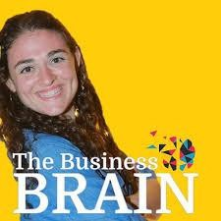
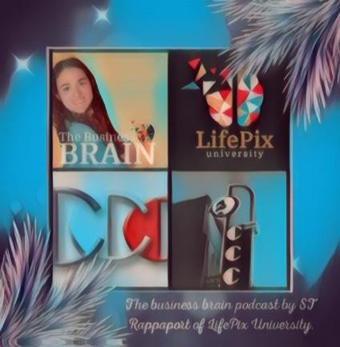
a brain engineer
and in 5th grade I still couldn't read properly.
After endless hours of tutors that left nothing but high bills, it was time to take another approach.
Let’s rewire the brain and solve the real problem.
Usually, when a person has a problem, they solve what they see at the surface. Let’s say, for example, you never make the deadlines you set for yourself and it’s getting really frustrating, so you decided from now on you’ll finish all your tasks 24 hours early. It might work for a week or two but pretty quickly you’ll be late again.

Slide 11

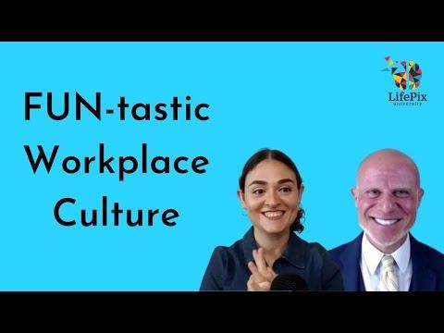
Why? This is because there is a reason WHY you are constantly being late. You’re not trying to but there’s another problem. Maybe it’s because you never know how to start or maybe it’s because once you get distracted it’s extremely difficult to refocus or maybe doing research just messes with your brain and you can’t seem to do it.
When you solve the real core problem (and there might be a few!) then everything else will fall into place. You’ll not only be making your deadlines at work, you’ll also be making deadlines with your personal goals. How awesome is that?

Slide 12

The way your brain is wired, and thinks is incredibly important.
You see, there are 28 cognitive functions, 28 parts to thinking. When one or more of these cognitive functions are weak it affects many areas of your life.
Do you ever get overwhelmed when you begin a new project? Not sure where to start? It may be because your cognitive function called “Focusing & Perceiving” is weak. It doesn’t mean you're bad. It doesn’t mean you’re incapable. It just means you’ve got a weak thinking skill and it can be fixed!
Or maybe you decide to plan your day every morning but for some reason it’s not working out and you’re feeling really frustrated because you're putting in so much work.
You’re trying really hard to implement a specific method to help more things done but your brain is just not able to do it.

Slide 13

What's really happening here is you’ve got a cognitive deficiency. It doesn’t mean you're doomed, we all have them, but if we don’t fix the core problem, you’ll continue with the same struggles, day in and day out.
The cool part is that as you improve your cognitive functions, all areas of your life begin to improve. I mean when do we not need to “Focus and Perceive” or use “2+ pieces of information”?
By rewiring my brain and improving my 28 thinking skills, not only did my reading improve, but
so did all other areas of my life. I did better in school, I made more friends and my favorite, my confidence went through the roof,

Slide 14

But it didn't stop there-
At 17 I started getting training in the Feuerstein method.

Slide 15

During that time, I took Tony Robbin's RPM program, which I found really interesting, but struggled to implement. Don't get me wrong, I tried. I really did. I just couldn't do it.
So, I dropped it.
A few months later I took another training in the Feuerstein method that focused on improving the cognitive function of categorizations.
Aha!
This is the reason I couldn't do Tony's program. My cognitive function of categorizations was weak and getting the way. Once I improved the cognitive function, magic happened! I was now able to implement the program with ease.
Have you ever taken a course or program & didn't get your desired result? It's possible you too got a weaker thinking skill getting in your way like I did.
But it doesn't have to stay like that.
As soon as you improve your cognitive functions, you'll see real magic your life too

Slide 16

Interpersonal Communication Conflict Management Strategy
Phonetic Micro Expression reading for mastering verbal tell signs.
The Famous Buffer-Boomerang Technique
Advanced telemarketing strategy, conflict management, interpersonal soft skills, customer support, rhetoric, gamification, pinball machines, employee motivation and phonetic micro expression reading.
Richard’s vision quest journey is filled with twists and turns. At 27 years old, he relocated to Costa Rica to train employees for one of the larger call centers in San Jose. With a mix of motivational public speaking style backed by tactful and appropriate rhetoric, Richard shared his knowledge and trained over 10 000 bilingual telemarketers over two decades.
Richard Blank has the largest collection of restored American Pinball machines and antique Rockola Jukeboxes in Central America making gamification a strong part of CCC culture.Richard Blank is the Chief Executive Officer for Costa Rica’s Call Center since 2008. Mr. Richard Blank holds a bachelors degree in Communication and Spanish from the University of Arizona and a certificate of language proficiency from the University of Sevilla, Spain.

Slide 17

A Keynote speaker for Philadelphia's Abington High School 68th National Honors Society induction ceremony. In addition, entered into the 2023 Hall of Fame for Business along side other famous alumni. Paying it forward to Abington Senior High School is very important to Mr. Blank. As such, he endows a scholarship each year for students that plan on majoring in a world language at the university level.
Costa Rica’s Call Center (CCC) is a state of the art BPO telemarketing outsource company located in the capital city of San Jose, Costa Rica. Our main focus has been, and will always be to personally train each and every Central America call center agent so that we may offer the highest quality of outbound and inbound telemarketing solutions and bilingual customer service to small and medium sized international companies, entrepreneurs as well as fortune 500 companies.
https://costaricascallcenter.com/en/outbound-bpo-campaigns/ #Thebusinessbrainpodcast #STRappaport #LifePixUniversity #RichardBlank #CostaRica #CallCenter #Outsourcing #Telemarketing #BPO #Sales #Entrepreneur #B2B #Business

Slide 18

#Podcast #Gamification #CEO #learnpodcasting #podcastepisode #podcastguest #podcasting #podcastinterview #podcastplaylist #podcasts #podcastskills #podcastshow
The business brain podcast , ST Rappaport, LifePix University, Richard Blank,Costa Rica's Call Center, Outsourcing, Telemarketing, BPO, Nearshore, Sales, Entrepreneur, B2B, Business,Podcast,Gamification,Leadership,Marketing, Radio, Guest, Money, education, trainer,
A Fun-tastic Workplace Culture with Richard Blank.The business brain podcast by ST Rappaport of LifePix University.

