Slide 1
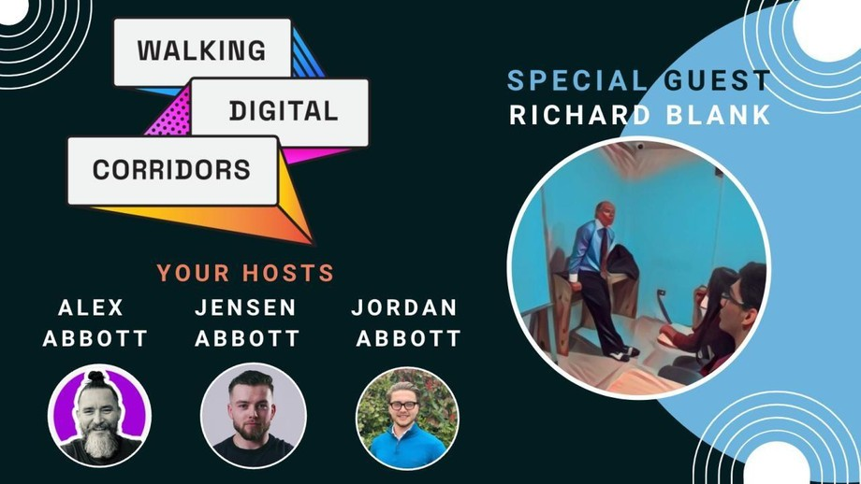
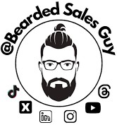
Downloaded from: justpaste.it/walkingdigitalcorridors
Walking Digital Corridors podcast guest Richard Blank. Can cold calling beat AI?
How can AI enhance the selling process without losing that personal connection? You’ll hear Richard make a compelling case for why cold calling is far from dead, while Alex challenges its relevance in today’s tech- driven landscape. Expect a lively debate .
Cold Calling vs. Social Selling: Navigating the AI-Powered Sales Frontier
As AI revolutionises the sales landscape, the debate is heating up. Is cold calling a relic of the past, or does it still have a place in a world dominated by social selling and automation?

Slide 2

Join us for a high-octane discussion on Cold Calling vs. Social Selling:
Navigating the AI-Powered Sales Frontier, featuring Alex, his sons Jordan and Jensen—both deep in the trenches of today’s sales world—and special guest Richard Blank, Cold Calling expert.

Slide 3
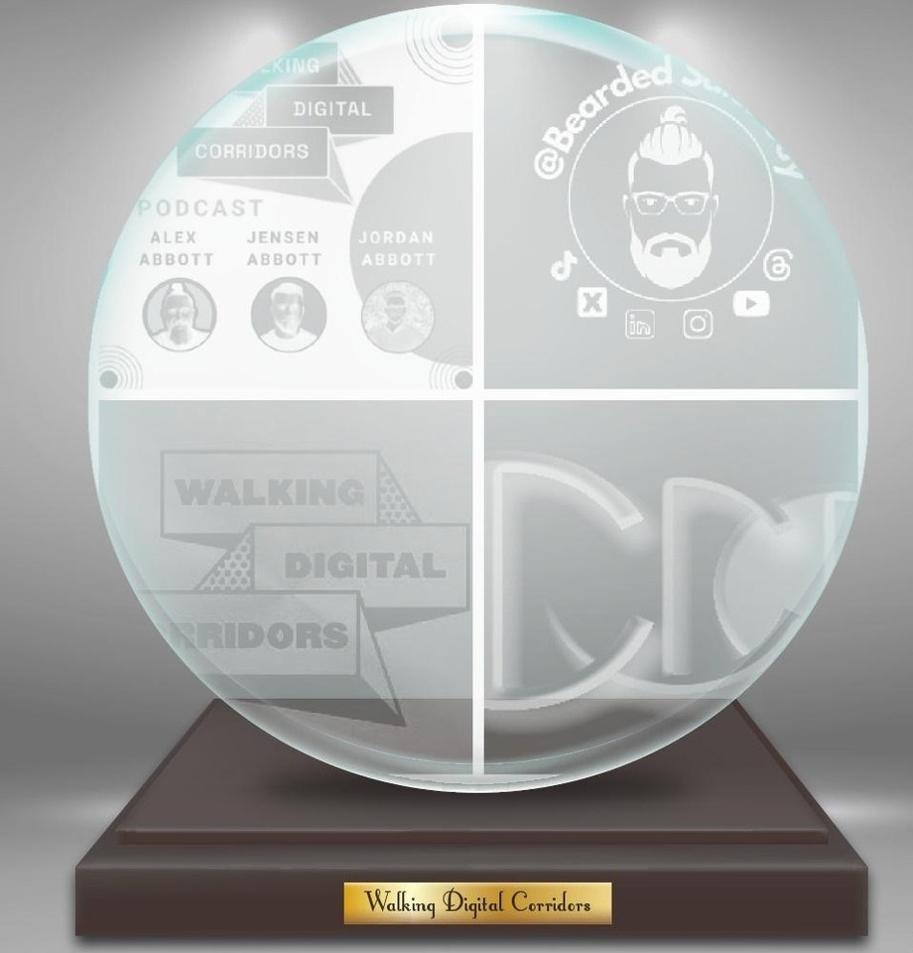
Here’s what we’re asking:
Can cold calling really hold its own in the age of AI?

Slide 4

Is the human touch still essential, or can automation replace it in B2B deals?

Slide 5


How can AI enhance the selling process without losing that personal connection?
You’ll hear Richard make a compelling case for why cold calling is far from dead, while Alex challenges its relevance in today’s tech-driven landscape.

Slide 6
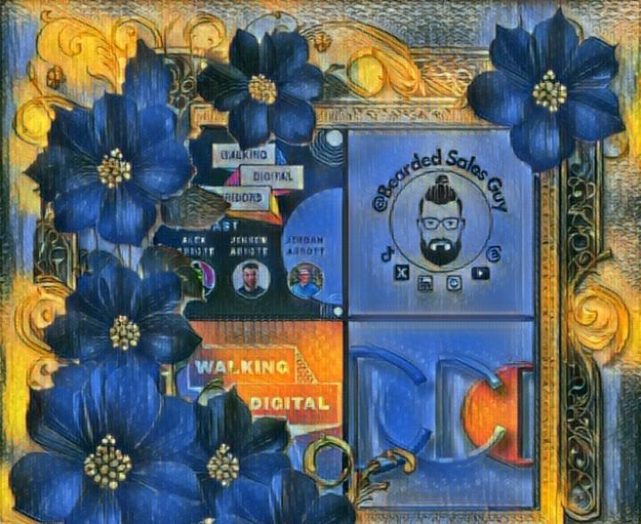

Expect a lively debate with actionable strategies for sales and customer success teams navigating this rapidly changing frontier.
Want to future-proof your sales tactics? Don’t miss out. Tune in to challenge your assumptions and walk away with practical insights to up your game.

Slide 7
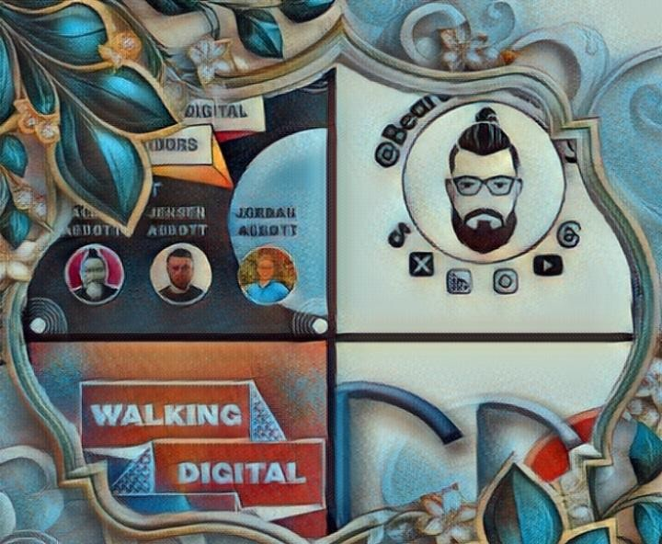
Creating conversations with your target audience is easier said than done, these days!

Slide 8

Alex and his Sons, Jordan and Jensen share their experience in sales, marketing and customers success.

Slide 9

We aim to share practical tips to help our listeners walk digital corridors effectively and create conversations with their target audience!

Slide 10

Our mission is to bring positive mental health back to sales by empowering our audience to create a predictable flow of commercial conversations with their target audience.

Slide 11

We just happen to be pretty good at it ourselves and want to share our approach with you!

Slide 12
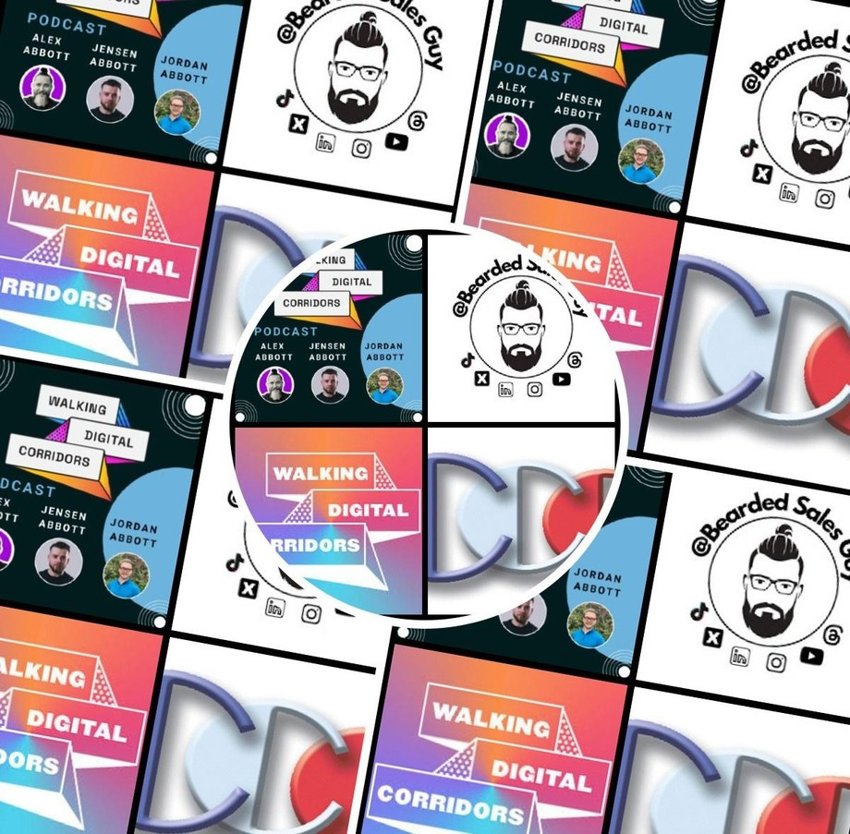
Almost four years ago my son, Jordan, Jensen and I were banging our heads against a brick wall trying to make our clients successful at developing pipeline, something every business we spoke to was struggling with in one form or another, whether it's size, quality or progression.

Slide 13
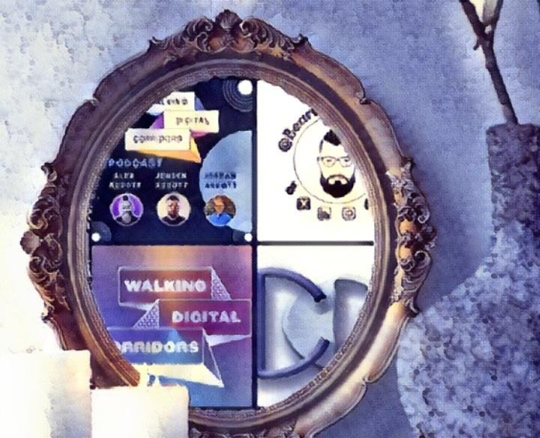
So we tested every approach known. And we're still testing!

Slide 14

In the last two years we have refined our approach and now share this with others who want to leverage social media to build meaningful relationships that scale over time.

Slide 15

The results:
Call rates have improved by 30x
Territory penetration has increased by 15x

Slide 16
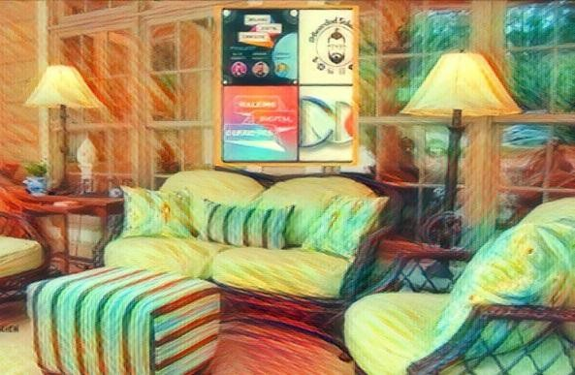
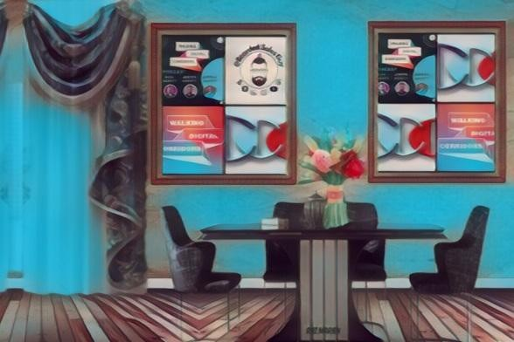
34% of calls progress with a meaningful next step agreed
Clients (on average) generate calls with 10.2% of their target audience
The number of stakeholders engaged in each active account increased by 6.4x
Each week, Alex, Jordan and Jensen share real life examples of what’s working and what’s not, we aim to give you practical tips you can try today after each episode - we hope you enjoy our podcast, we welcome questions and new topics to discuss so please engage with us on socials or drop us a note.

Slide 17
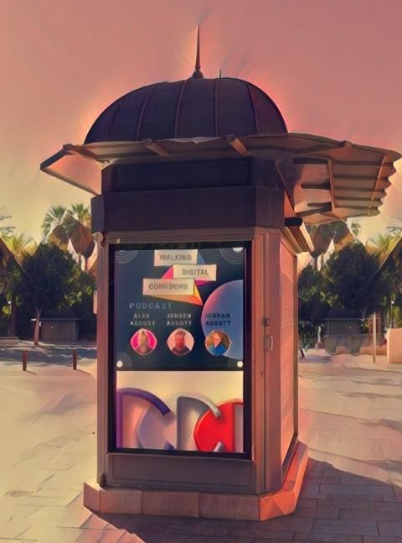
e Hosts
Jordan Abbott (a.k.a. The Sales Poet)
Jordan is a seasoned sales development rep, a regular podcaster, and on the Board of the Emerging Professionals Network, a membership body part of the Institute of Sales Professionals designed to encourage young people into the sales profession. In his spare time he's known as the Sales Poet and enjoys spending time with his partner and two pooches.

Slide 18

Alex Abbott (a.k.a. Bearded Sales Guy) Founder, CEO
My mission is to bring positive mental health back to sales by making sales fun again. Solving the one problem that feeds all others in sales, a lack of pipeline.

Slide 19
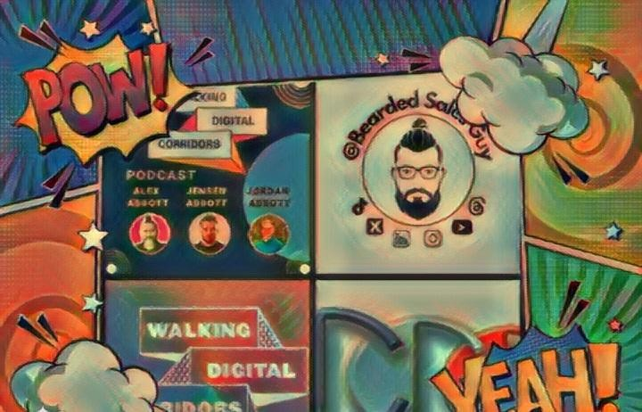
Through our podcast I aim to empower the community to create a predictable flow of commercial conversations with their target audience, to grow their business.
After almost 4 years of testing I've found a method that works and want to share it with you.

Slide 20

My Wife and I run another community called She Loves Social which is aimed at empowering women with new digital sales skills to help them re-enter the workplace walking digital corridors safely and effectively.
Jensen Abbott

Slide 21
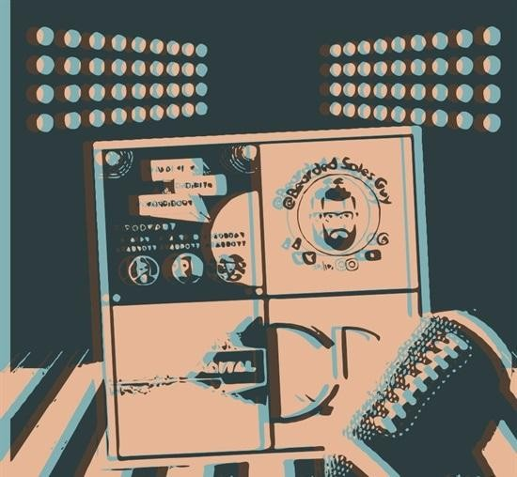
Business Development Manager & Co-host
Jensen started his career as an apprentice stone mason spending most of his days fitting precious stone into kitchens and by night hitting the gym preparing himself for competition. Today, he is part of the Walking Digital Corridors team putting his new found digital relationship building into practice. Being the youngest on the team it’s lovely to hear of his successes developing relationships with his target audience as a BDR.

Slide 22

Richard’s vision quest journey is filled with twists and turns. At 27 years old, he relocated to Costa Rica to train employees for one of the larger call centers in San Jose. With a mix of motivational public speaking style backed by tactful and appropriate rhetoric, Richard shared his knowledge and trained over 10 000 bilingual telemarketers over two decades.
Richard Blank has the largest collection of restored American Pinball machines and antique Rockola Jukeboxes in Central America making gamification a strong part of CCC culture.Richard Blank is the Chief Executive Officer for Costa Rica’s Call Center since 2008.

Slide 23

Mr. Richard Blank holds a bachelors degree in Communication and Spanish from the University of Arizona and a certificate of language proficiency from the University of Sevilla, Spain.

Slide 24

A Keynote speaker for Philadelphia's Abington High School 68th National Honors Society induction ceremony. In addition, entered into the 2023 Hall of Fame for Business along side other famous alumni. Paying it forward to Abington Senior High School is very important to Mr.

Slide 25


Blank. As such, he endows a scholarship each year for students that plan on majoring in a world language at the university level.
Costa Rica’s Call Center (CCC) is a state of the art BPO telemarketing outsource company located in the capital city of San Jose, Costa Rica. Our main focus has been, and will always be to personally train each and every Central America call center agent so that we may offer the highest quality of outbound and inbound telemarketing solutions and bilingual customer service to small and medium sized international companies, entrepreneurs as well as fortune 500 companies.
https://costaricascallcenter.com/en/outbound-bpo-campaigns/

Slide 26

Jensen Abbott, Alex Abbott , Jordan Abbott, Walking Digital Corridors podcast, Richard Blank, Costa Rica's Call Center, Outsourcing, Telemarketing Call Centre, BPO, Nearshore Contact Center, Sales, Entrepreneur, B2B, Business, Podcast, Gamification,Leadership, Marketing, CX, Guest, Money, B2C education, BPO trainer,
#JensenAbbott #Jensen Abbott #AlexAbbott #JordanAbbott #WalkingDigitalCorridorspodcast #CostaRica #CallCenter #Outsourcing #Telemarketing #BPO #Sales #Entrepreneur #B2B #Business #Podcast #Gamification #CEO #learnpodcasting #podcastepisode #podcastguest #podcasting #podcastinterview #podcastplaylist #podcasts #podcastskills #podcastshow

Slide 27


