Slide 1
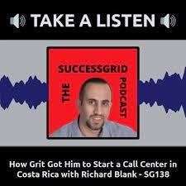

Downloaded from: justpaste.it/SuccessGridTVAJordanian
SuccessGrid TV. A Jordanian podcast with Hussein Taleb. How grit got Richard Blank to Costa Rica.
SuccessGrid Everything starts inside your own mind and how would you like to achieve more in your own life and Raise Your Standards.
Hey, Hussein Taleb here! I am the the Founder of SuccessGrid.com and I am so grateful you're here to be part of this awesome community.
I love connecting with people who have a passion for Entrepreneurship, Self Development & Achieving Success.

Slide 2
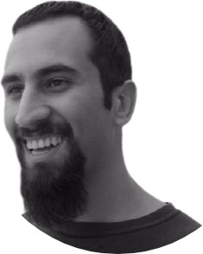
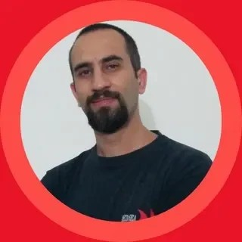
I started this website with the intention of educating and inspiring people to always strive to Raise the Standards to Achieve Greatness.
Hussein Taleb The SuccessGrid Podcast Growth, Business and Entrepreneurship Episode 138

Slide 3

I live in Jordan. And I’m passionate about Learning and knowing more about lots of things Such as personal Growth, Business and basically anything about the Internet

Slide 4
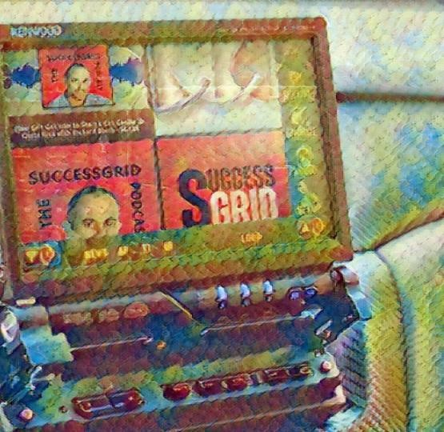
Launch Profitable Funnels & Become an expert with Free Video Certification Course and Accelerate Your Success
SuccessGrid

Slide 5
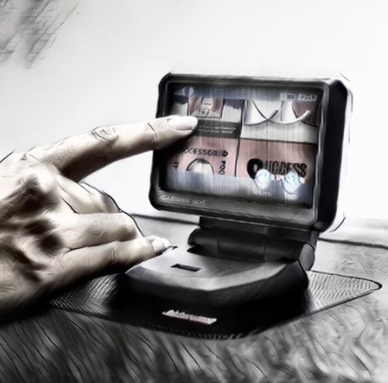
Everything starts inside your own mind and how would you like to achieve more in your own life and Raise Your Standards.

Slide 6
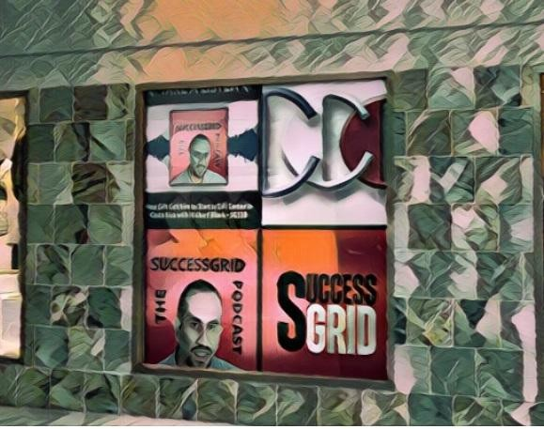
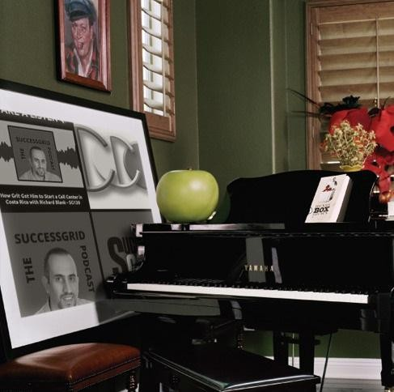
Funnels Secrets
How to Build Your Own Online Business From Scratch. SuccessGrid Academy

Slide 7
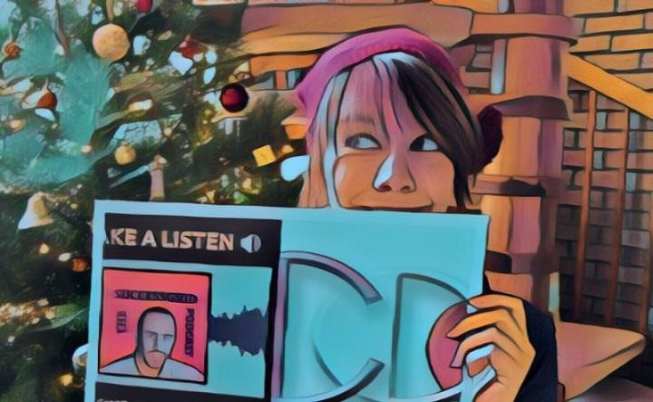
The Place Where You Learn in the Fields of Self-growth, Entrepreneurship, and Business. Metalaholic Shop
We want to provide amazing people who each have unique passions, for the music and the instruments. we strive to make clothing that is a representation of our customers and the things they love.

Slide 8
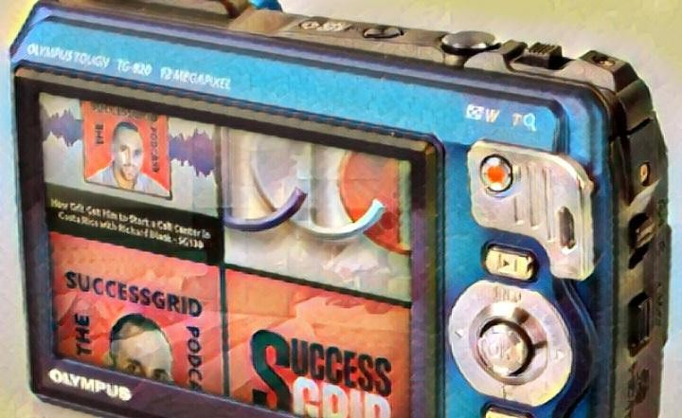
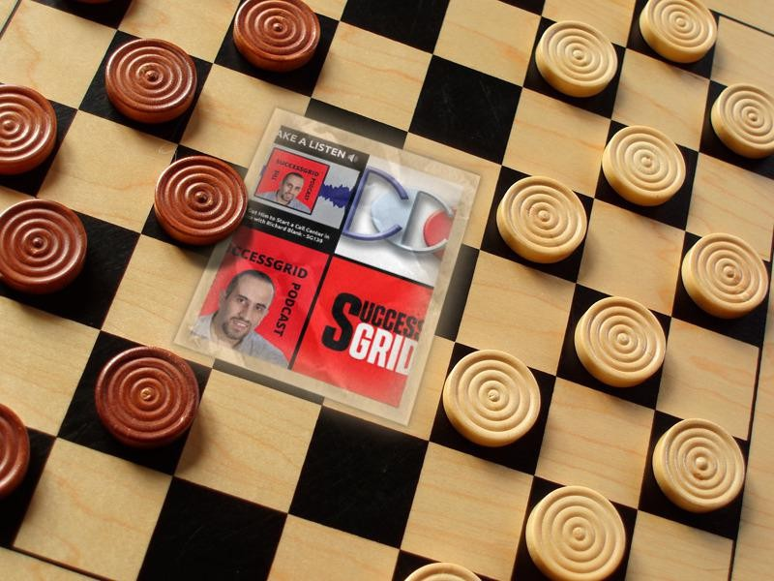
Richard’s vision quest journey is filled with twists and turns. At 27 years old, he relocated to Costa Rica to train employees for one of the larger call centers in San Jose.

Slide 9

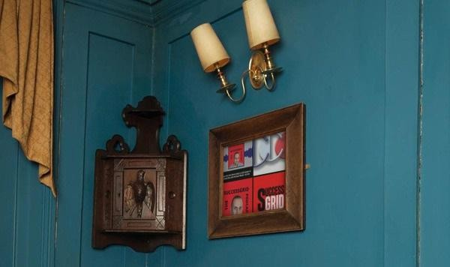
With a mix of motivational public speaking style backed by tactful and appropriate rhetoric, Richard shared his knowledge and trained over 10 000 bilingual telemarketers over two decades.
Richard Blank has the largest collection of restored American Pinball machines and antique Rockola Jukeboxes in Central America making gamification a strong part of CCC culture.
Richard Blank is the Chief Executive Officer for Costa Rica’s Call Center since 2008.

Slide 10
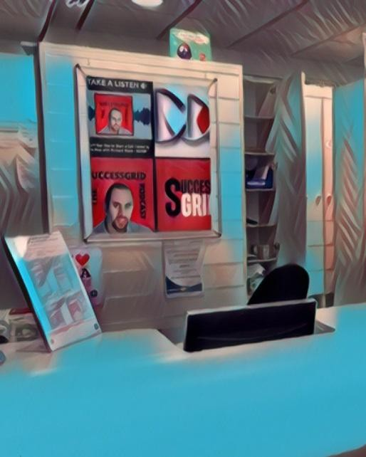
Mr. Richard Blank holds a bachelors degree in Communication and Spanish from the University of Arizona and a certificate of language proficiency from the University of Sevilla, Spain.

Slide 11

A Keynote speaker for Philadelphia's Abington High School 68th National Honors Society induction ceremony. In addition, entered into the 2023 Hall of Fame for Business along side other famous alumni.

Slide 12

Paying it forward to Abington Senior High School is very important to Mr. Blank.

Slide 13
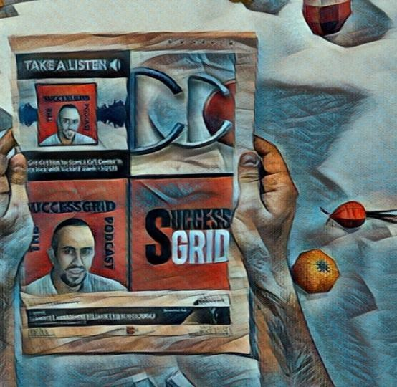
As such, he endows a scholarship each year for students that plan on majoring in a world language at the university level.

Slide 14
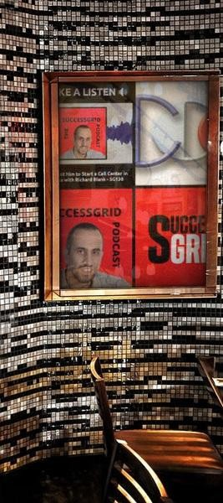
Costa Rica’s Call Center (CCC) is a state of the art BPO telemarketing outsource company located in the capital city of San Jose, Costa Rica.

Slide 15
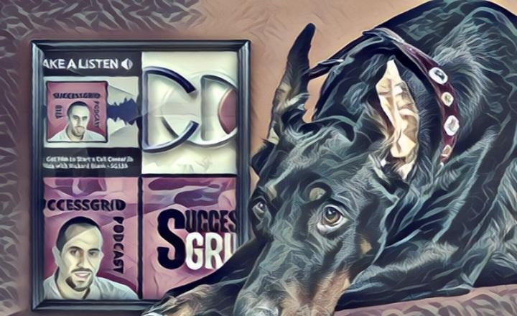
Our main focus has been, and will always be to personally train each and every Central America call center agent so that we may offer the highest quality of outbound and inbound telemarketing solutions and bilingual customer service to small and medium sized international companies, entrepreneurs as well as fortune 500 companies.

Slide 16

https://costaricascallcenter.com/en/outbound-bpo-campaigns/

Slide 17
Hussein Taleb, SuccessGrid TV,Richard Blank, Costa Rica's Call Center, Outsourcing, Telemarketing Call Centre,

Slide 18

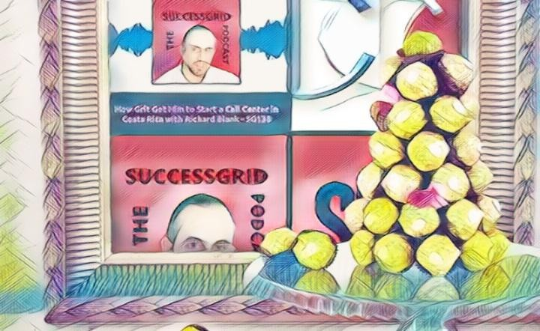
BPO, Nearshore Contact Center, Sales, Entrepreneur, B2B, Business, Podcast, Gamification,Leadership, Marketing,
CX, Guest, Money, B2C education, BPO trainer,

Slide 19
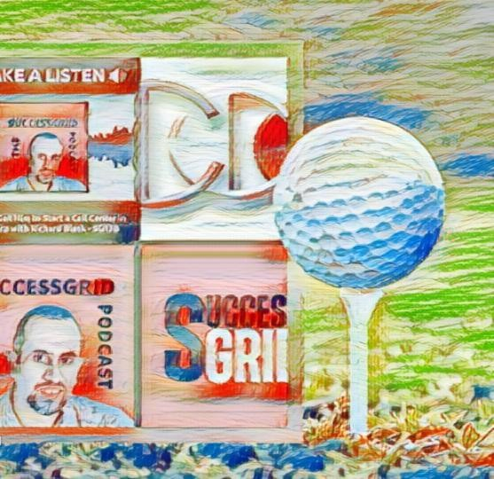
#HusseinTaleb #SuccessGridTV #RichardBlank #CostaRica #CallCenter #Outsourcing #Telemarketing #BPO

Slide 20
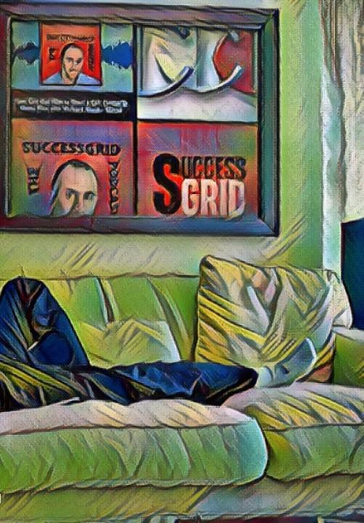
#Sales #Entrepreneur #B2B #Business #Podcast #Gamification #CEO #learnpodcasting #podcastepisode

Slide 21

#podcastguest #podcasting #podcastinterview #podcastplaylist #podcasts #podcastskills #podcastshow

Slide 22


Slide 23


Slide 24



Slide 25


Slide 26
