Slide 1

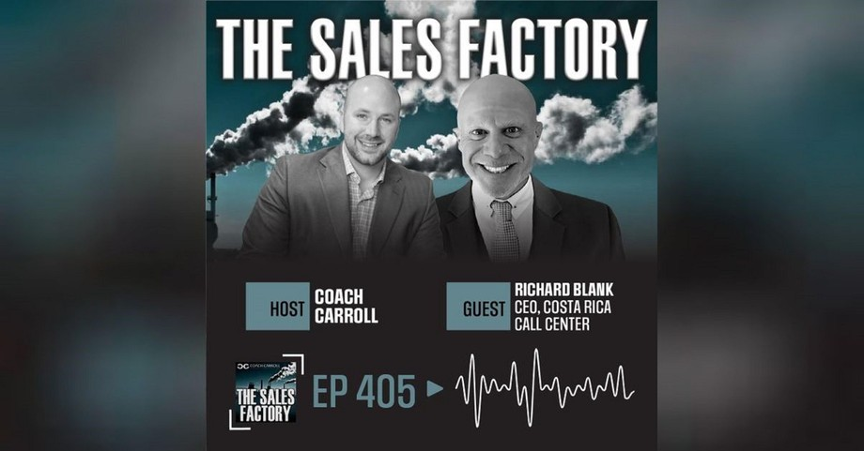
Downloaded from: justpaste.it/thesalesfactroypodcast
The Sales Factory Podcast. Episode #405: Sell More by Mastering the Art of Speech | Richard Blank
Richard Blank is the founder and operator of Costa Rica's Call Center - a state of the art Business Process Outsourcing (BPO) telemarketing company located in San Jose, Costa Rica. You better grab your notepad and pencil for this one because Richard dropped some absolute fire!
DJ Carroll is known as Coach Carroll to the hundreds of thousands of people who’ve been a part of, his elite coaching services, utilized his free information to help their business, or had the opportunity to attend one of his engaging and dynamic shows.

Slide 2
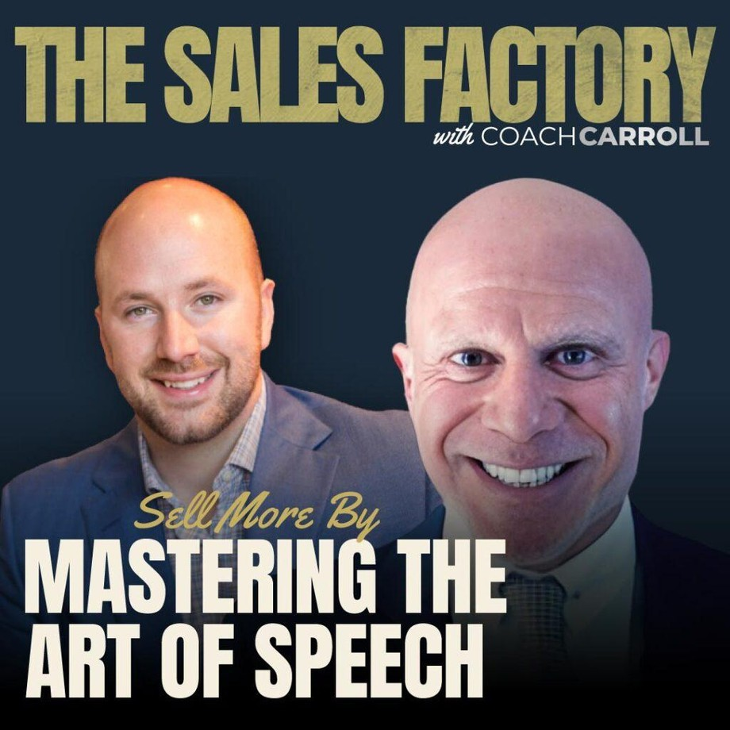
In his own life, he has embraced the role of entrepreneur, starting and growing strong businesses and then selling them—just to start on another exciting venture.

Slide 3
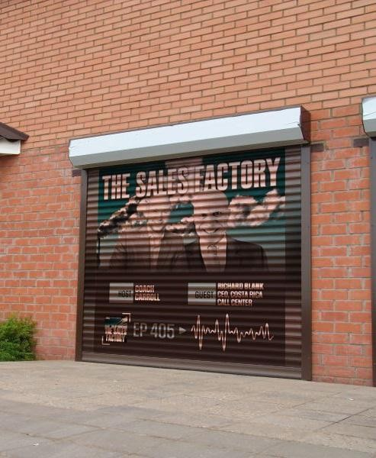
He finds the energy, skills, and passion for growing businesses to be something that he is constantly eager to experience.

Slide 4
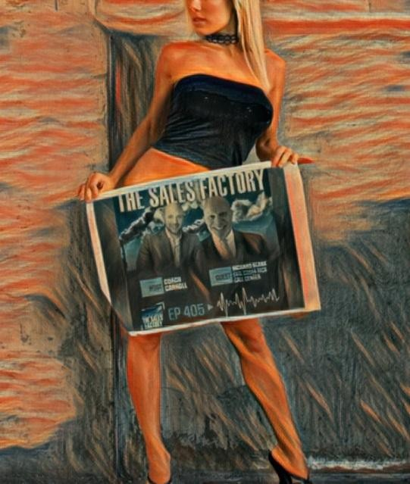
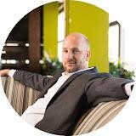
There is always an opportunity nearby, for anyone willing to put in the focused work and effort
—and that has always been a quality DJ has possessed. Because of this, he has a perspective that makes him a sought out expert who offers “real-world” information with an edgy twist.
Richard Blank is the founder and operator of Costa Rica's Call Center - a state of the art Business Process Outsourcing (BPO) telemarketing company located in San Jose, Costa Rica.

Slide 5
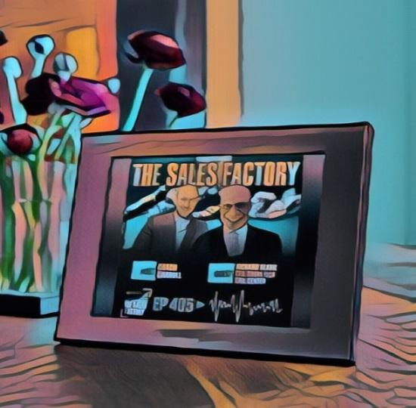
You better grab your notepad and pencil for this one because Richard dropped some absolute fire! We cover topics like, the art of speech, phonetics, micro-expression reading, conflict management and more!

Slide 6

DJ Carroll
CEO at Carroll Media Corp
Building Data-Driven Sales and Marketing Technology AKA #CoachCarroll

Slide 7
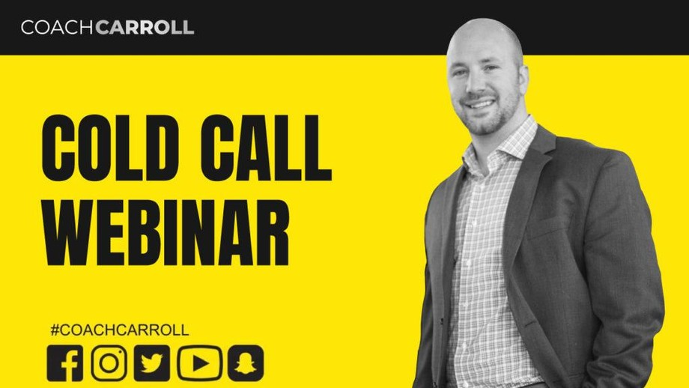
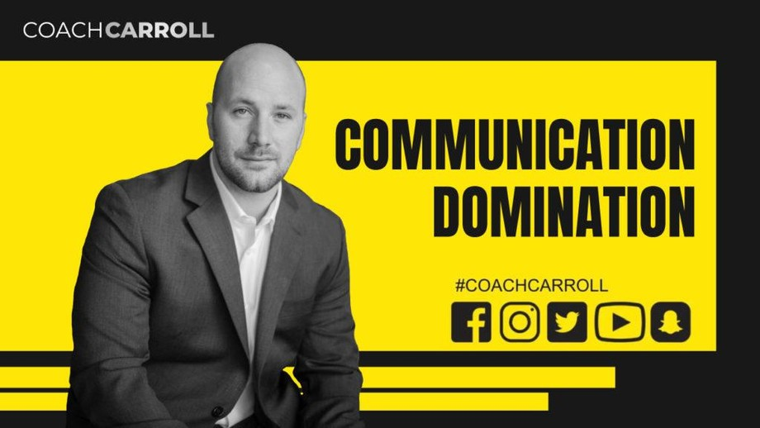
weaponizing the next generation of business leaders!
It’s easy to waste years of your life searching for the secrets of entrepreneurship without much to show for it. Join DJ Carroll, also known as Coach Carroll, as he pulls back the curtain on topics like high-level sales, marketing, brand awareness, social media strategies and a lot more!

Slide 8
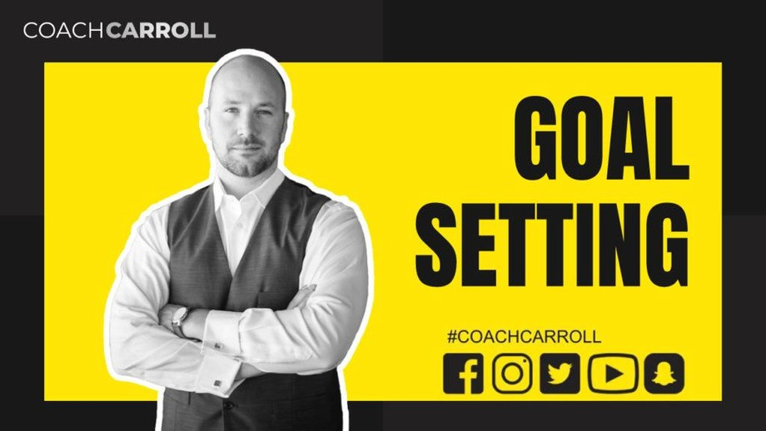
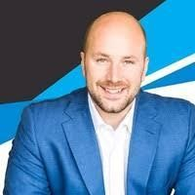
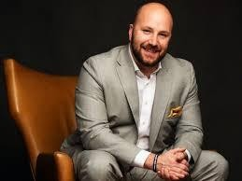
Each episode contains powerful information to help you grow business, drive bigger dollar sales, and build a respected brand.
DOING BIG DEALS. GROWING BIG PEOPLE.
Millions in sales with big companies, hundreds of thousands of people trained. For over a decade Coach Carroll has been crafting strategies, tactics and tools that have helped business leaders big and small!

Slide 9
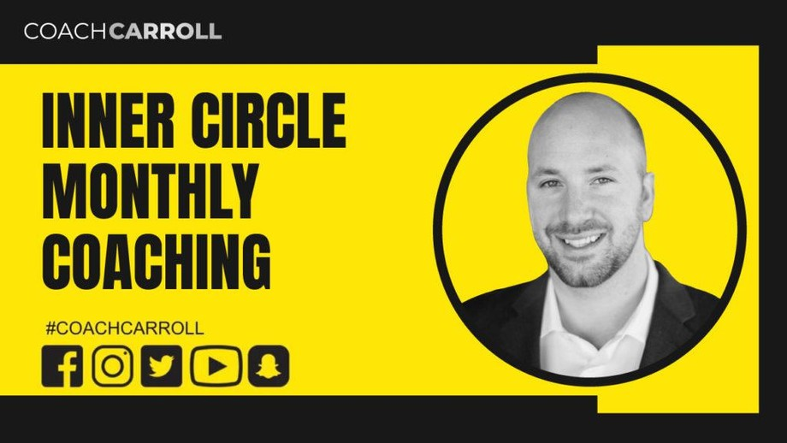
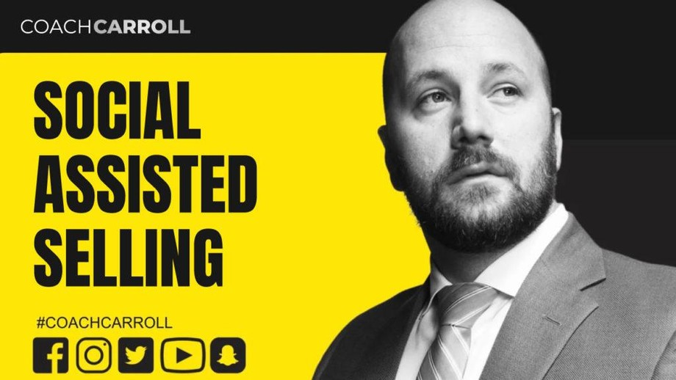
Personally performing over 2,000 coaching sessions, helping close deals with some of the biggest companies in the world and studying under the greatest teaches of all time like; Jim Rohn, Les Brown, Tony Robbins, Eric Thomas, & Brendon Burchard and more!
Coach Carroll is committed to weaponizing the next generation of business leaders & their teams! Early in his career, he realized that everyone does not have the same access to information or tools.
It has since become his mission to level the playing field. Creating trainings programs, developing courses and writing books that he wishes would have been available to him.

Slide 10
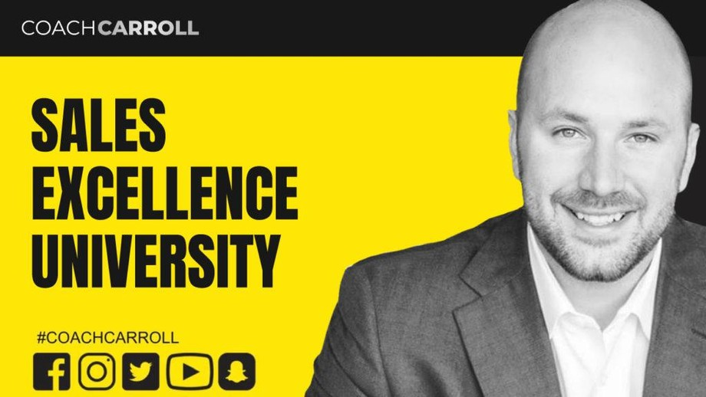
The 4 Pillars of SUCCESS #DreamMore
One of the biggest mistakes most high performers make is never thinking big enough! I encourage you to first dream more!
#BeMore
Big dreams demand a big commitment to personal development. To achieve more - you must become more than your currently are.
#DoMore
The power of positive thought comes to life, through positive actions. It's time to charge up and become more efficient so you can do more than ever before!
#GiveMore
One of the most rewarding activities is helping your fellow man by giving back and helping causes that are close to your heart!
LIVE EVENTS THAT DRIVE RESULTS

Slide 11
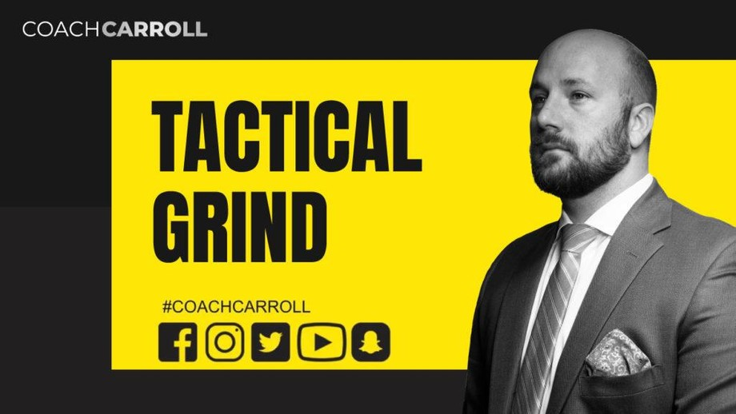
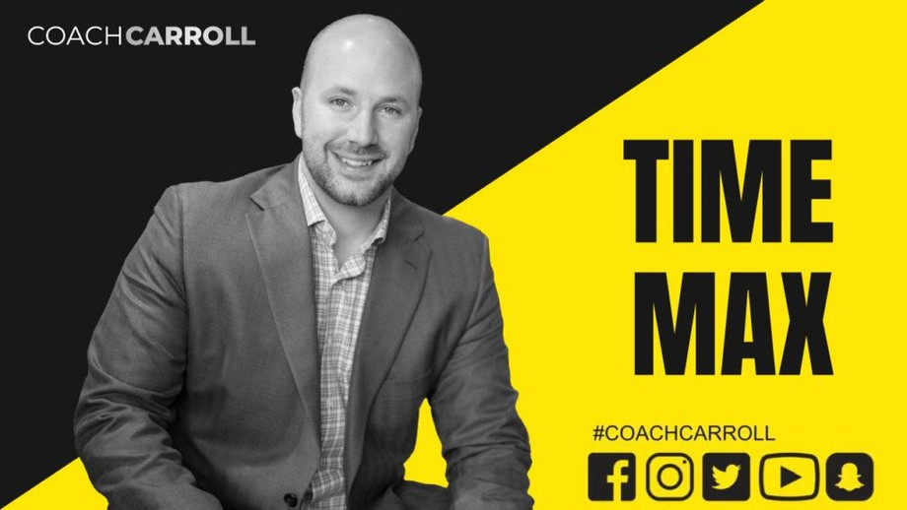
Coach Carroll is a sales psychology and advertising strategy expert focused on helping others achieve their business goals. An author and speaker, Coach travels the country motivating, inspiring, and training the next generation of business leaders and their teams.
One of the most sought-after generational keynote speakers. He combines his unexpected research discoveries, front line experiences, and trademark high energy with how-to actions that drive results. His presentations will inspire your organization to take action, so they can unlock their true potential. Coach Carroll’s unique, high-energy presentation style is ideal for in-person and virtual events.

Slide 12
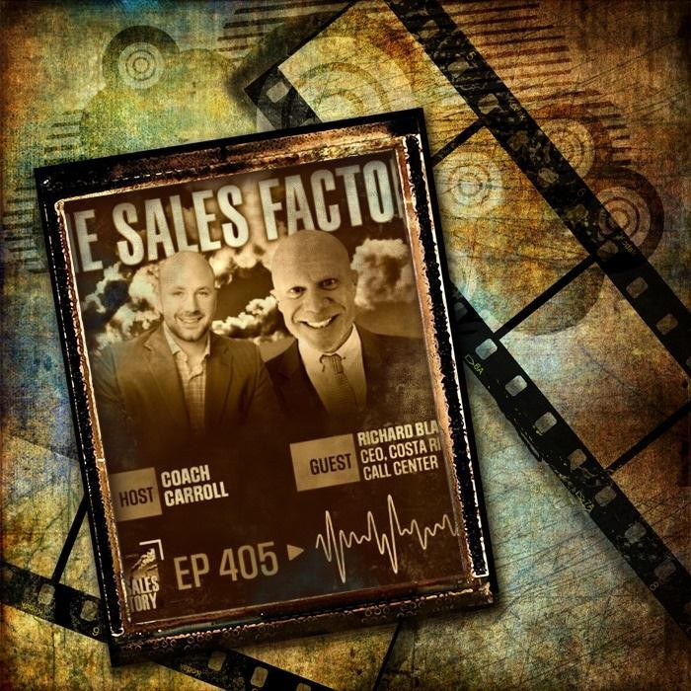
ARE YOU READY TO START?
Coach Carroll is hardcore committed to rocketing your company into outpacing, outselling, and outperforming your competition. His coaching techniques and seminars uncover the secrets your team MUST learn and develop to obtain an imperative competitive edge. Coach Carroll’s O3 Method, trains you and your team implementable, measurable skills and tactics that secure the physiological advantages which win out every time.
These are proven, successful, holistic approaches to your business & sales challenges plus, closable solutions that drive up revenues, maximize your income and build momentum, so there’s no stopping your company!
Coach Carroll can create change at a blistering speed.

Slide 13
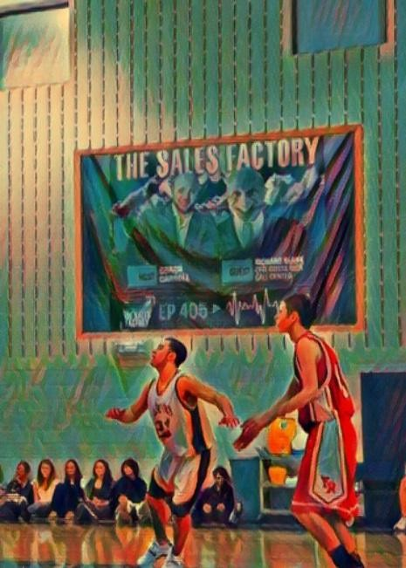
A renowned international presenter, that has delivered his high energy message to thousands of professionals across the globe – it’s safe to say – Your search stops here!

Slide 14

Advanced telemarketing strategy, conflict management, interpersonal soft skills, customer support, rhetoric, gamification, pinball machines, employee motivation, tell signs through phonetic micro expression reading, the pros and cons of A.I and finally, The Famous Buffer- Boomerang Technique

Slide 15
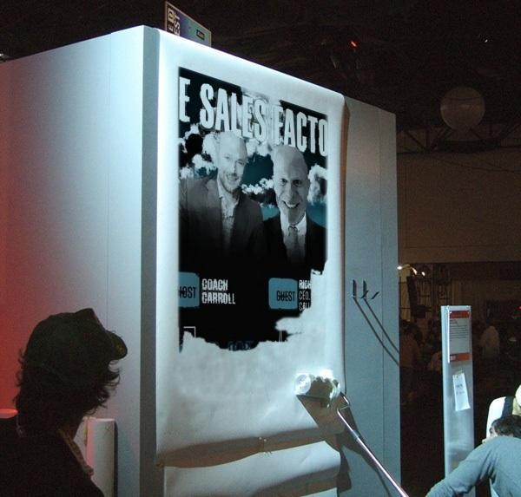
Richard’s vision quest journey is filled with twists and turns. At 27 years old, he relocated to Costa Rica to train employees for one of the larger call centers in San Jose. With a mix of motivational public speaking style backed by tactful and appropriate rhetoric, Richard shared his knowledge and trained over 10 000 bilingual telemarketers over two decades.

Slide 16

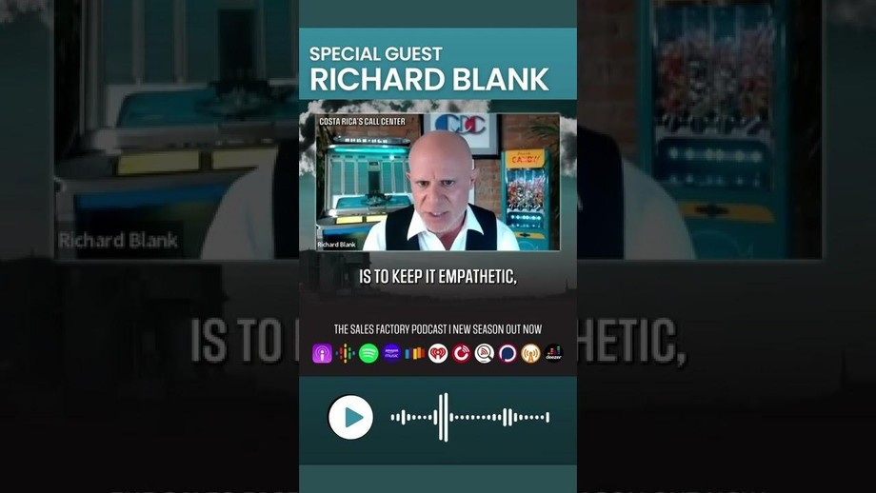
Richard Blank has the largest collection of restored American Pinball machines and antique Rockola Jukeboxes in Central America making gamification a strong part of CCC culture.Richard Blank is the Chief Executive Officer for Costa Rica’s Call Center since 2008.
Mr. Richard Blank holds a bachelors degree in Communication and Spanish from the University of Arizona and a certificate of language proficiency from the University of Sevilla, Spain.

Slide 17
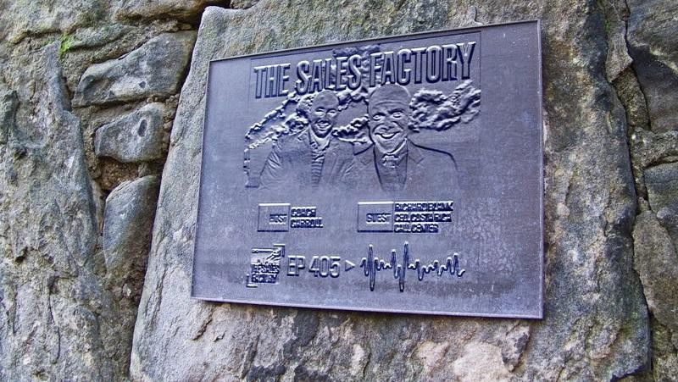
A Keynote speaker for Philadelphia's Abington High School 68th National Honors Society induction ceremony. In addition, entered into the 2023 Hall of Fame for Business along side other famous alumni. Paying it forward to Abington Senior High School is very important to Mr. Blank. As such, he endows a scholarship each year for students that plan on majoring in a world language at the university level.

Slide 18

Costa Rica’s Call Center (CCC) is a state of the art BPO telemarketing outsource company located in the capital city of San Jose, Costa Rica. Our main focus has been, and will always be to personally train each and every Central America call center agent so that we may offer the highest quality of outbound and inbound telemarketing solutions and bilingual customer service to small and medium sized international companies, entrepreneurs as well as fortune 500 companies.

Slide 19

https://costaricascallcenter.com/en/outbound-bpo-campaigns/
The Sales Factory Podcast, Coach Carroll, Richard Blank, Costa Rica's Call Center, Outsourcing, Telemarketing Call Centre, BPO, Nearshore Contact Center, Sales, Entrepreneur, B2B, Business, Podcast, Gamification,Leadership, Marketing, CX, Guest, Money, B2C education, BPO trainer,

Slide 20
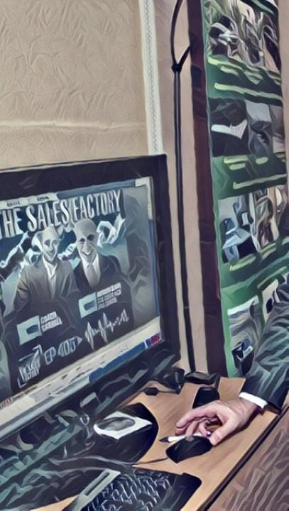
#TheSalesFactoryPodcast #CoachCarroll #RichardBlank #CostaRica #CallCenter #Outsourcing #Telemarketing #BPO #Sales #Entrepreneur #B2B #Business #Podcast #Gamification #CEO #learnpodcasting #podcastepisode #podcastguest #podcasting #podcastinterview #podcastplaylist #podcasts #podcastskills #podcastshow

Slide 21
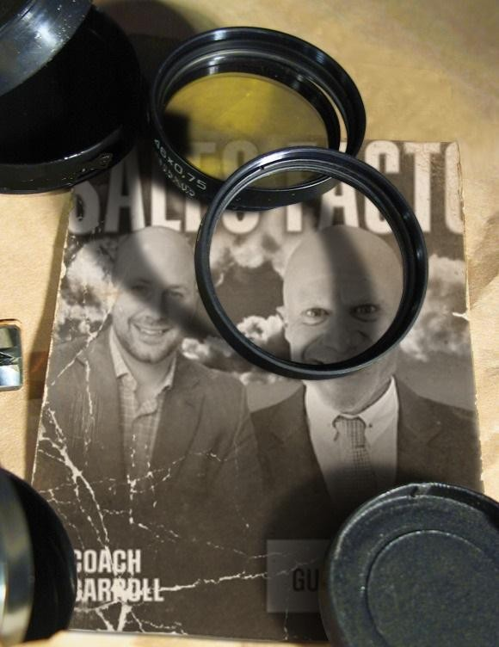
The Sales Factory Podcast with DJ Coach Carroll. The Art of Speech by Richard Blank. Episode #405

Slide 22


Slide 23


Slide 24


Slide 25



Slide 26

https://youtu.be/CBwttpu-m8E?si=M8TtSj82PO8kDh8N

Slide 27


