Slide 1


Downloaded from: justpaste.it/8yvty
What makes you HAPPY? podcast guest Richard Blank Costa Rica's Call Center
Jake Pearson: Welcome back to the podcast where we ask the question, What makes you happy? My name is Jake Pearson, and today we have with us the CEO of Costa Rica's call Center. Richard Blank, from Costa Rica, formerly living in Philadelphia. Richard,
Richard Blank: how are you? I'm doing great, Jake. So happy to be here tonight, and I got a ton of things to share that make me very happy.
Richard Blank: Beautiful.

Slide 2
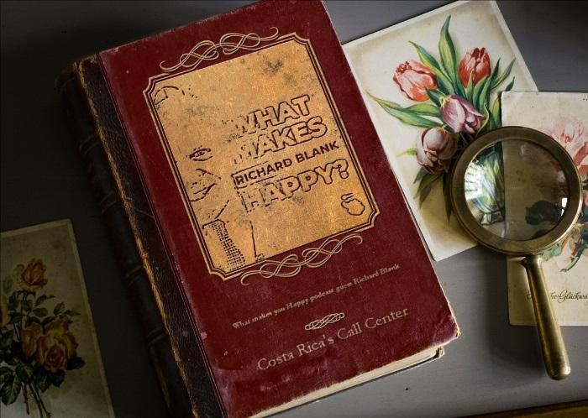
Jake Pearson: Well, let's get straight into it, Richard. What does make you happy?
Richard Blank: A first is better weather. When I moved away from Philadelphia, I didn't have to worry about snow anymore. And secondly, I believe that living a true life will make you happy. Money and jewels and gold, they lose their luster. And if you have.

Slide 3

Richard Blank: If you have balance and center and you can live a very fulfilled life, and I chose to be a linguist at the University of Arizona. I was a Spanish communication major and I tripled down on my own skills and moved to Costa Rica, 27 years old to work at a friend's call center. Eventually, I built my own.
Richard Blank: Fell in love and married a Costa Rican, and here we are today. And putting business aside, Jake, it's really about once again following through on what makes you the most happy. You can earn a living so many different ways, and I decided to not live somebody else's life. But do my own. And naturally being a giver and not a receiver, I was able to teach English as a second language stability, balance, delivery, strategy, and diplomacy.

Slide 4
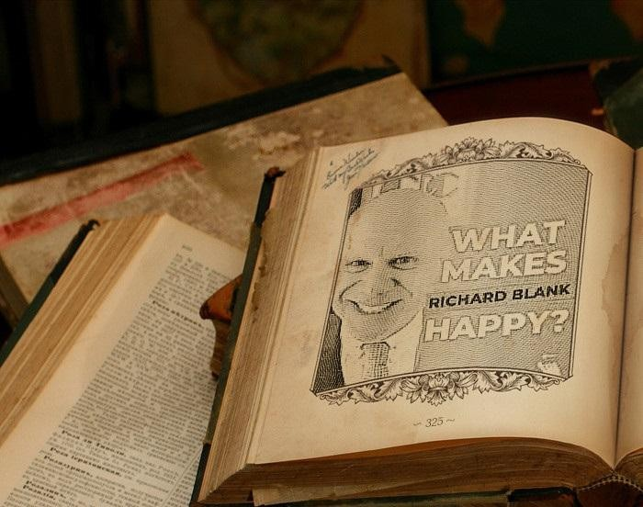
Richard Blank: And since English is their second language, I increased their vocabulary with a the source. And I believe in beautiful speech because today a lot of people are just chatting and using emails. For me, I believe that the best relationships are built when people can communicate, so there's no miscommunications people can properly express.

Slide 5
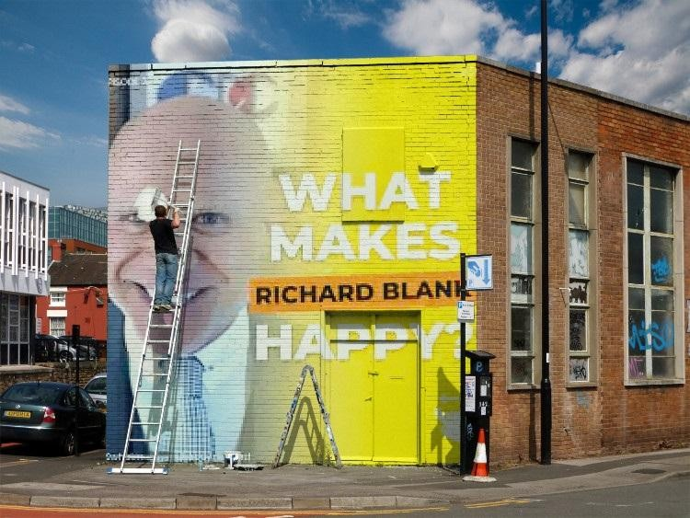
Richard Blank: Given luxury of time, they can take a step back, readjust themselves, be able to retain relationships, and maybe represent yourself in the best light. And so the older that I get, I cut fat, focus on the meat and realize my priorities in life. And a lot of them, I good friend, is spending time with family and those that you care.
Richard Blank: Really about your health because if you don't feel good every day, you can't be happy. But I indulge. There are certain times that I really enjoy that I like to reward myself. I'm an avid collector of pinball machines and juke boxes. I love to drive in my convertible. That makes me exceptionally happy working out in the gym so I can get those sort of endorphins and feel good and you know, if I'm able to enjoy some amazing seafood and exotic fruit and some delicious drinks.

Slide 6

Richard Blank: These are the sort of physiological things that make me exceptionally happy. The last thing that really makes me happy is a ton of money because if you don't have money and you're not happy, And that's not a real life. There's so many different things you can do in this world that can make you happy, and one of 'em right now is spending time with you and your amazing audience and sharing these ideas that if you can get past your parents guilt, if you can work through the naysayers and the grave believers and those that say you can't, if you can still be responsible financially and with your family, then by all means, I think you should take.

Slide 7
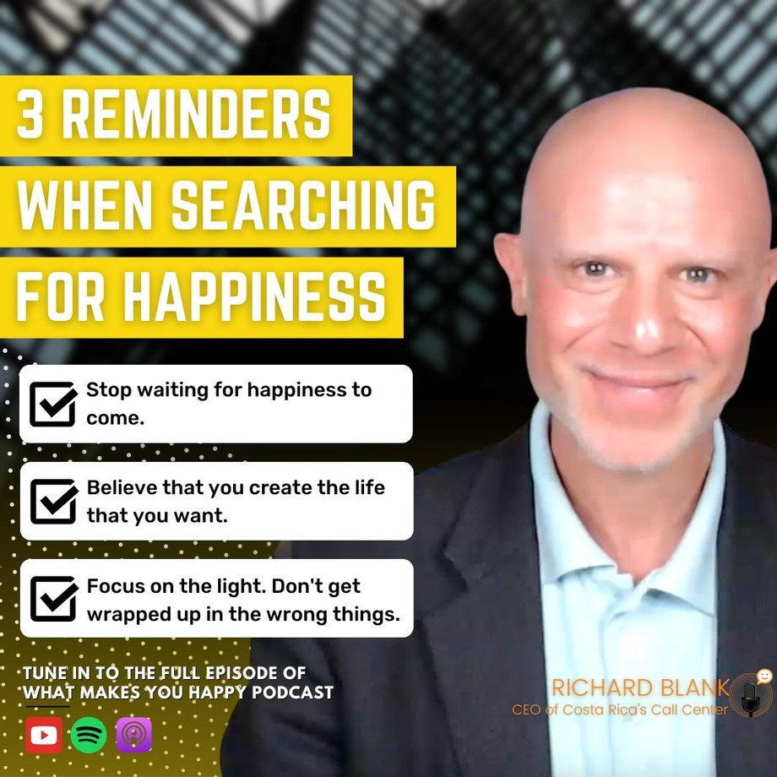
Richard Blank: And I should think you should drink life and see where it could take you. And so for me, I'm really just trying to share with you that I've been very true and I can stand tall and look at myself in the mirror. And I believe that those are the sort of things, my friend, that make an exceptionally happy life.
Jake Pearson: Beautifully said, and, and I do appreciate you sharing what makes you happy in your life. What would you. Say, Well, actually it's very interesting because what you said right there in that last few sentences probably ties into what you would say to our listeners and our audience with what they could do for their own happiness.

Slide 8
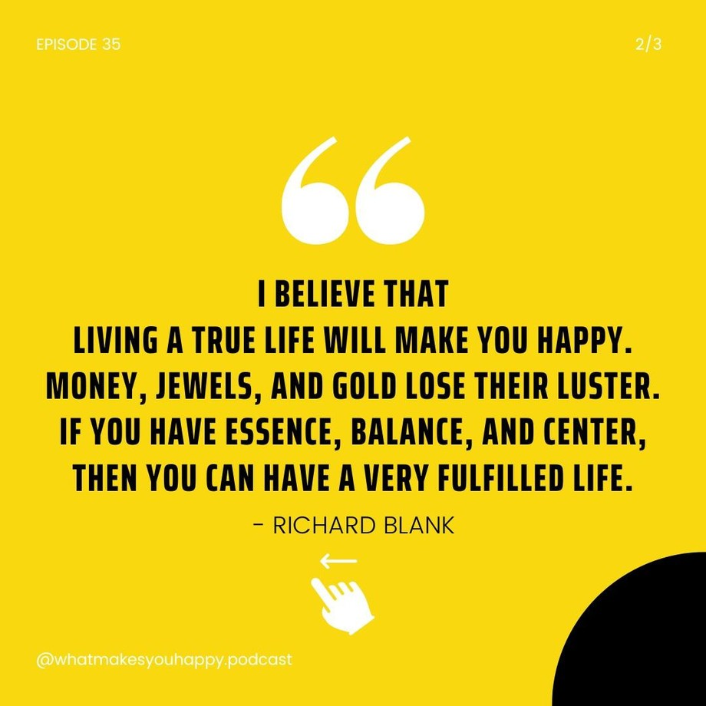
Jake Pearson: Right? What would you say?
Richard Blank: Oh, it's very easy. Fortune favors the brave. We've all read the stories. You need to leave a castle to slay a dragon, and if you get that dragon, then you can save a princess, and eventually you become. It's, it's this sort of circle that you have to have there. If you're sitting back and waiting for these things to arrive at your doorstep, it may.

Slide 9
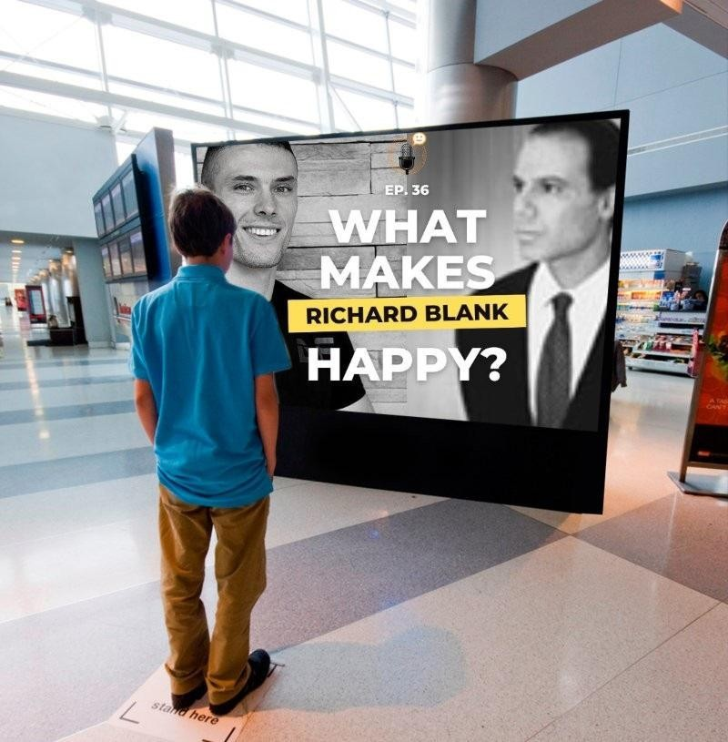
Richard Blank: But most of the time, no. You need to have some sort of incentive. You don't need to step on people's backs to get somewhere, but you need to have some sort of initiative. You can be bold and have some grit, especially in Australia. I love hearing those stories. You guys are very strong out there. You're very strong witted and, and, and you're survivalists, and I believe that you make the life that you want.
[00:04:44] Richard Blank: If it's brick by brick, then it may take a while and things happen a little bit faster than so be it. But in your mind, you must prepare yourself for forced marches, whereas a dreamer, Jake, you might have to walk alone. You might have to be the only one that believes in your dream. And maybe it's almost like the philosophy of the candle in the darkness.

Slide 10

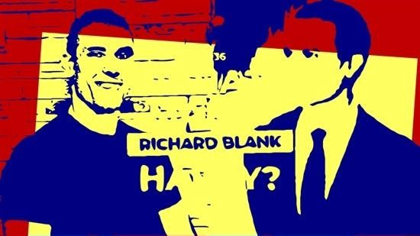
Richard Blank: Focus on the light, just don't focus on the sweet stuff that's around you. Cause if you keep thinking about that, you get wrapped up in some sort of spider's web and then you won't be able to get out and uh, then it becomes too late. So I think the best thing that somebody should do is have patience.
Richard Blank: Take deep breaths and meditate and ponder, and then you might be able to put your best
Jake Pearson: mind. Beautifully said. I really, really enjoyed that insight there. Richard. Thank
you so much for coming on the podcast to share all things that make you happy. We really appreciate it here, not just for me, but to speak on audiences.
Jake Pearson: Behalf as well, and if you'd love to connect with Richard, you can do so just by going to the podcast episode description below, as usual, and clicking the few links there.
Richard, it's been an absolute pleasure to have you on the podcast. Thank you so much. Thanks for listening to the podcast. We hope it gives you something to think about on your quest to discover what makes you happy.

Slide 11
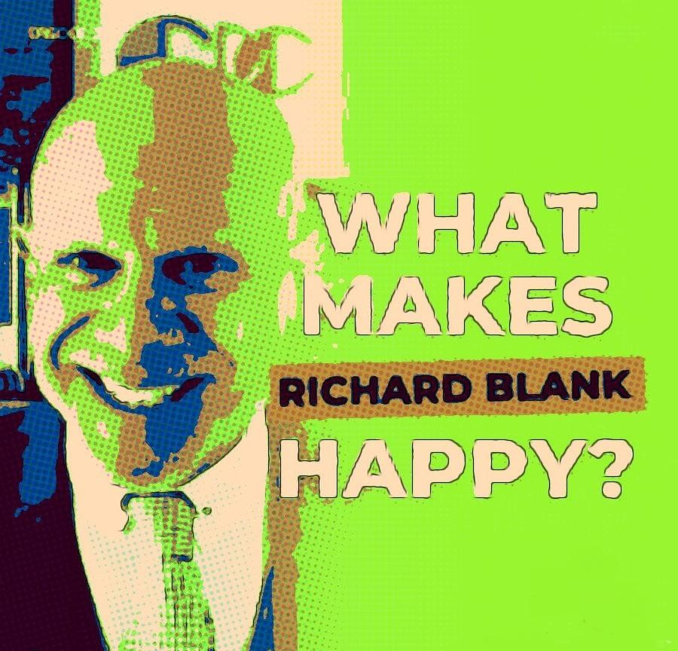
Jake Pearson: Makes sure to check out what makes you happy. podcast.com to connect with today's guest and follow us on all our social media platforms and to stay up to date at what's happening next at. You happy. Don't forget to share this episode with a friend, and we'll see you next time.

Slide 12


What Makes You Happy Podcast has accepted Richard Blank's invitation to join the audience for a solid discussion regarding moving abroad and starting a company from scratch in Costa Rica. Jake Pearson discusses with Richard advanced telemarketing strategy, conflict management, interpersonal soft skills, customer support, rhetoric, gamification, employee motivation and phonetic micro expression reading.

Slide 13

What Makes You Happy? Do you know the answer to that question?
With 1440 minutes in the day, it's easy to spend time thinking about everything but your happiness. So why not take 5 minutes to remind yourself of all the happiness you have, when you hear me, Jake Pearson, ask the question to people all over the world? What Makes You Happy? A collection of short stories & interviews to help you cultivate happiness. Hosted by Jake Pearson. Access the collection to be happier!
Richard’s journey in the call center space is filled with twists and turns. When he was 27 years old, he relocated to Costa Rica to train employees for one of the larger call centers in San Jose. With a mix of motivational public speaking style backed by tactful and appropriate rhetoric, Richard shared his knowledge and trained over 10 000 bilingual telemarketers.
Richard Blank has the largest collection of restored American Pinball machines and antique Rockola Jukeboxes in Central America making gamification a strong part of CCC culture.Richard Blank is the Chief Executive Officer for Costa Rica’s Call Center since 2008. Mr. Richard Blank holds a bachelors degree in Communication and Spanish from the University of Arizona and a certificate of language proficiency from the University of Sevilla, Spain. A Keynote speaker for Philadelphia's Abington High School 68th National Honors Society induction ceremony. Giving back to Abington Senior High School is very important to Mr. Blank. As such, he endows a scholarship each year for students that plan on majoring in a world language at the university level.

Slide 14

Costa Rica’s Call Center (CCC) is a state of the art BPO telemarketing outsource company located in the capital city of San Jose, Costa Rica. Our main focus has been, and will always be to personally train each and every Central America call center agent so that we may offer the highest quality of outbound and inbound telemarketing solutions and bilingual customer service to small and medium sized international companies, entrepreneurs as well as fortune 500 companies.
We encourage you to visit one of our call centers on your next personal vacation or business trip to Central America’s paradise, Costa Rica. While you are here, we would recommend taking an extra day of your trip to visit breathtaking virgin beaches, play golf next to the ocean, try your luck at deep sea fishing, explore tropical jungles, climb volcanos or just relax in natural hot springs. Come and see for yourself why call center outsourcing in Costa Rica is a perfect solution for your growing company and a powerhouse in the BPO industry. https://youtu.be/WWadeNV-3mg
https://costaricascallcenter.com/en/outbound-bpo-campaigns/
https://youtu.be/81dOqX0Ws3k https://youtu.be/DR2CT75cWLI https://youtu.be/S-4RosnWngc

Slide 15
https://music.amazon.co.jp/podcasts/78a07447-0e30-49e6-b06e- 084ae6ccba92/episodes/e126cc3d-b5dd-4573-a7b7-87efb1c7076d/what-makes-you-happy- what-makes-this-ceo-happy
https://podcasts.apple.com/ph/podcast/what-makes-this-ceo-happy/id1624886080? i=1000583629716
https://open.spotify.com/episode/0WonEblGllUzcvn08CxA4S?si=4f52c631a89346c0

